Slide 1
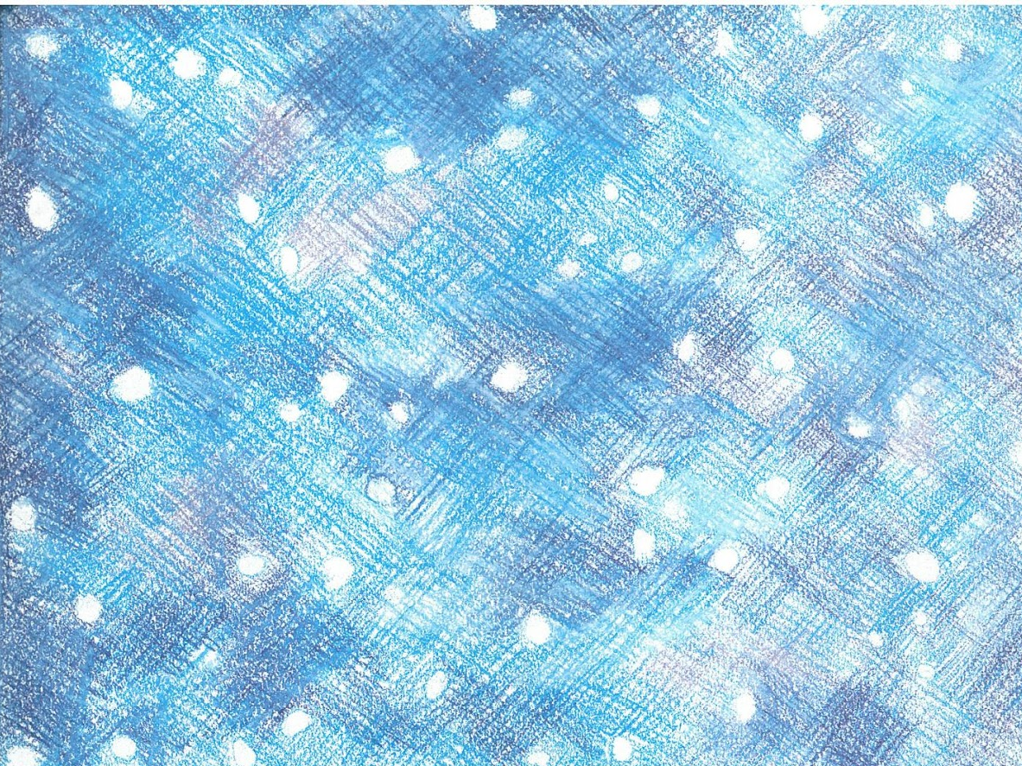
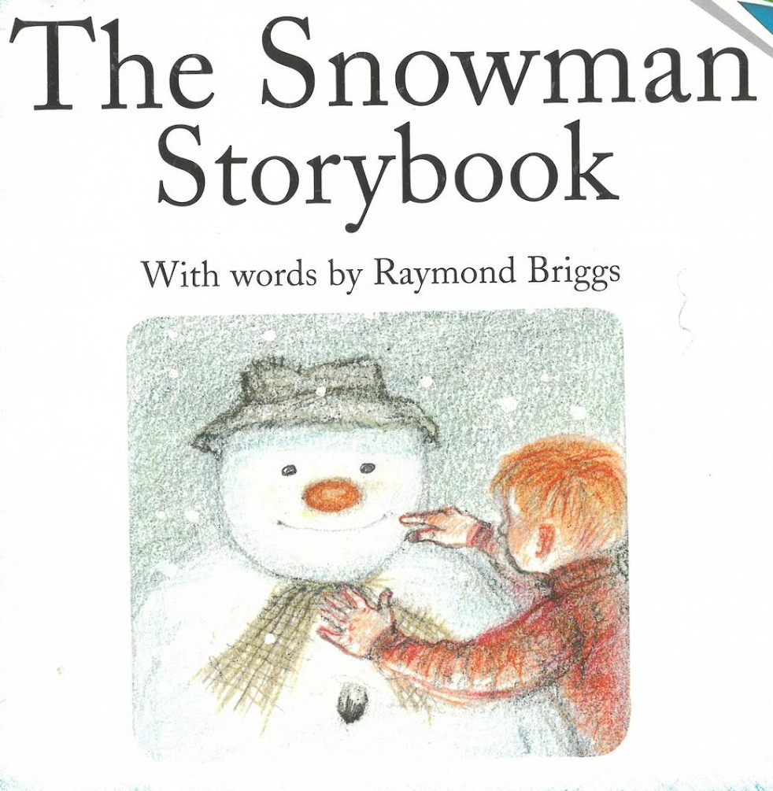

Slide 2
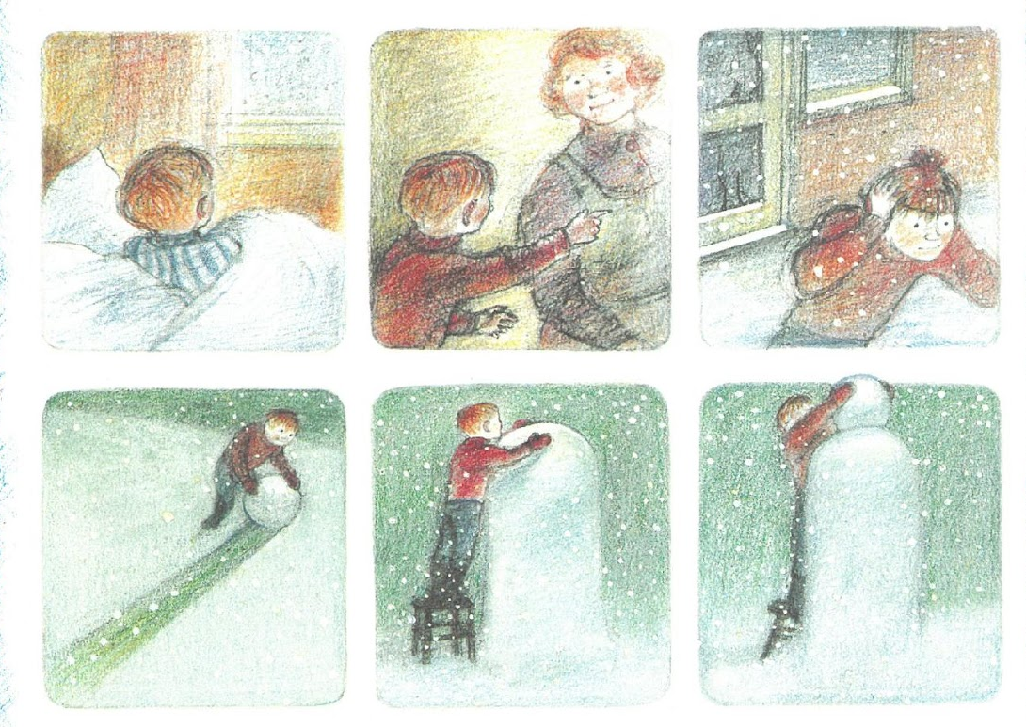
In the morning James woke to see snow falling. He ran into the garden as fast as he could,and he started to make a snowman.

Slide 3
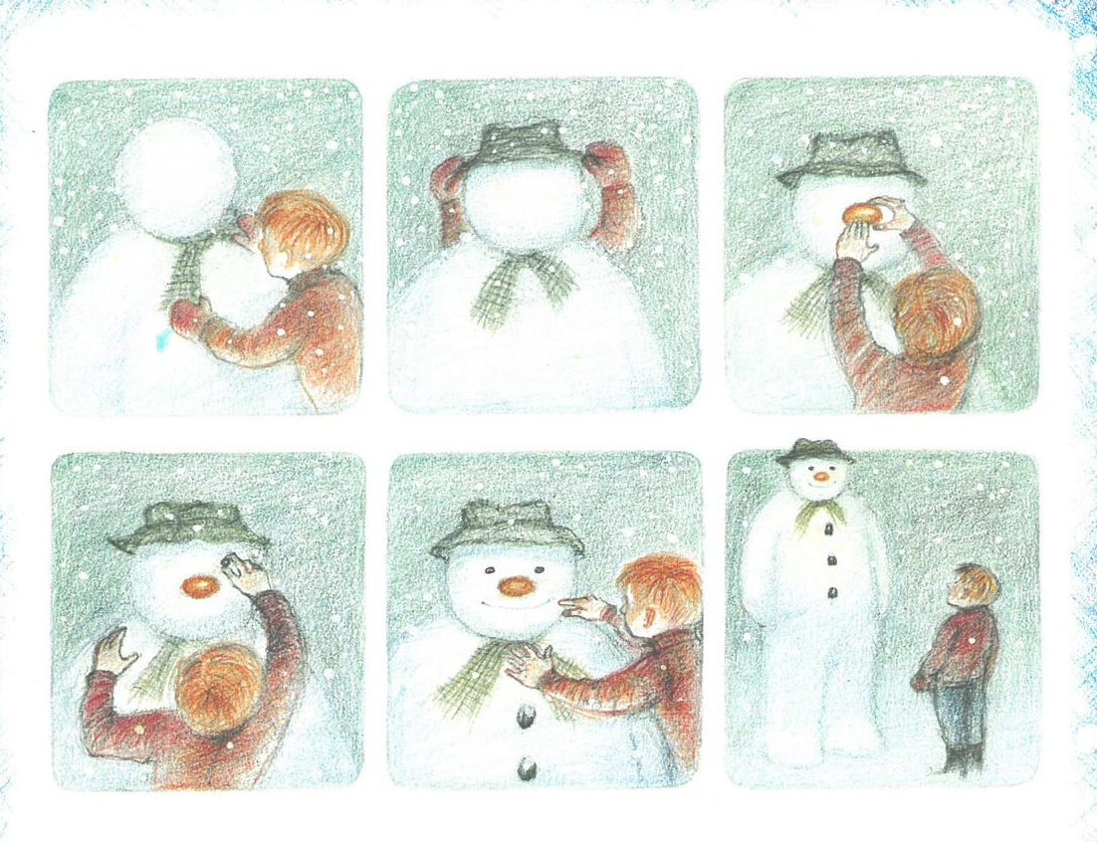
He gave him a scarf and a hat, a tangerine for a nose, and lumps of coal for his buttons and his eyes.

Slide 4
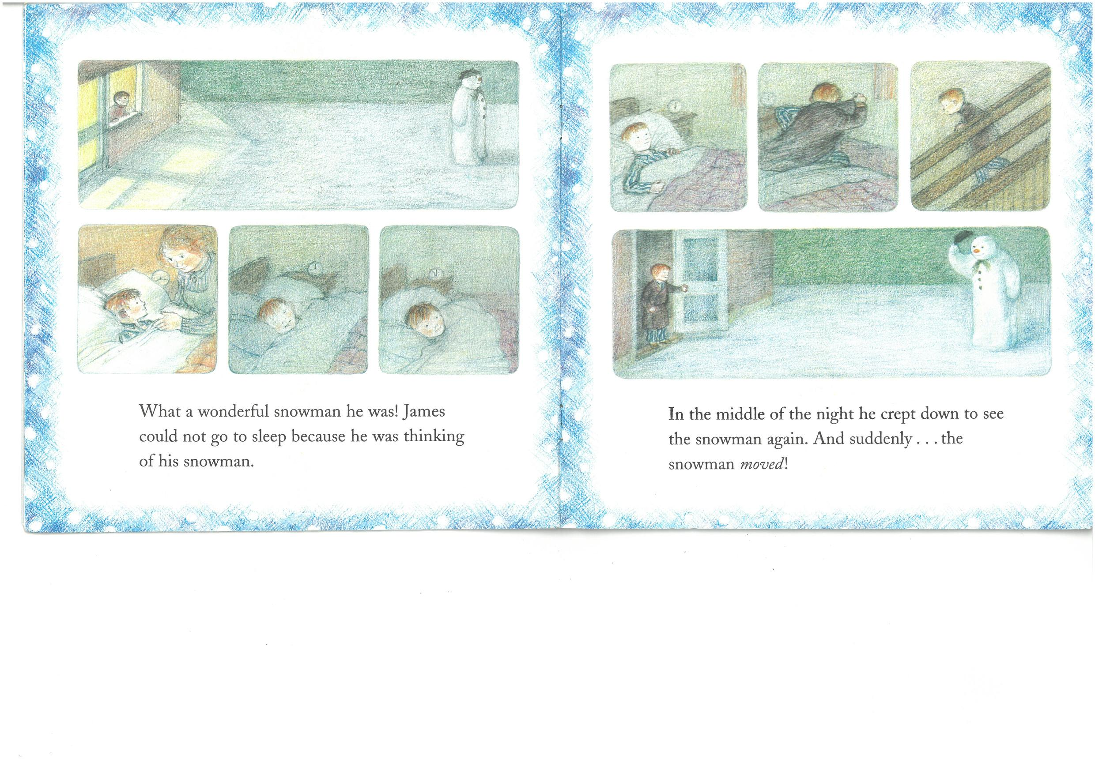
What a wonderful snowman he was! James could not go to sleep because he was thinking of his snowman.

Slide 5
In the middle of the night he crept down to see the snow again. And suddenly . . . the snowman moved!

Slide 6
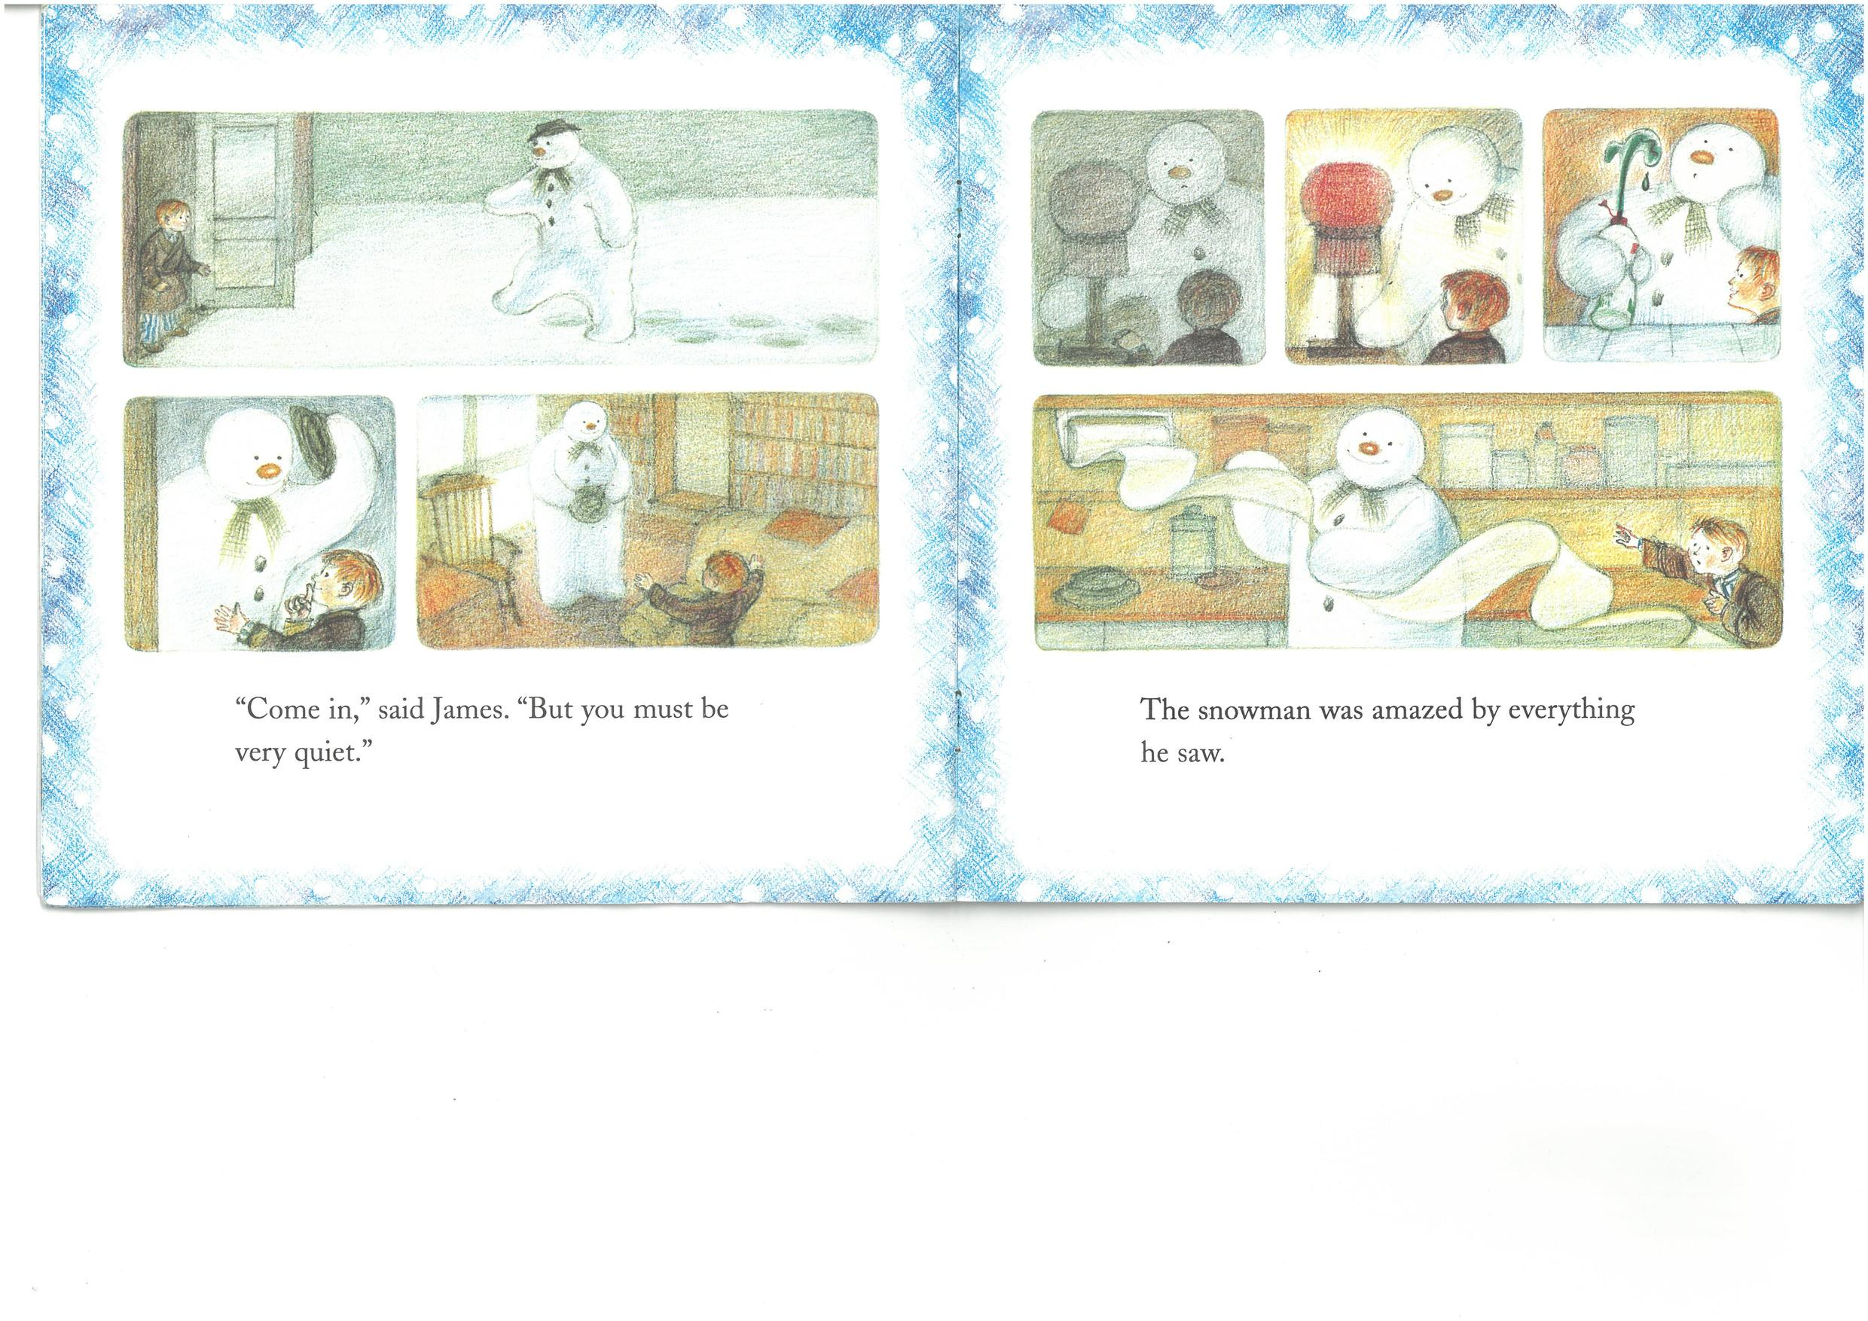
"Come in," said James. "But you must be very quiet."

Slide 7
The snowman was amazed by everything he saw.

Slide 8
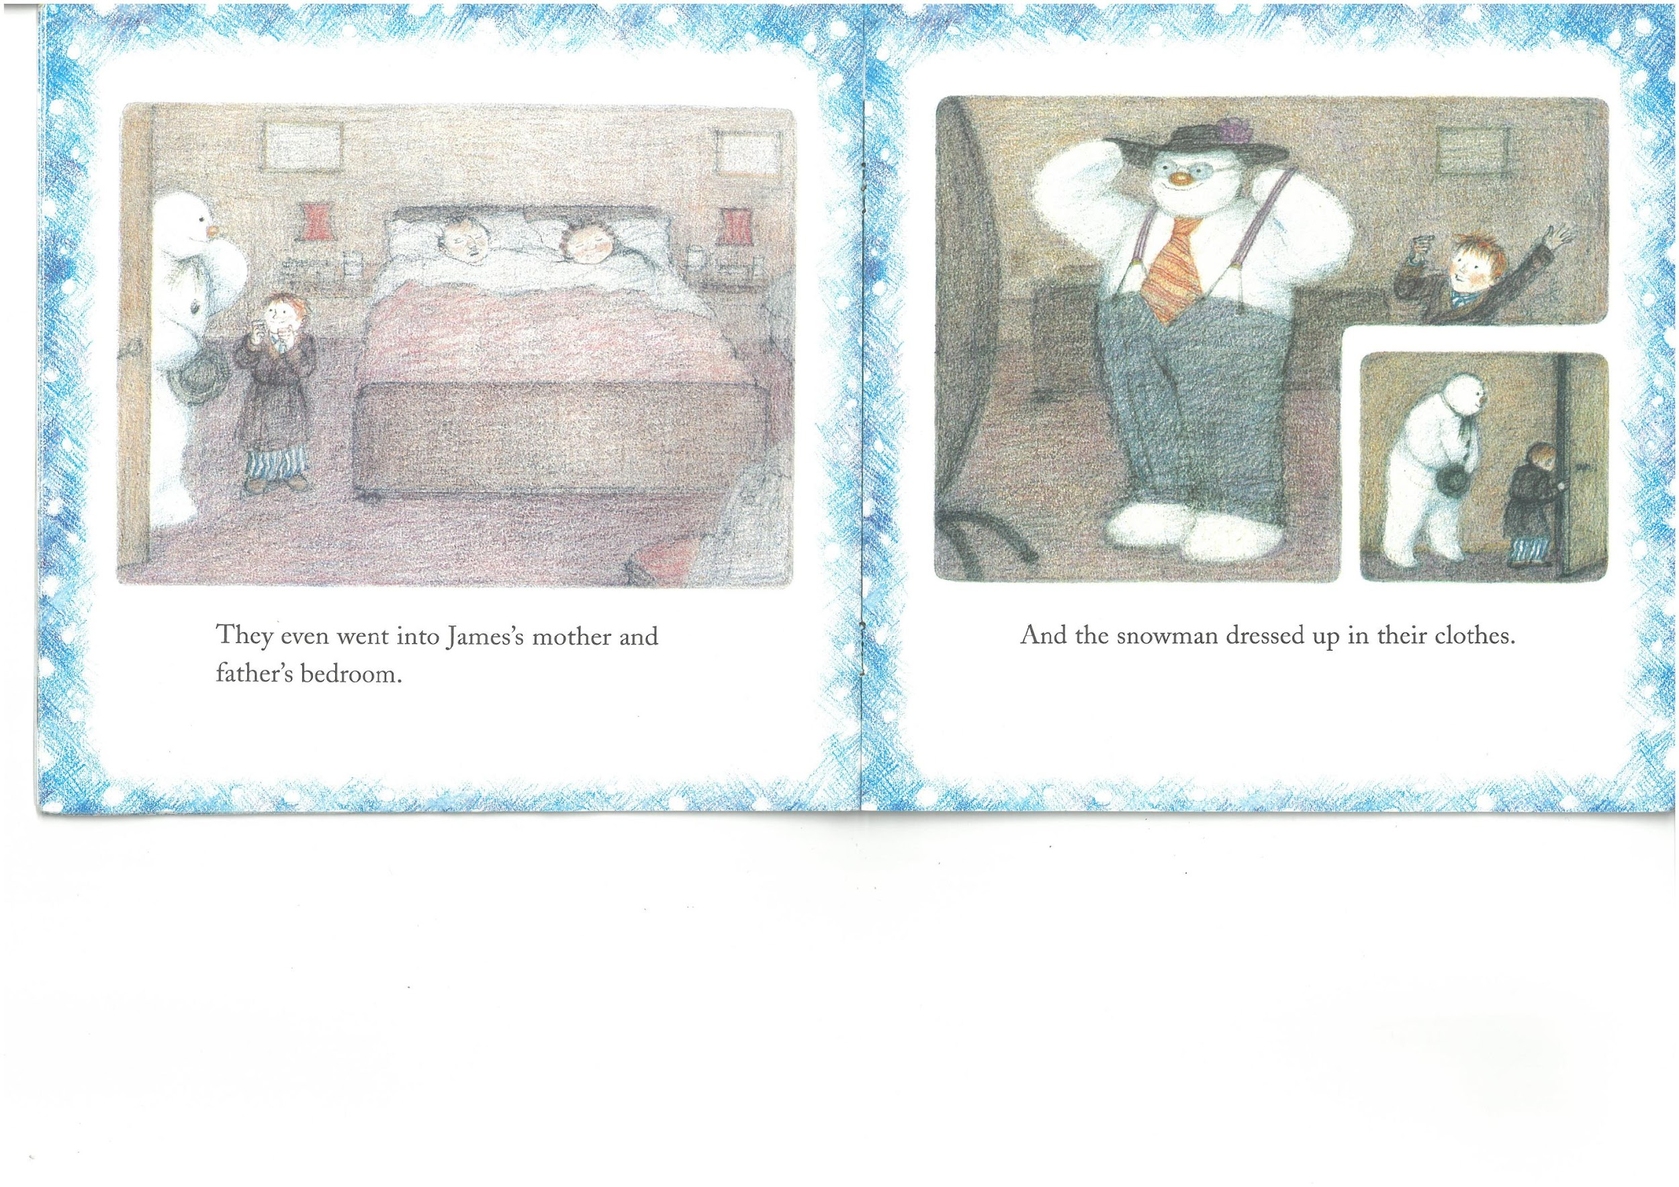
They even went into James's mother and father's bedroom.

Slide 9
And the snowman dressed up in their clothes.

Slide 10
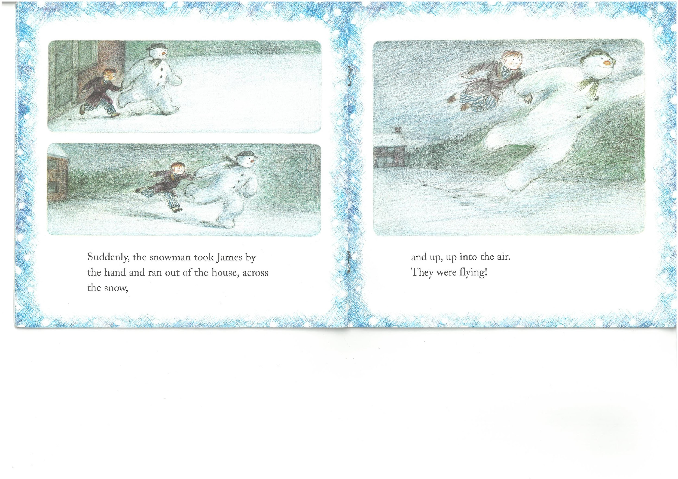
Suddenly, the snowman took James by the hand and ran out of the house, across the snow,

Slide 11
and up, up into the air, They were flying!

Slide 12
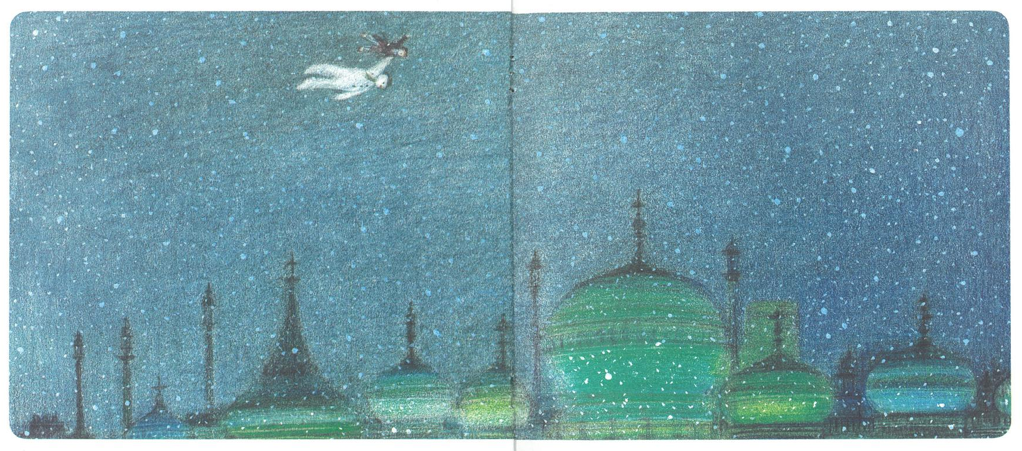

Slide 13
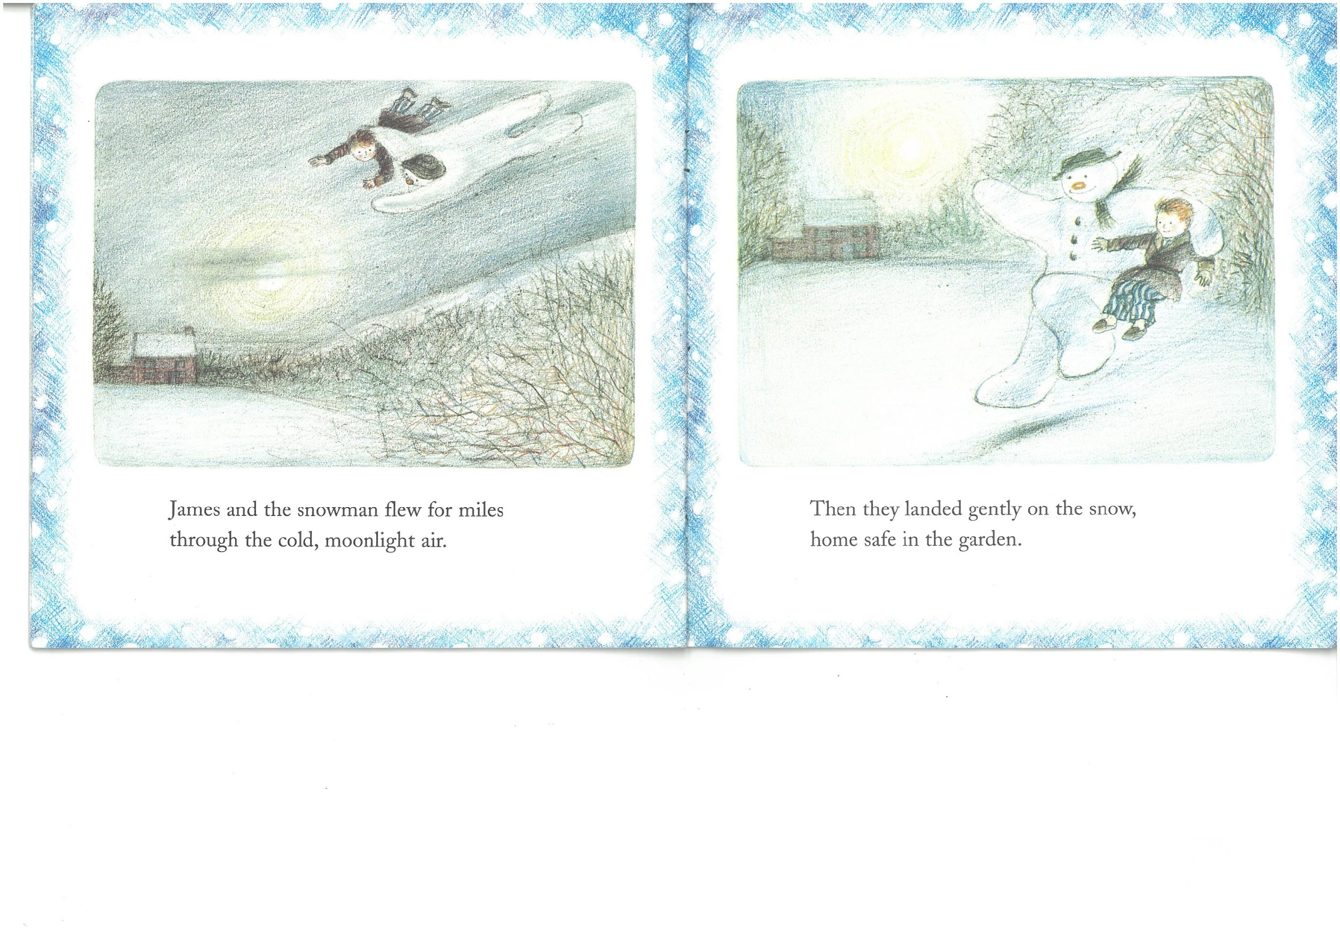
James and the snowman flew for miles through the cold, moonlight air.

Slide 14
Then they landed gently on the snow, home safe in the garden.

Slide 15
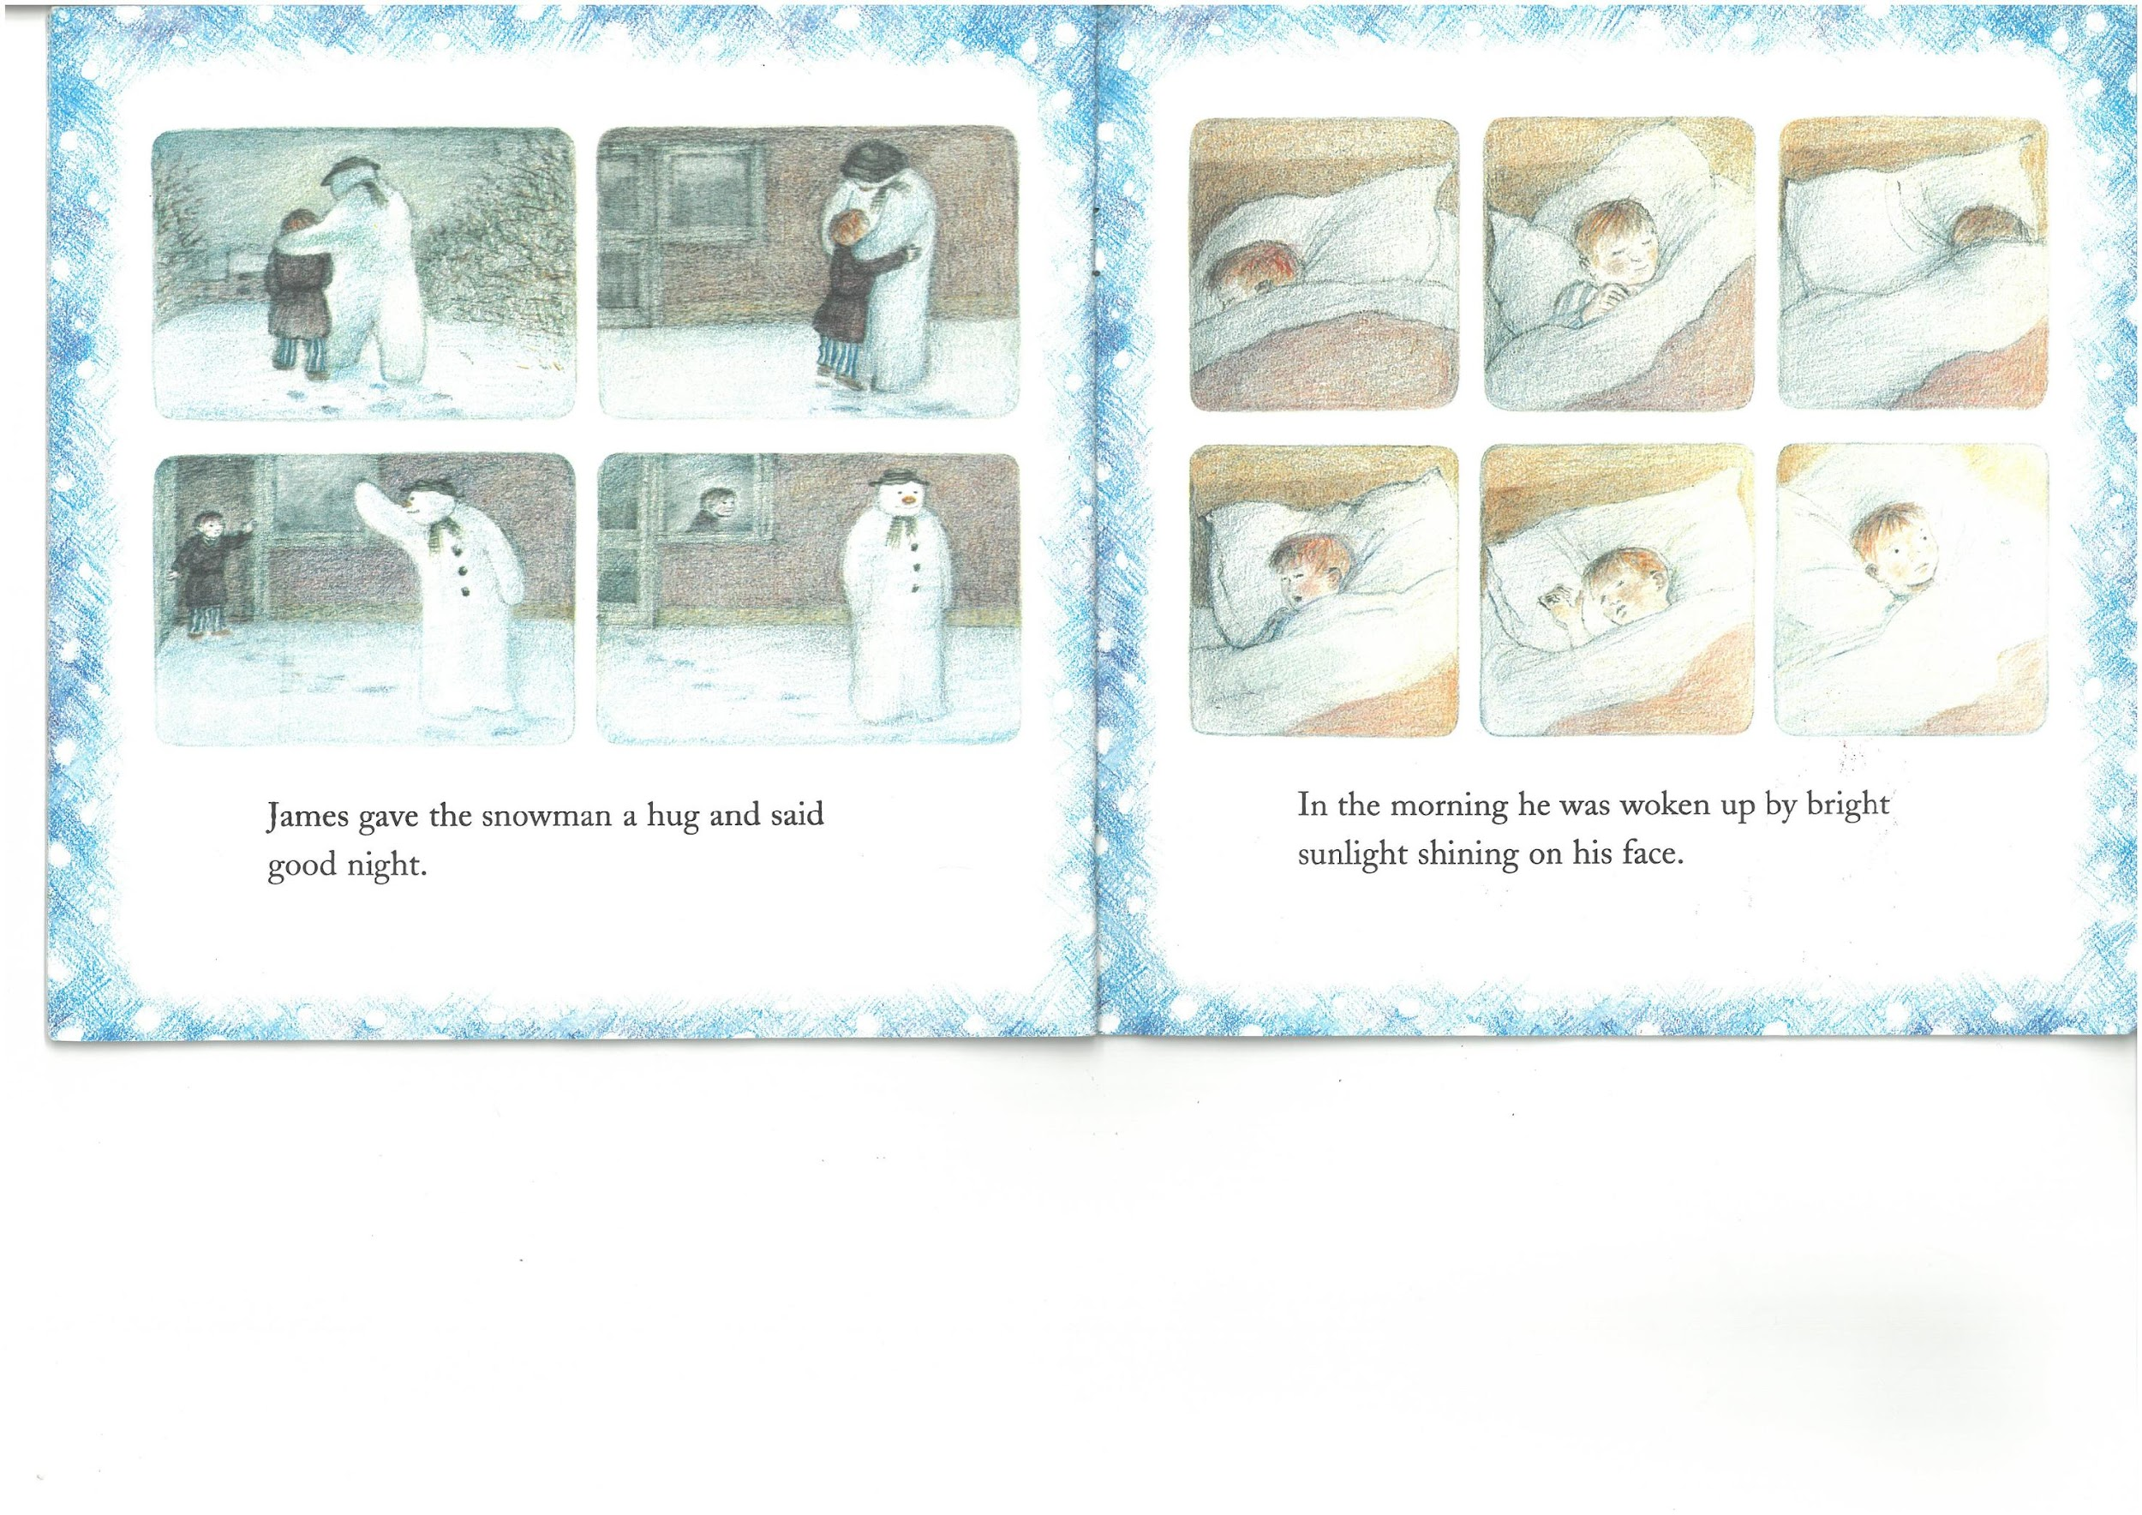
James gave the snowman a hug and said good night.

Slide 16
In the morning he was woken up by bright sunlight shining on his face.

Slide 17
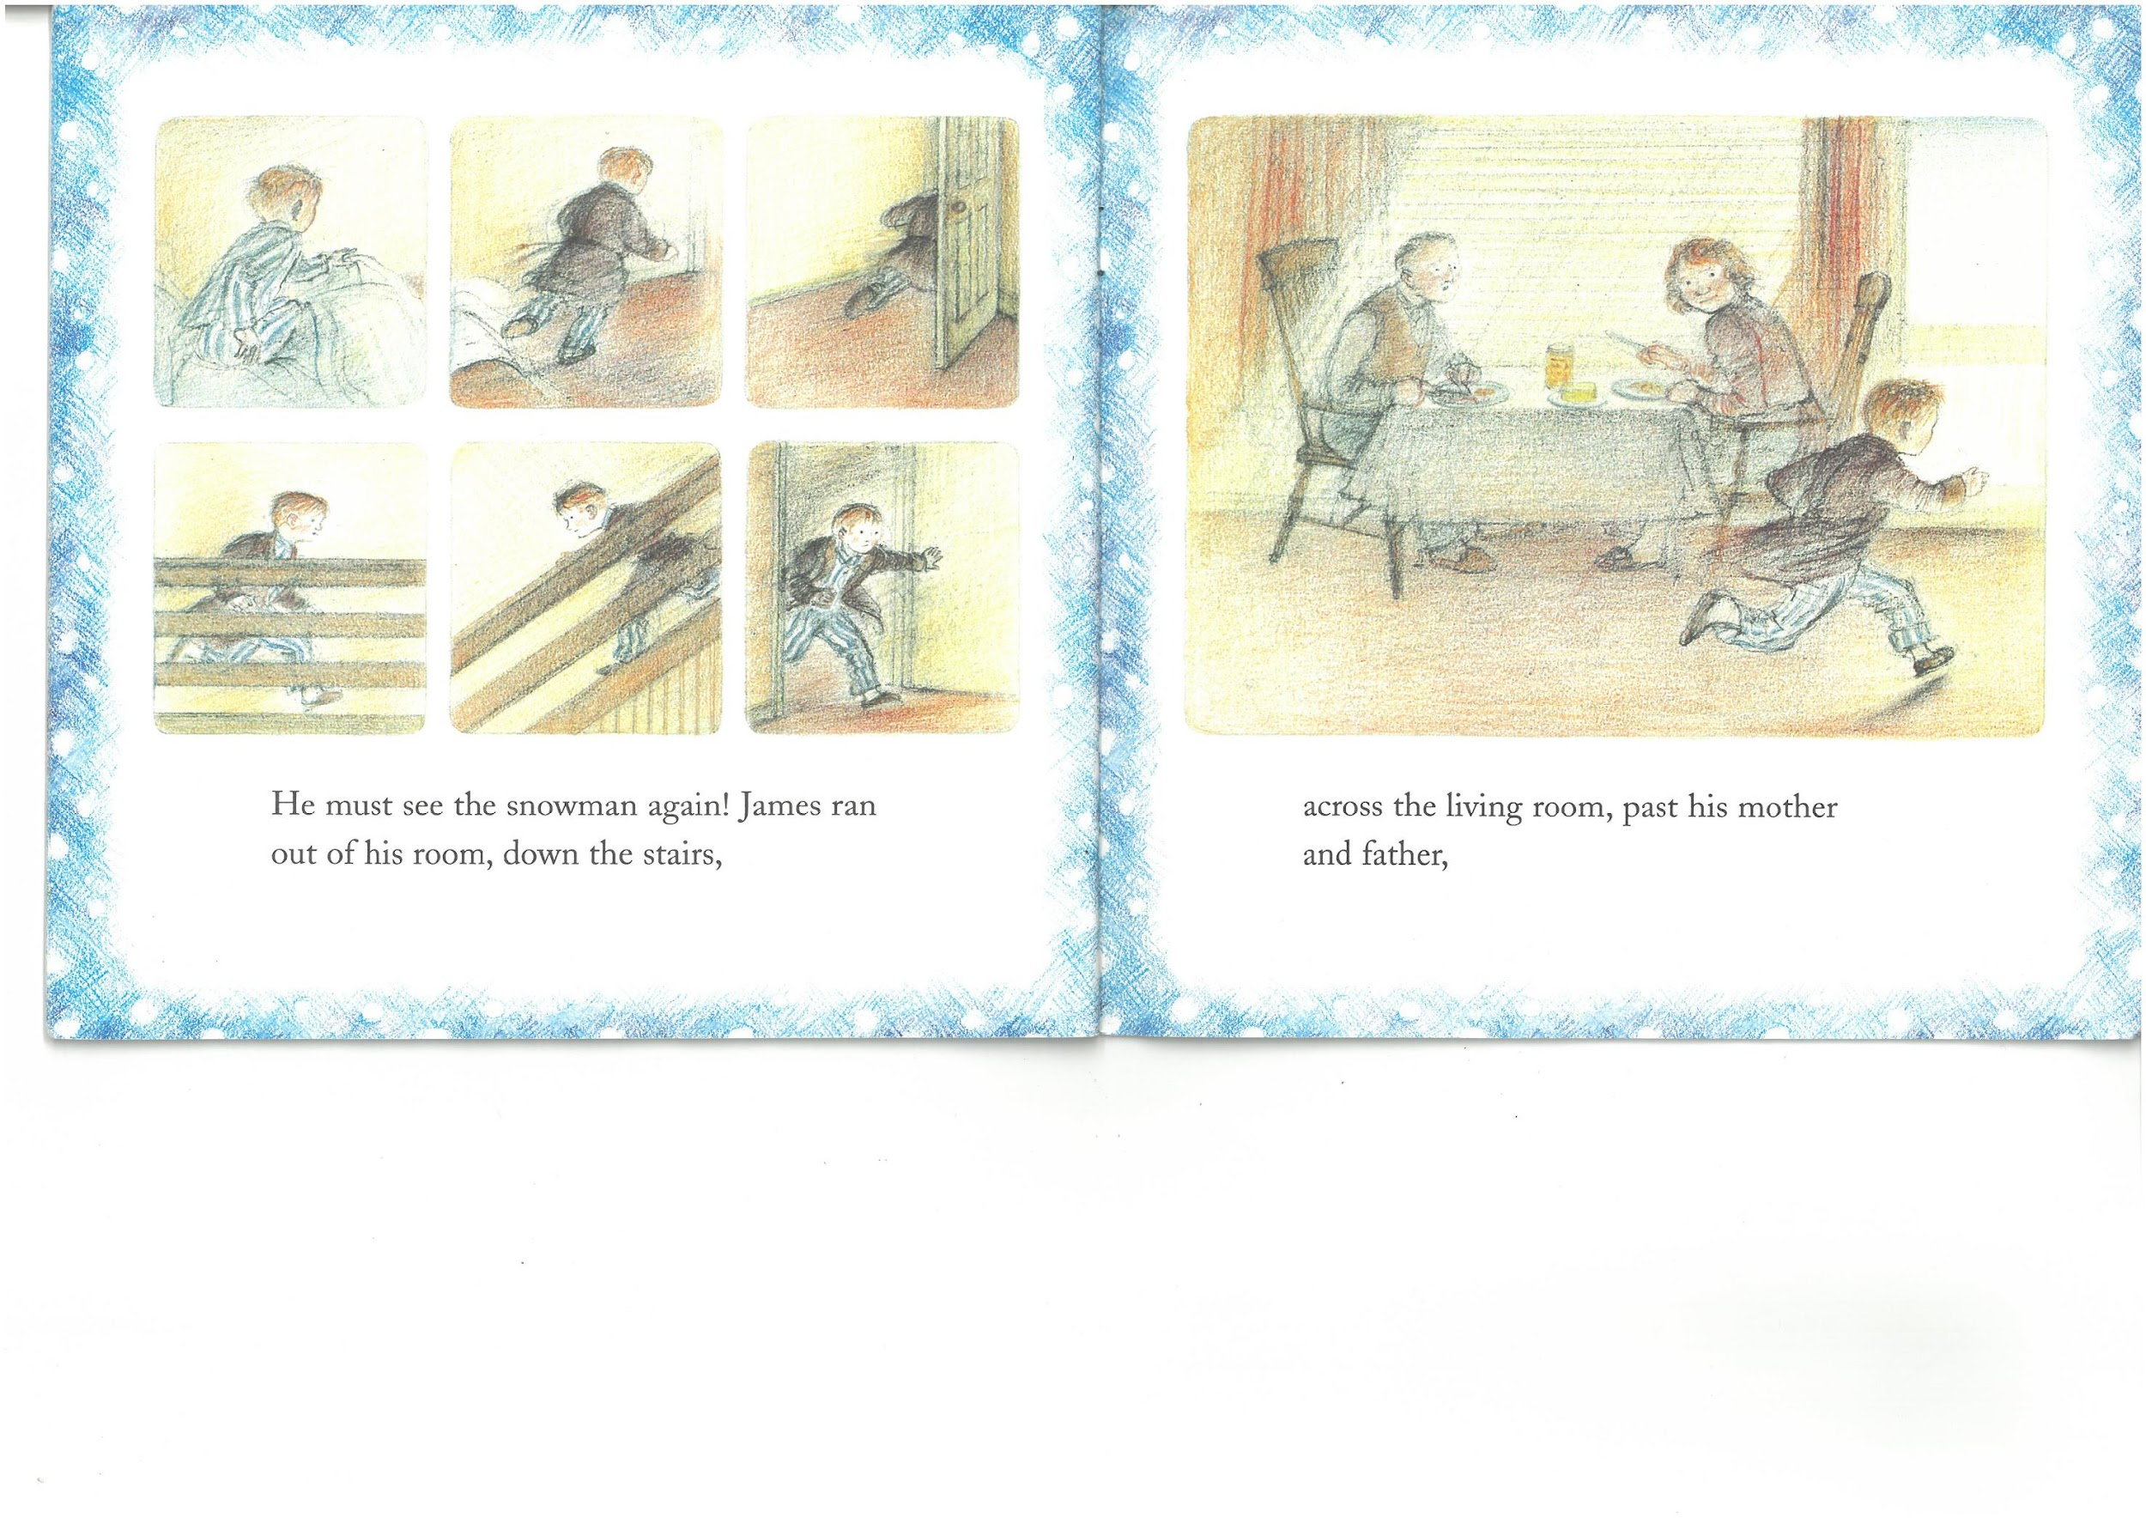
He must see the snowman again! James ran out of his room,
down the stairs,

Slide 18
across the living room, past his mother and father,

Slide 19
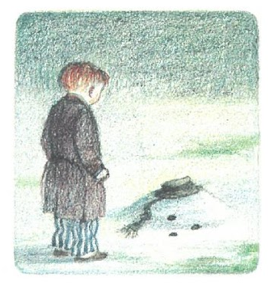
and into the garden.

