Slide 1

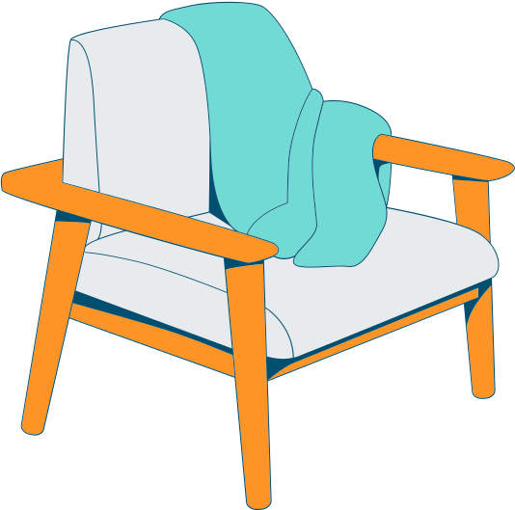
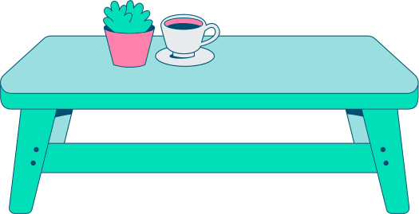
LESSON 3
HOMELY CHATTER
Trinity GESE Grade 1 Prep
Prepared by Imperial Academy

Slide 2
Lesson 3: Homely Chatter
Course: Trinity GESE Grade 1 Prep
Course Duration: 16 lessons
## Lesson Duration: 1.5 hours per lesson
## Age: ESL aged 6 to 8
## Class Size: 8 – 12
## Function: Talking about Household objects
## Materials List:
1. Lesson PowerPoint
2. Lesson Worksheet
3. Household Objects (window, bed, shelf, cupboard, table, chair, sofa, TV, toilet, shower, door)
## Target Language:
- Number 1 - 20
- Point to the…
- Give me the…
- Touch the…
- Show me the…
- window, bed, shelf, cupboard, table, chair, sofa, TV, toilet, shower, door
# Lesson Procedure:
## 1. Warm-up (10 mins)
Begin the lesson with a lively greeting. Using the Lesson PowerPoint, introduce the topic and target language. Prompt students to listen and repeat phrases like "Point to the…", "Touch the…" to master pronunciation.
## 2. Vocabulary Introduction (10 mins)
Utilise the Lesson PowerPoint to introduce the vocabulary of the lesson in the target language. Show pictures of the household objects one by one and say their names aloud. Encourage students to repeat after you.
## 3. Activity 1 (10 mins)
Initiate a 'Hide and Seek Objects' game. Hide mini pictures of household objects around the classroom. Students must find the objects and correctly identify them using "Point to the…" and "Touch the…" expressions.
## 4. Dialogue Practice 1 (15 mins)
**Part 1:** Pair up students and distribute a set of picture cards to each pair. Ask them to practice the dialogue, "Point to the…", "Touch the…" using the pictures in the cards.
**Part 2:** Form small groups and encourage them to continue the dialogue practice using different picture cards. Provide correction and guidance as necessary.
## 5. Activity 2 (10 mins)
Facilitate a 'Pass and Tell' game. Students sit in a circle. Pass a household object around the circle. When a student receives the object, they must use "Give me the…" and "Show me the…" expressions to identify it.
## 6. Dialogue Practice 2 (15 mins)
**Part 1:** Pair the students again and distribute a new set of picture cards to each pair. Instruct them to practice the dialogue, "Give me the…", "Show me the…" using the pictures in the cards.
**Part 2:** Form small groups and encourage them to continue the dialogue practice using different picture cards. Provide correction and guidance as necessary.
## 7. My Talking Time (10 mins)
Instruct students to draw a room in their house on a piece of paper and label the objects in the room. Encourage each student to stand up, show their drawing, and describe it using the target language.
## 8. My Review Time (10 mins)
Review the lesson by displaying different pictures and prompting the target questions, "Point to the…", "Touch the…", "Give me the…", "Show me the…" to individual students. Encourage them to respond using the target language. Provide praise and correction as necessary.
# Remarks:
This plan aims to inspire confidence in English speaking. Activities are designed for the age and proficiency level, providing an engaging learning environment. The content aligns with the Trinity GESE Grade 1 exam requirements. The overarching goal is to help students express themselves confide
LESSON PLAN

Slide 3


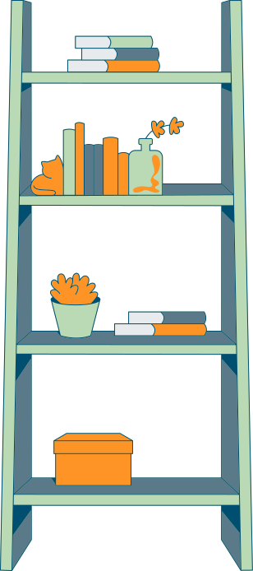

TARGET LANGUAGE
  Number 1 - 20
  Point to the…
  Give me the…
  Touch the…
  Show me the…

Slide 4

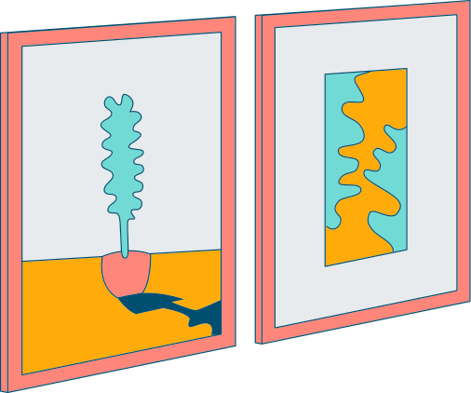


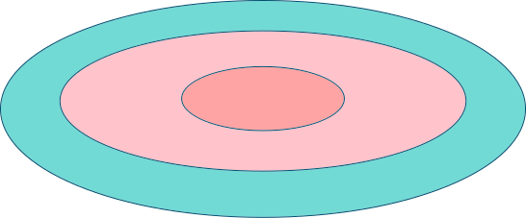
TARGET
VOCABULARY
  window
  bed
  shelf
  cupboard
  table
  chair
  sofa
  television
  toilet
  shower
  door

Slide 5
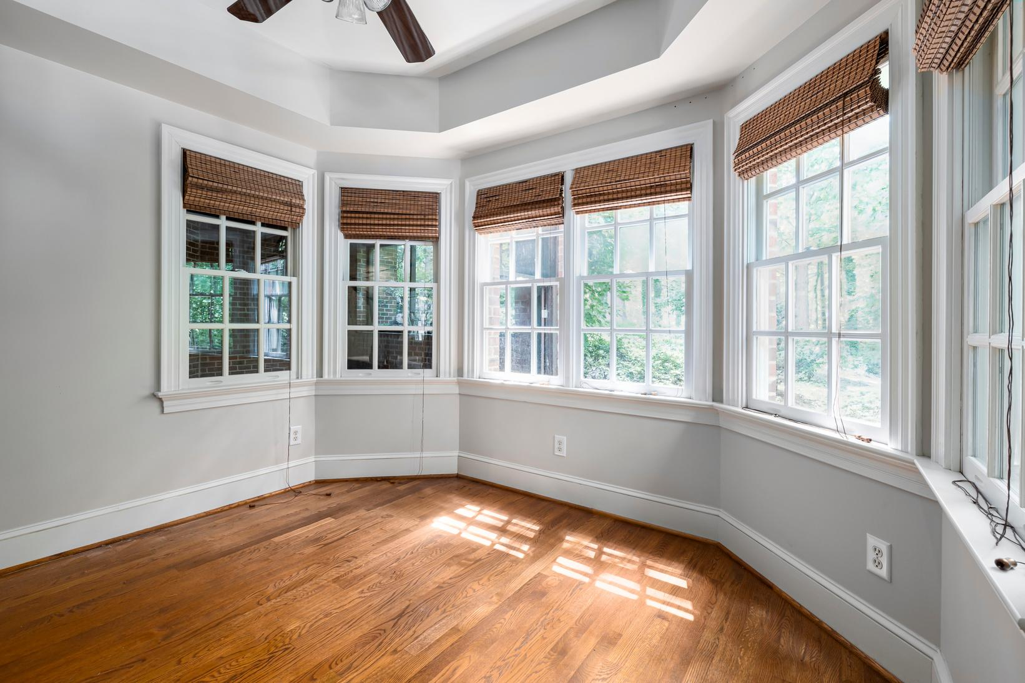

window
A space usually filled with glass in the wall of a building or in a vehicle, to allow light and air in and to allow people inside the building to see out

Slide 6
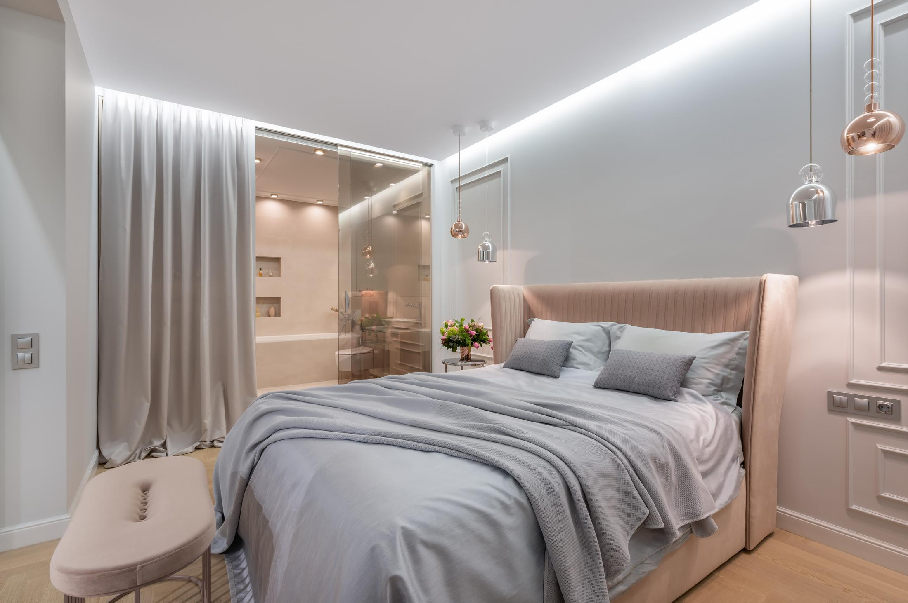
bed
A large, rectangular piece of furniture, often with four legs, used for sleeping on

Slide 7
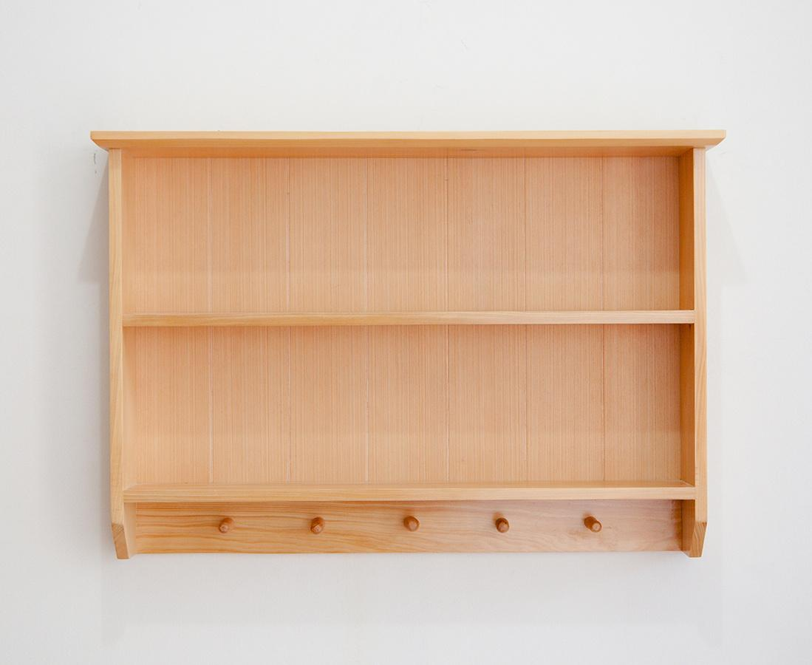
shelf
A long, flat board fixed horizontally, usually against a wall or inside a cupboard so that objects can be stored on it

Slide 8
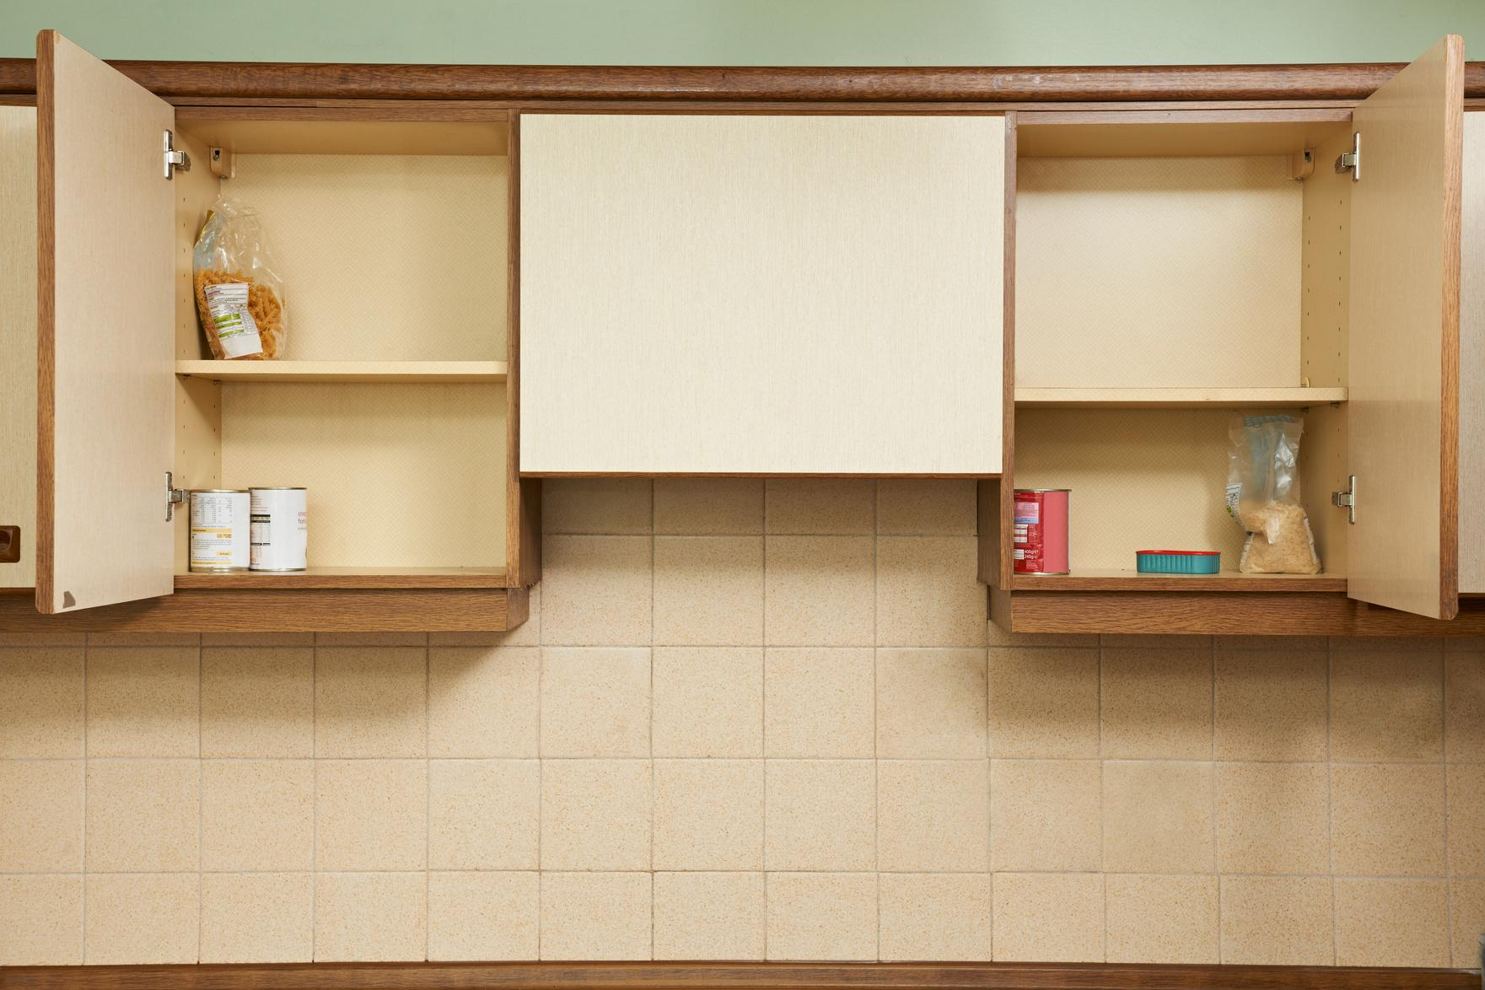
cupboard
A piece of furniture or a space for storing things, with a door or doors and usually with shelves

Slide 9
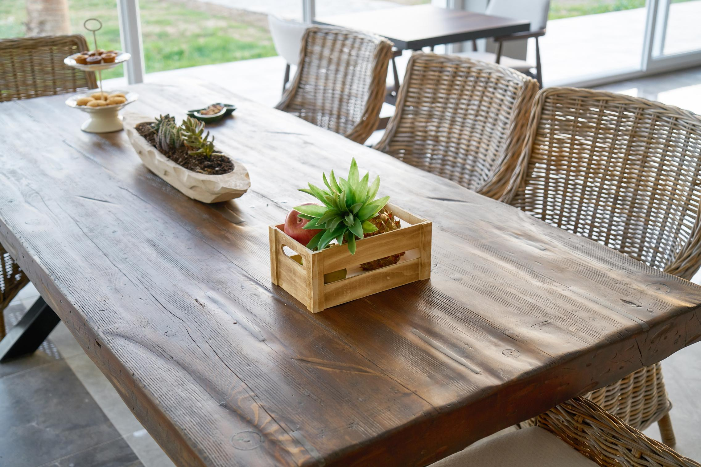
table
a flat surface, usually supported by four legs, used for putting things on

Slide 10
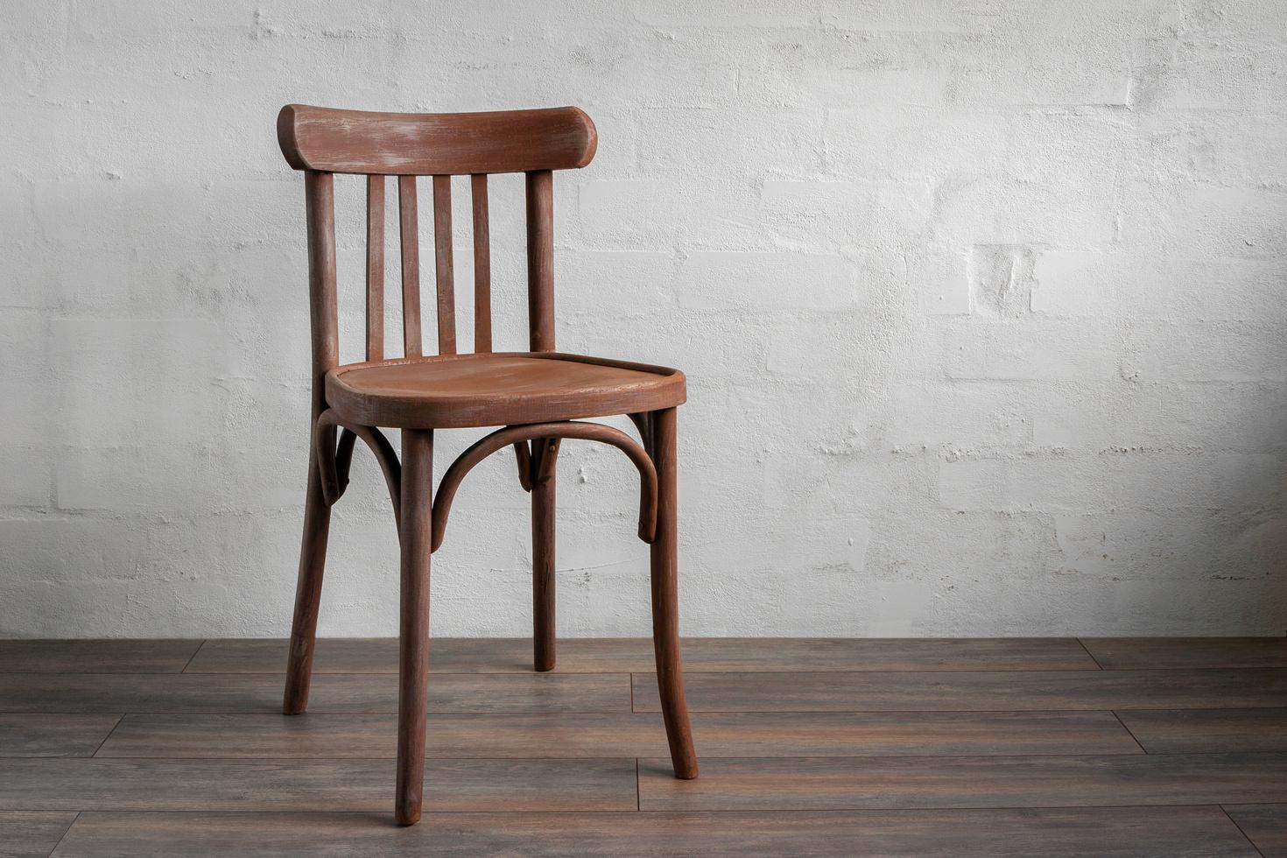
chair
A seat for one person that has a back, usually four legs, and sometimes two arms

Slide 11
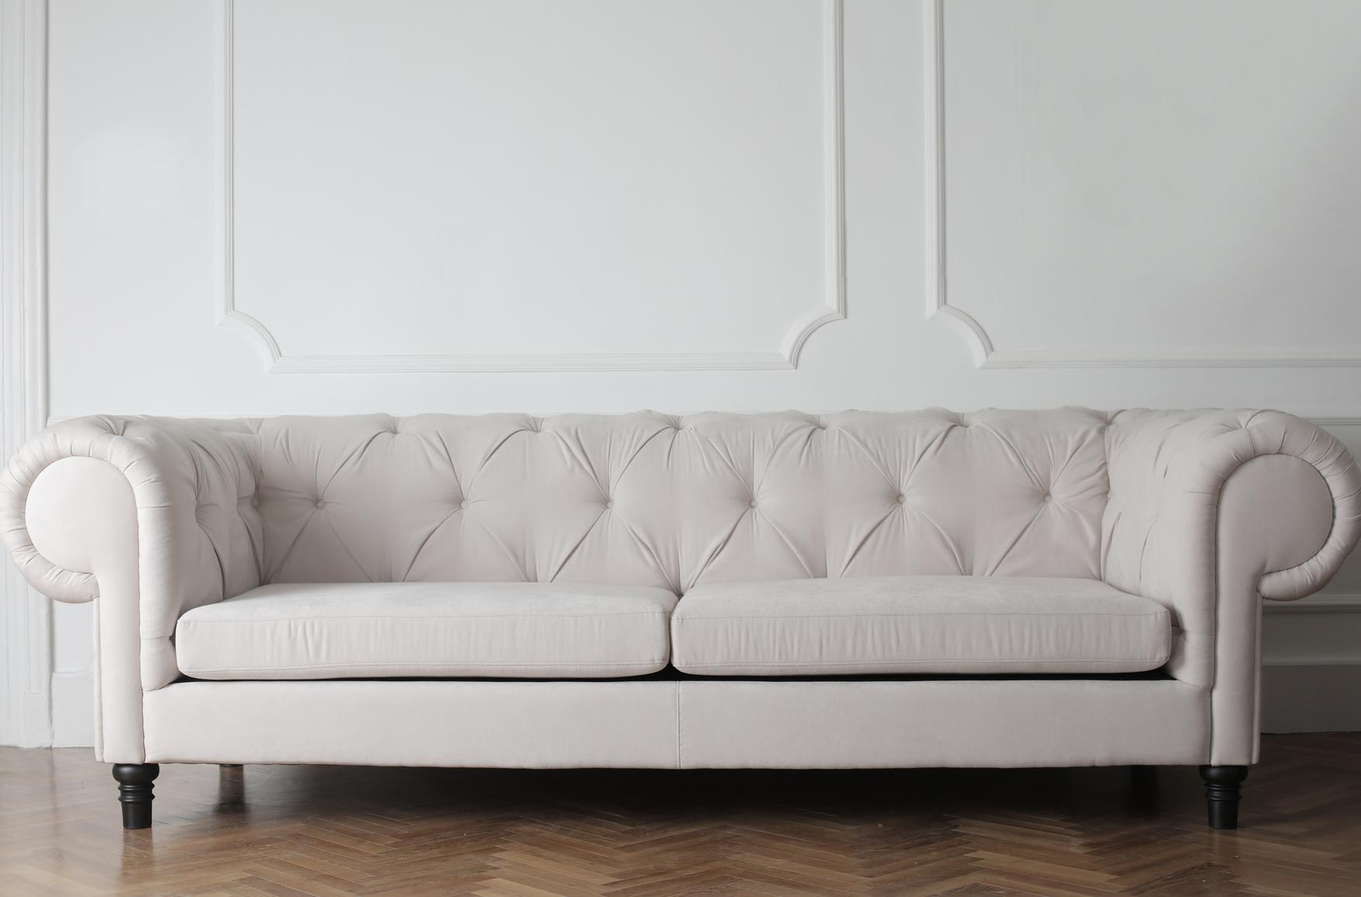
sofa
A long, soft seat with a back and usually arms, on which more than one person can sit at the same time

Slide 12
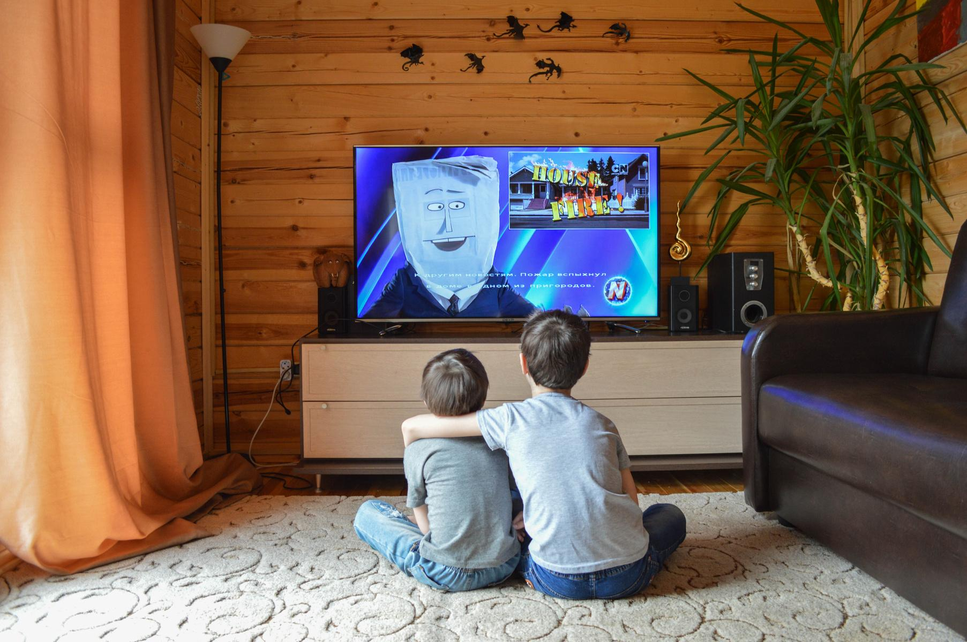
television
A device shaped like a box with a screen that receives electrical signals and changes them into moving images and sound

Slide 13
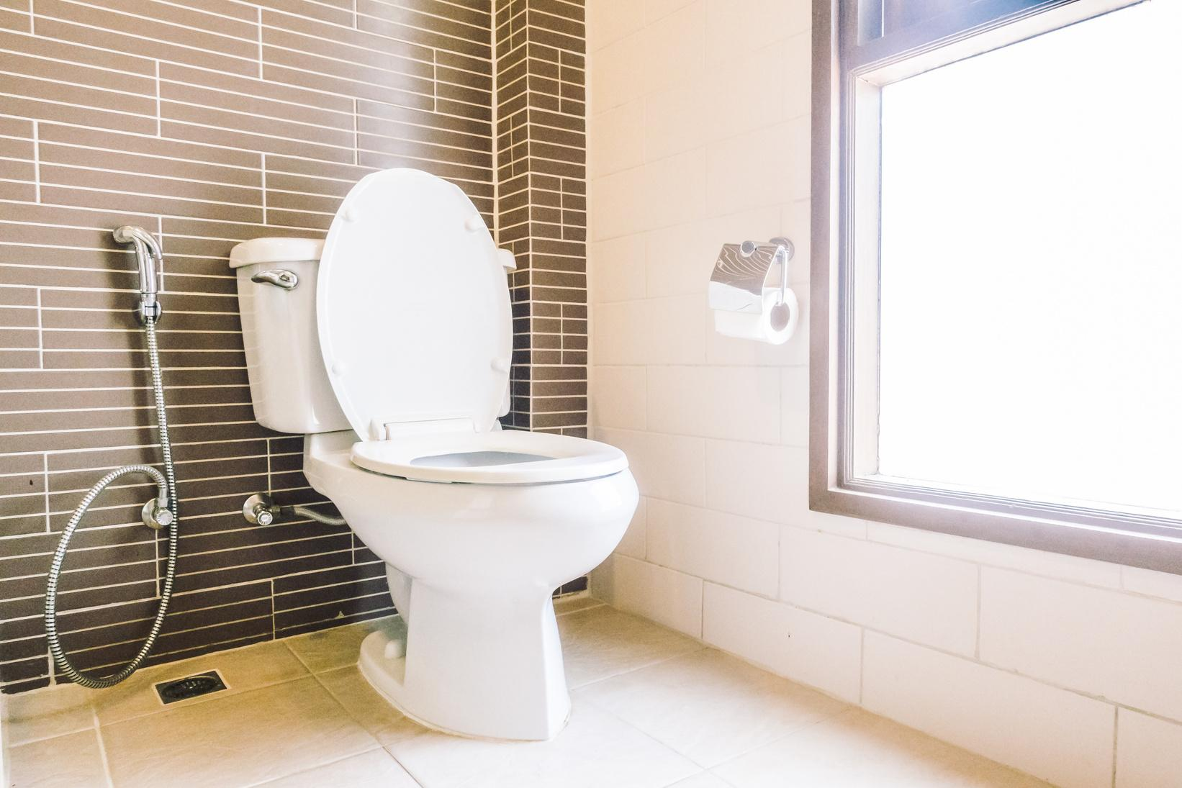
toilet
A bowl-shaped device with a seat that you sit on or stand near when emptying the body of urine or solid waste, or another device used for this purpose

Slide 14
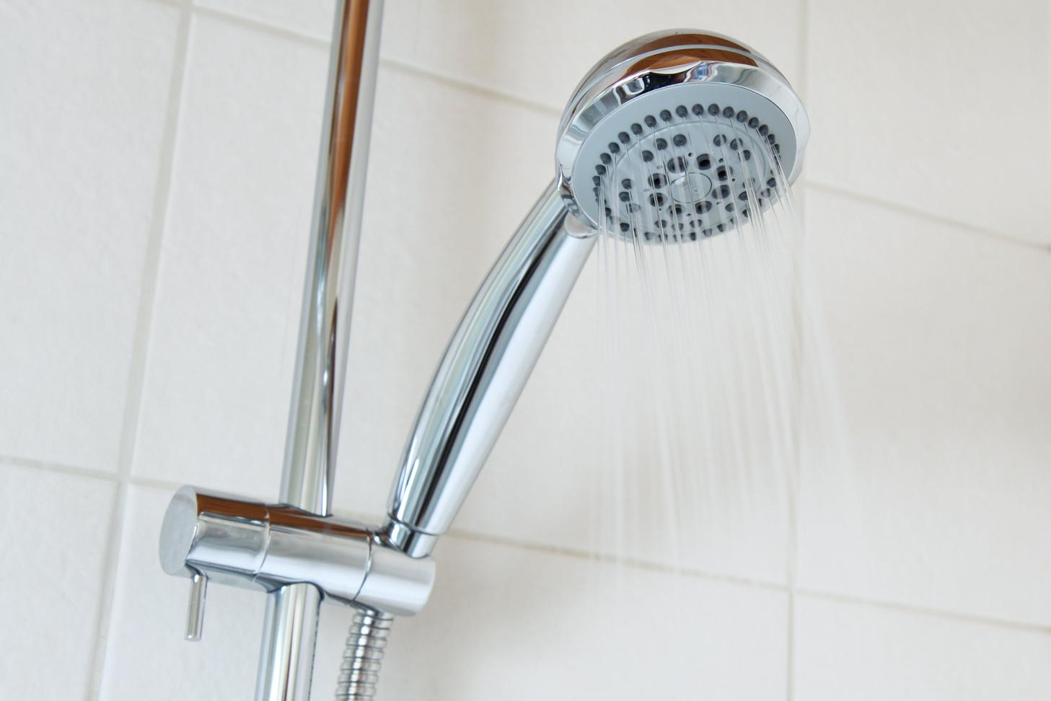
shower
A device that releases drops of water through a lot of very small holes and that you stand under to wash your whole body

Slide 15
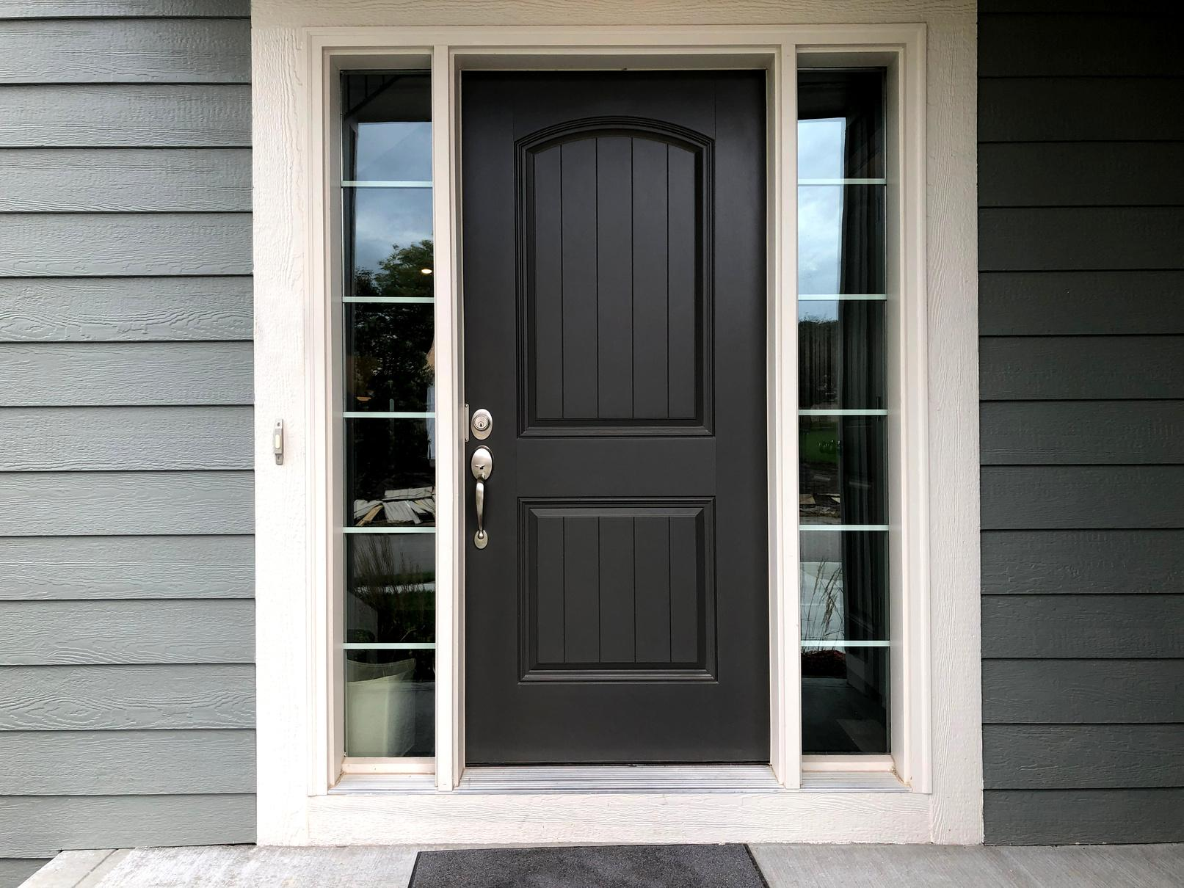
door
A flat object that is used to close the entrance of something such as a room or building, or the entrance itself

Slide 16



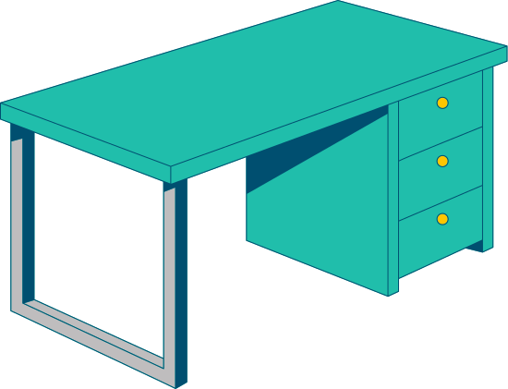
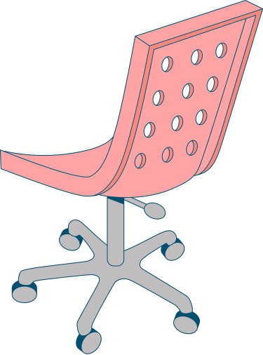
VOCABULARY
EXTENSION
1. wardrobe
2. armchair
3. curtain
4. sink
5. mirror
6. washbasin
  7. bathtub
  8. lamp
  9. fridge
  10. stove
  11. double bed
  12. single bed

Slide 17
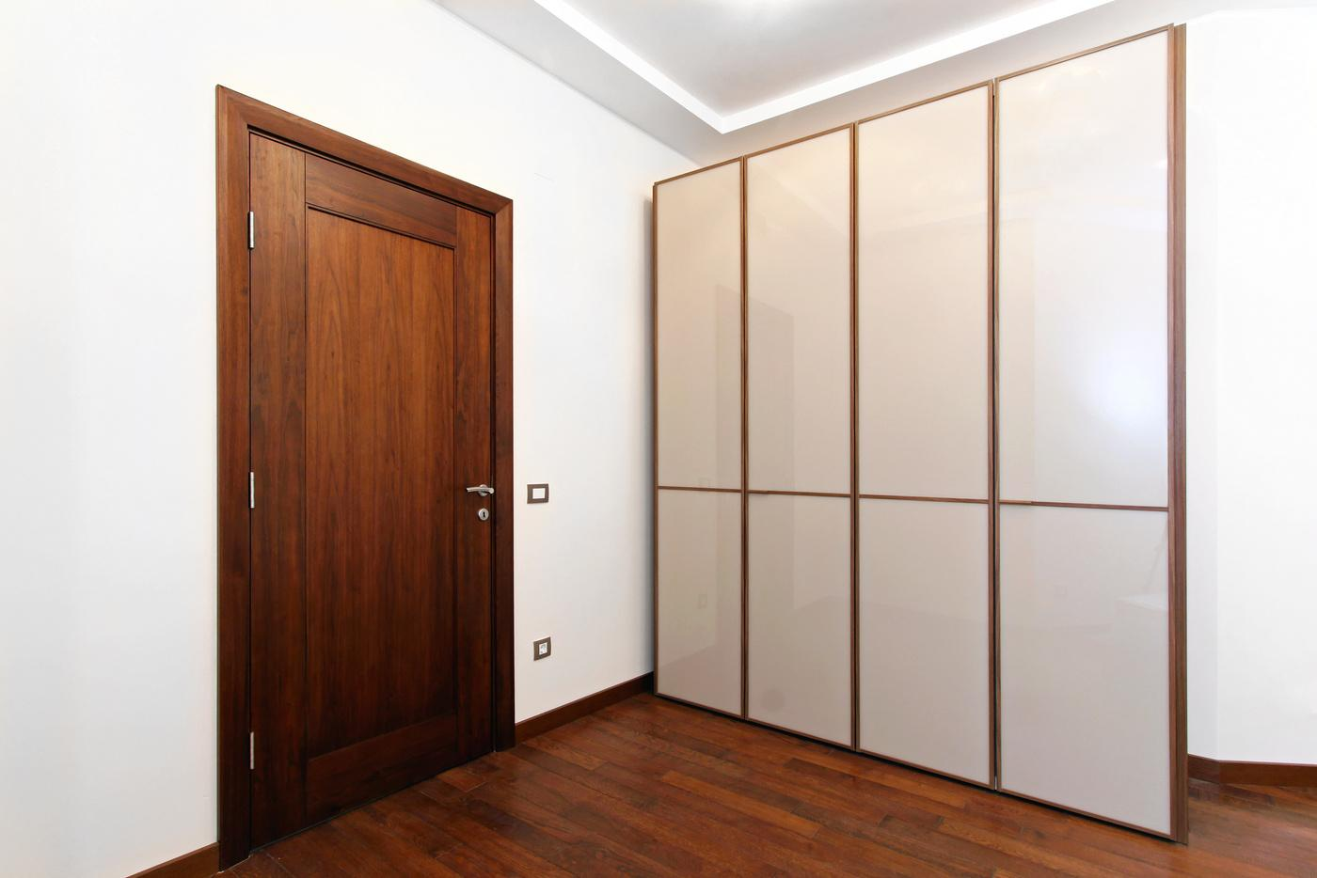
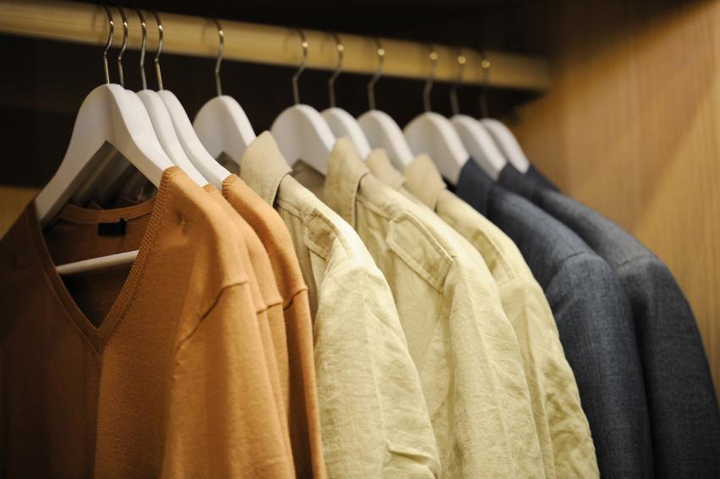
wardrobe
A tall cupboard in which you hang your clothes

Slide 18
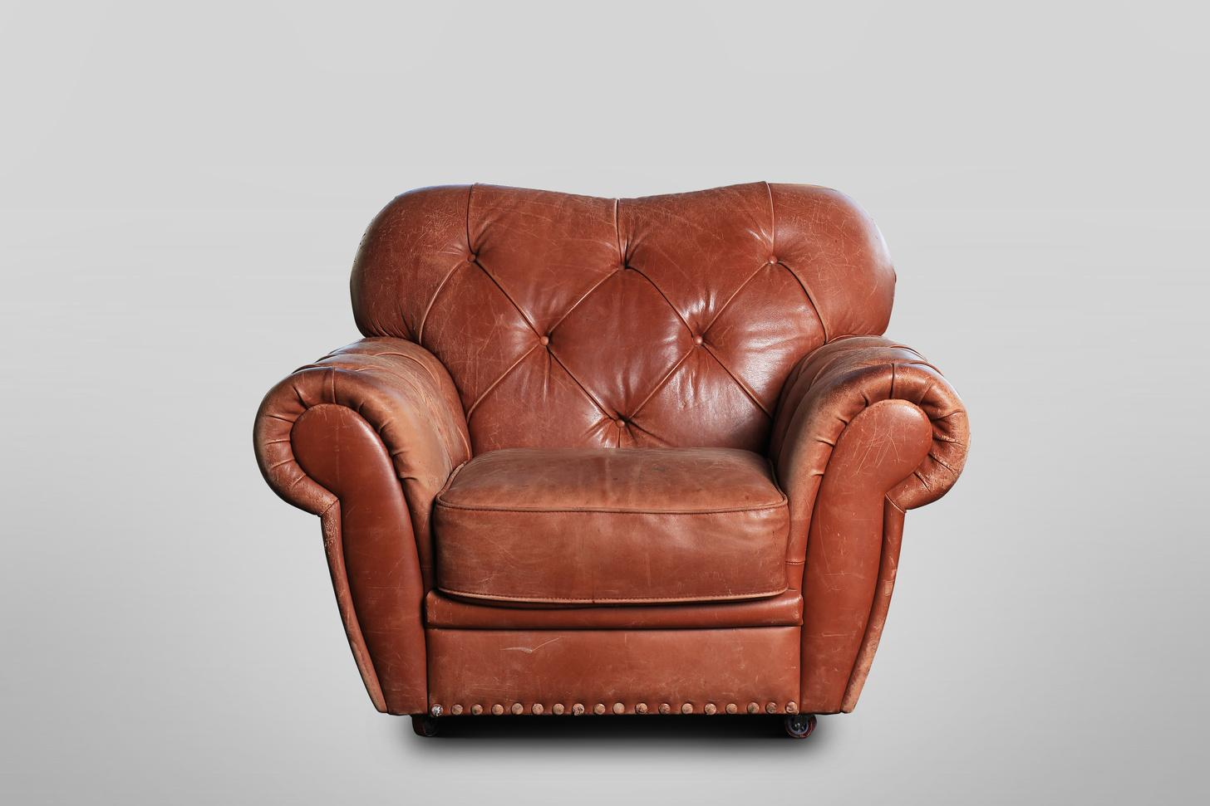
armchair
A comfortable chair with sides that support your arms

Slide 19
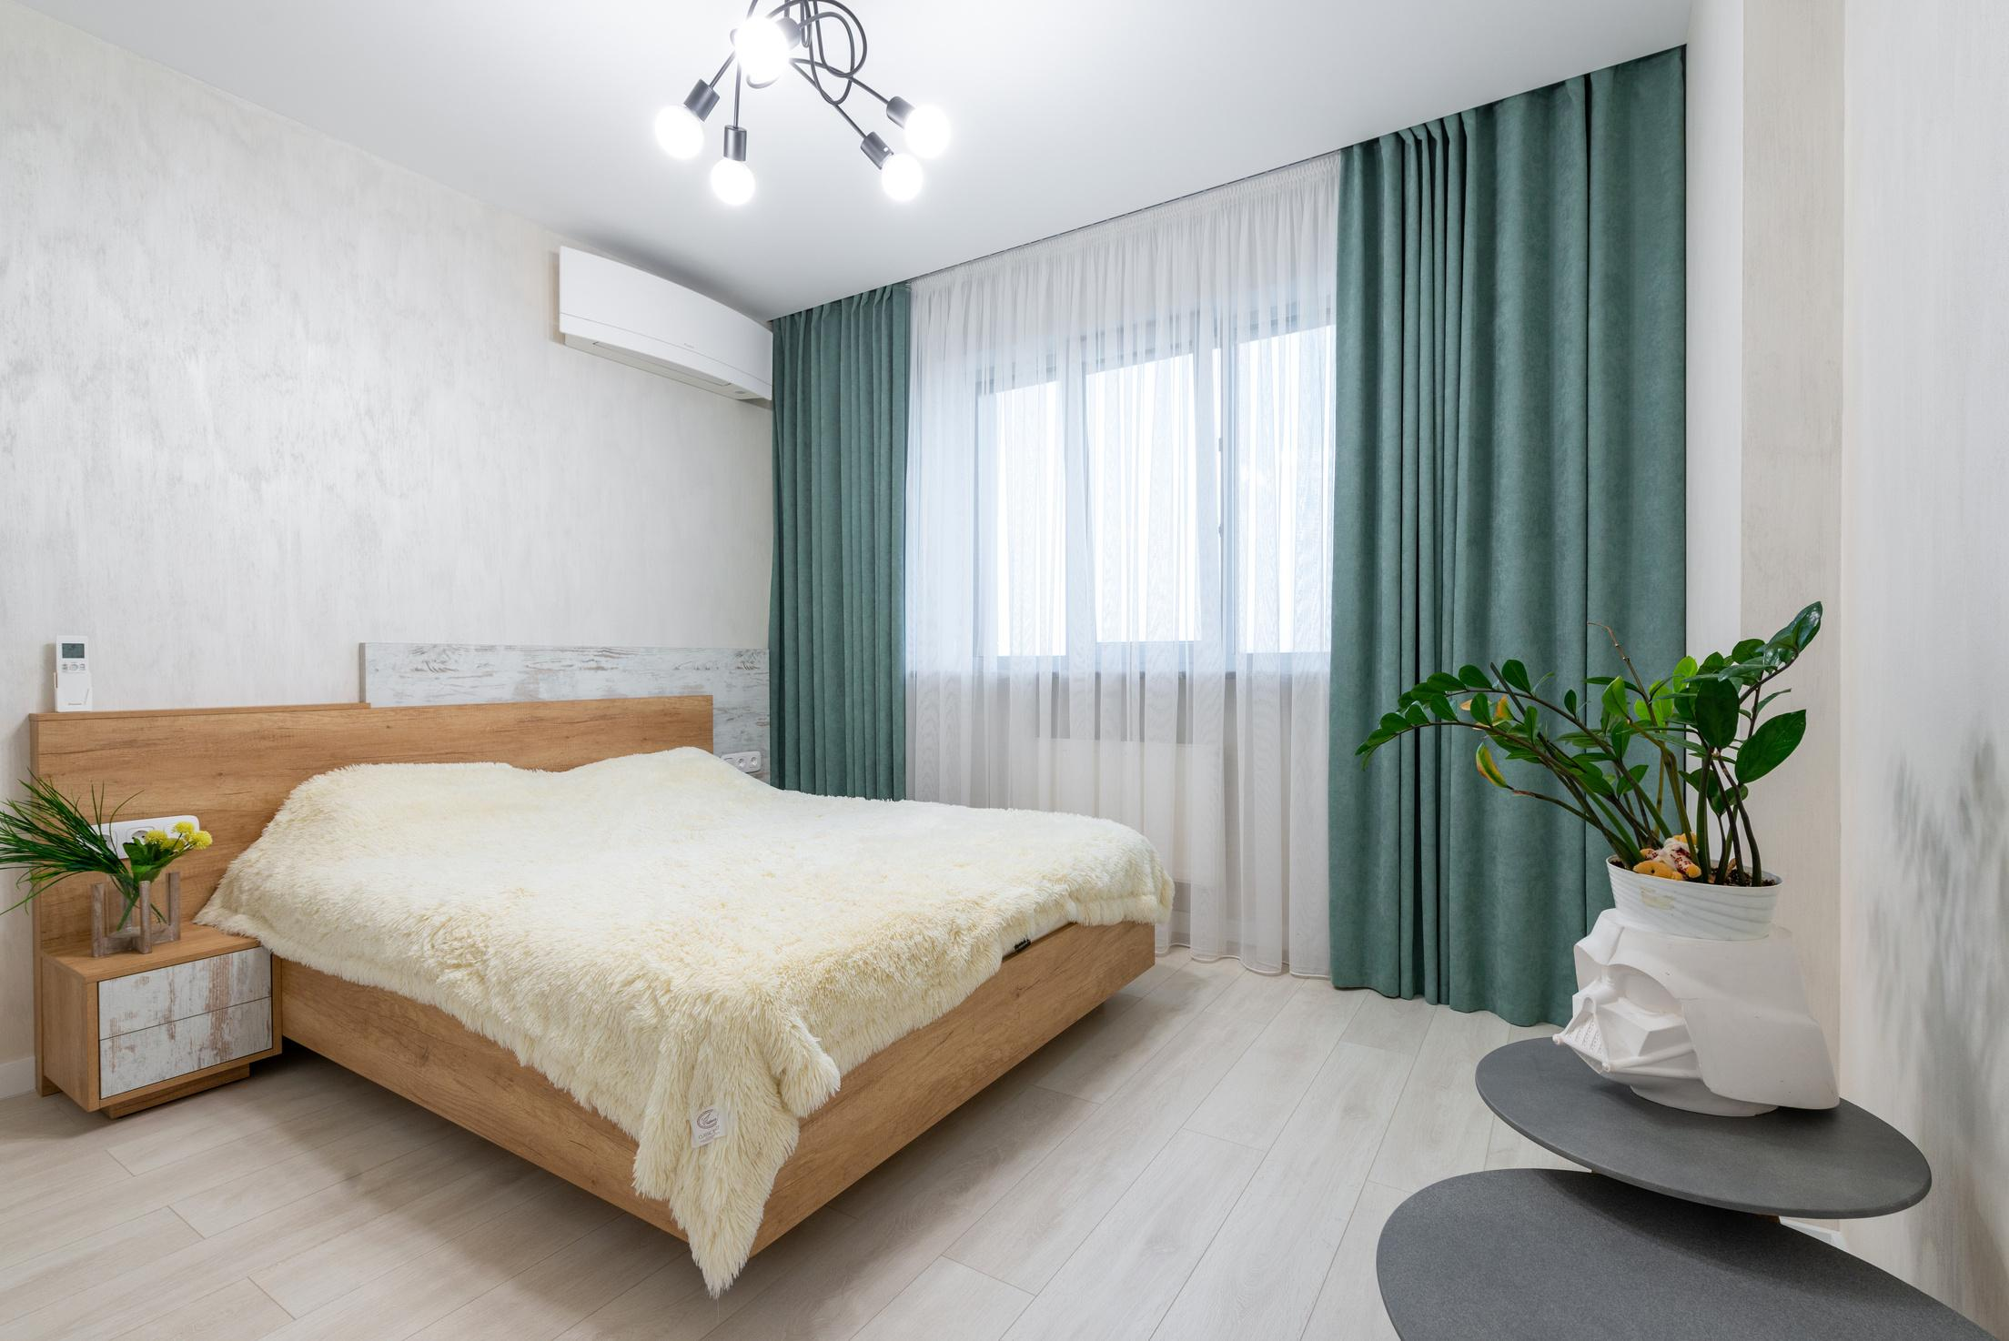
curtain
A piece of material, especially cloth, that hangs across a window or opening to make a room or part of a room dark or private

Slide 20
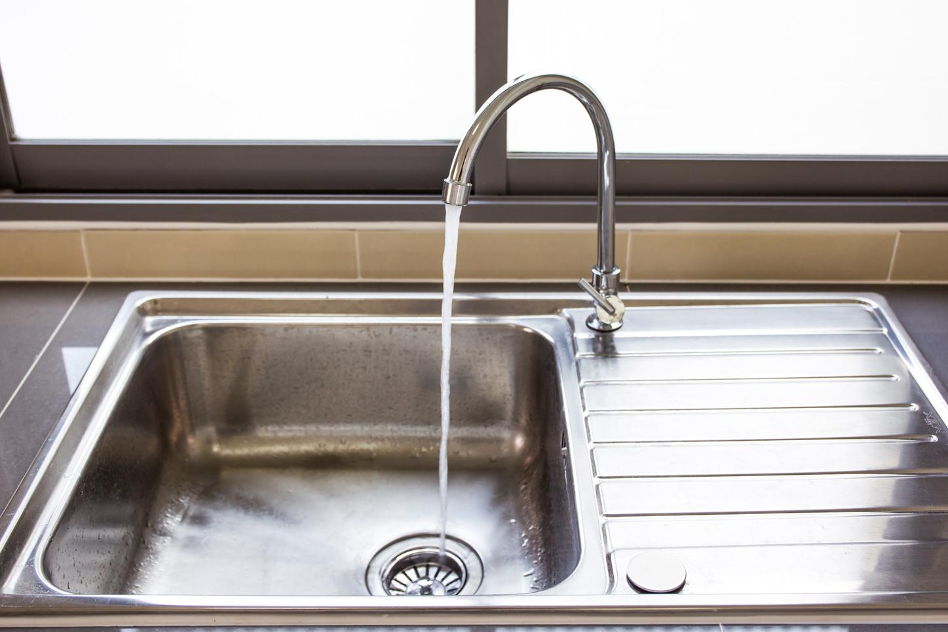
sink
To (cause something or someone to) go down below the surface or to the bottom of a liquid or soft substance

Slide 21

mirror
A piece of glass with a shiny, metal-covered back that reflects light, producing an image of whatever is in front of it

Slide 22
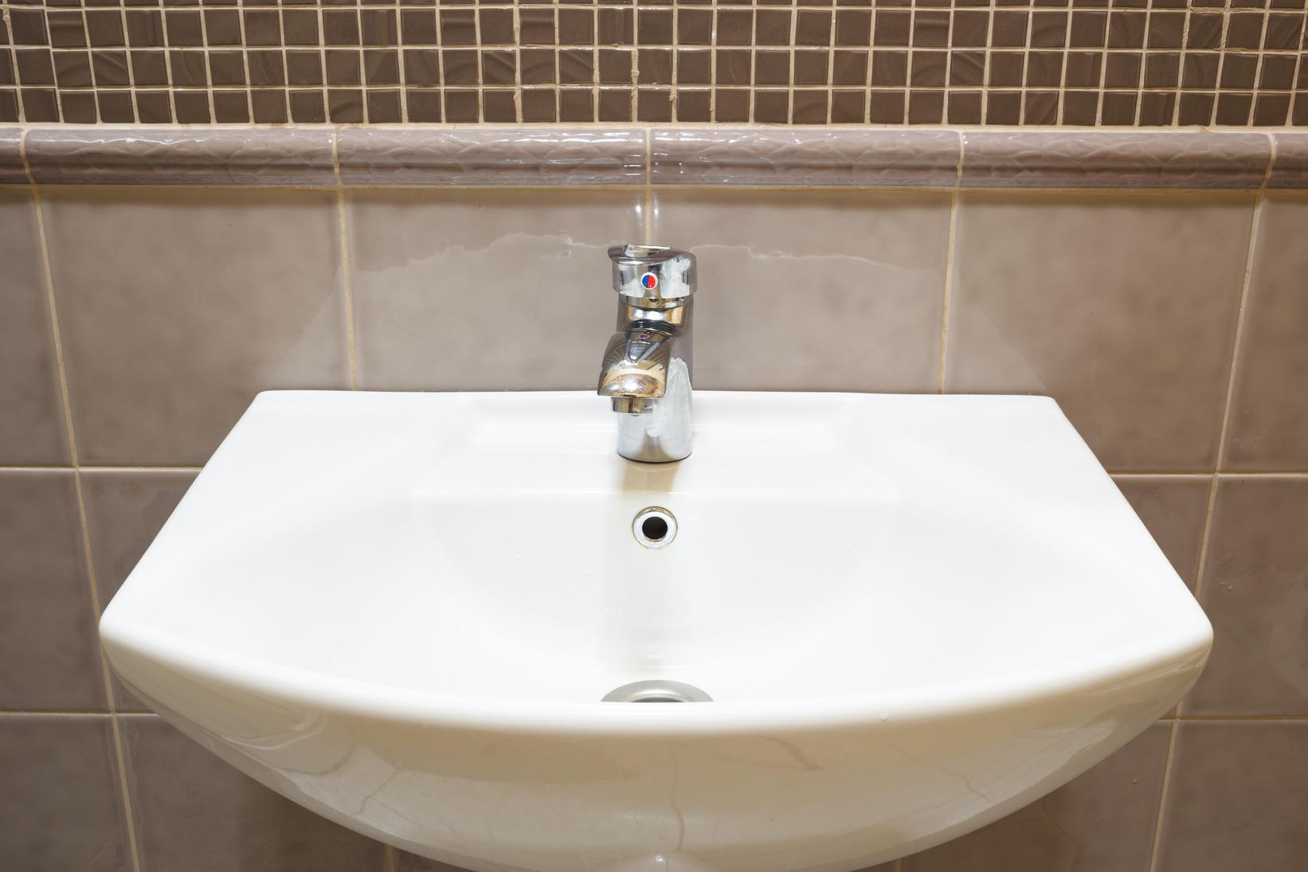
washbasin
A bowl that is attached to the wall in a bathroom or near a toilet and has pipes to supply and carry away water, in which you wash your hands, face, etc.

Slide 23
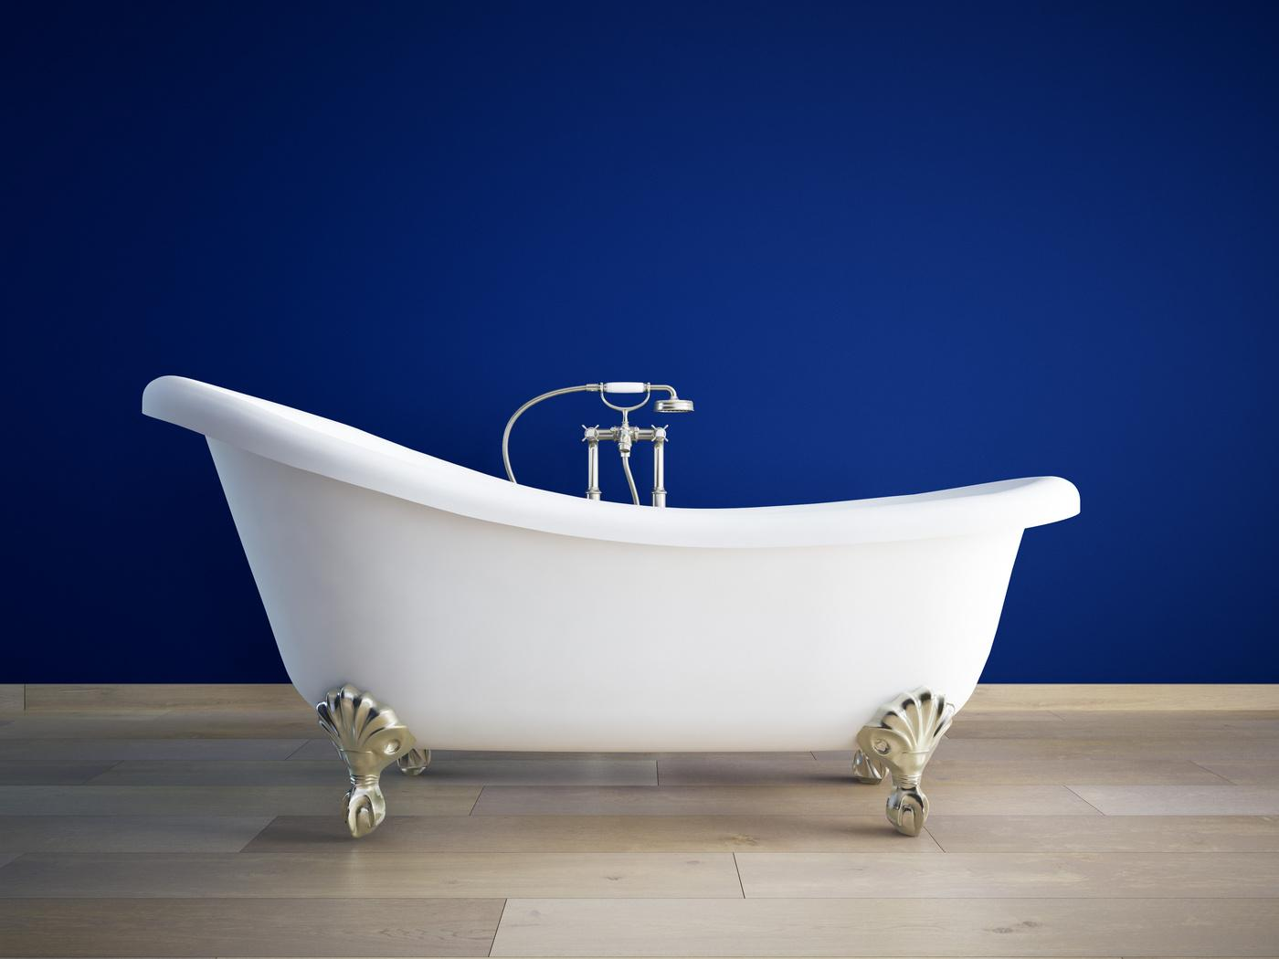
bathtub
A long plastic, metal, or ceramic container that is filled with water so that you can sit or lie in it to wash your whole body

Slide 24

lamp
A device for giving light, especially one that has a covering or is contained within something

Slide 25
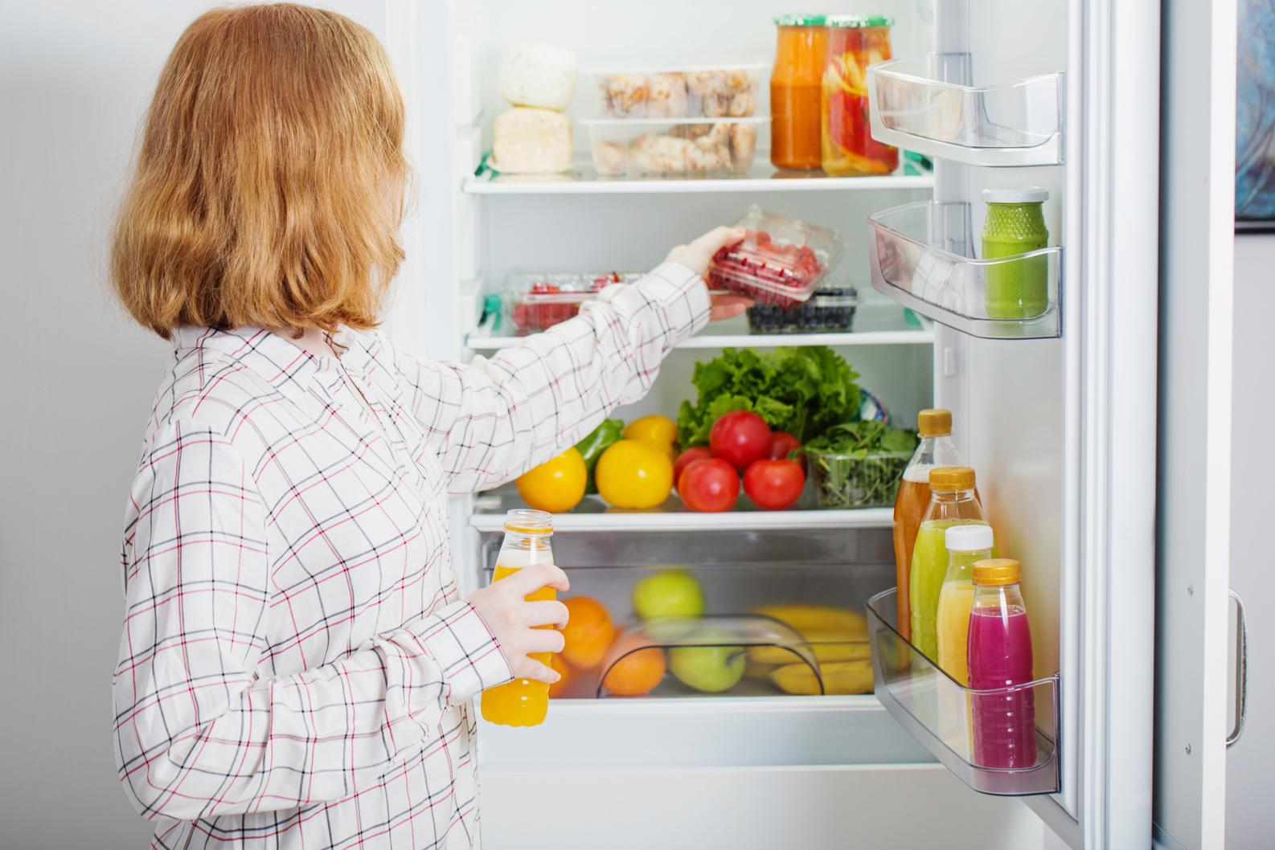
fridge
A piece of kitchen equipment that uses electricity to preserve food at a cold temperature

Slide 26
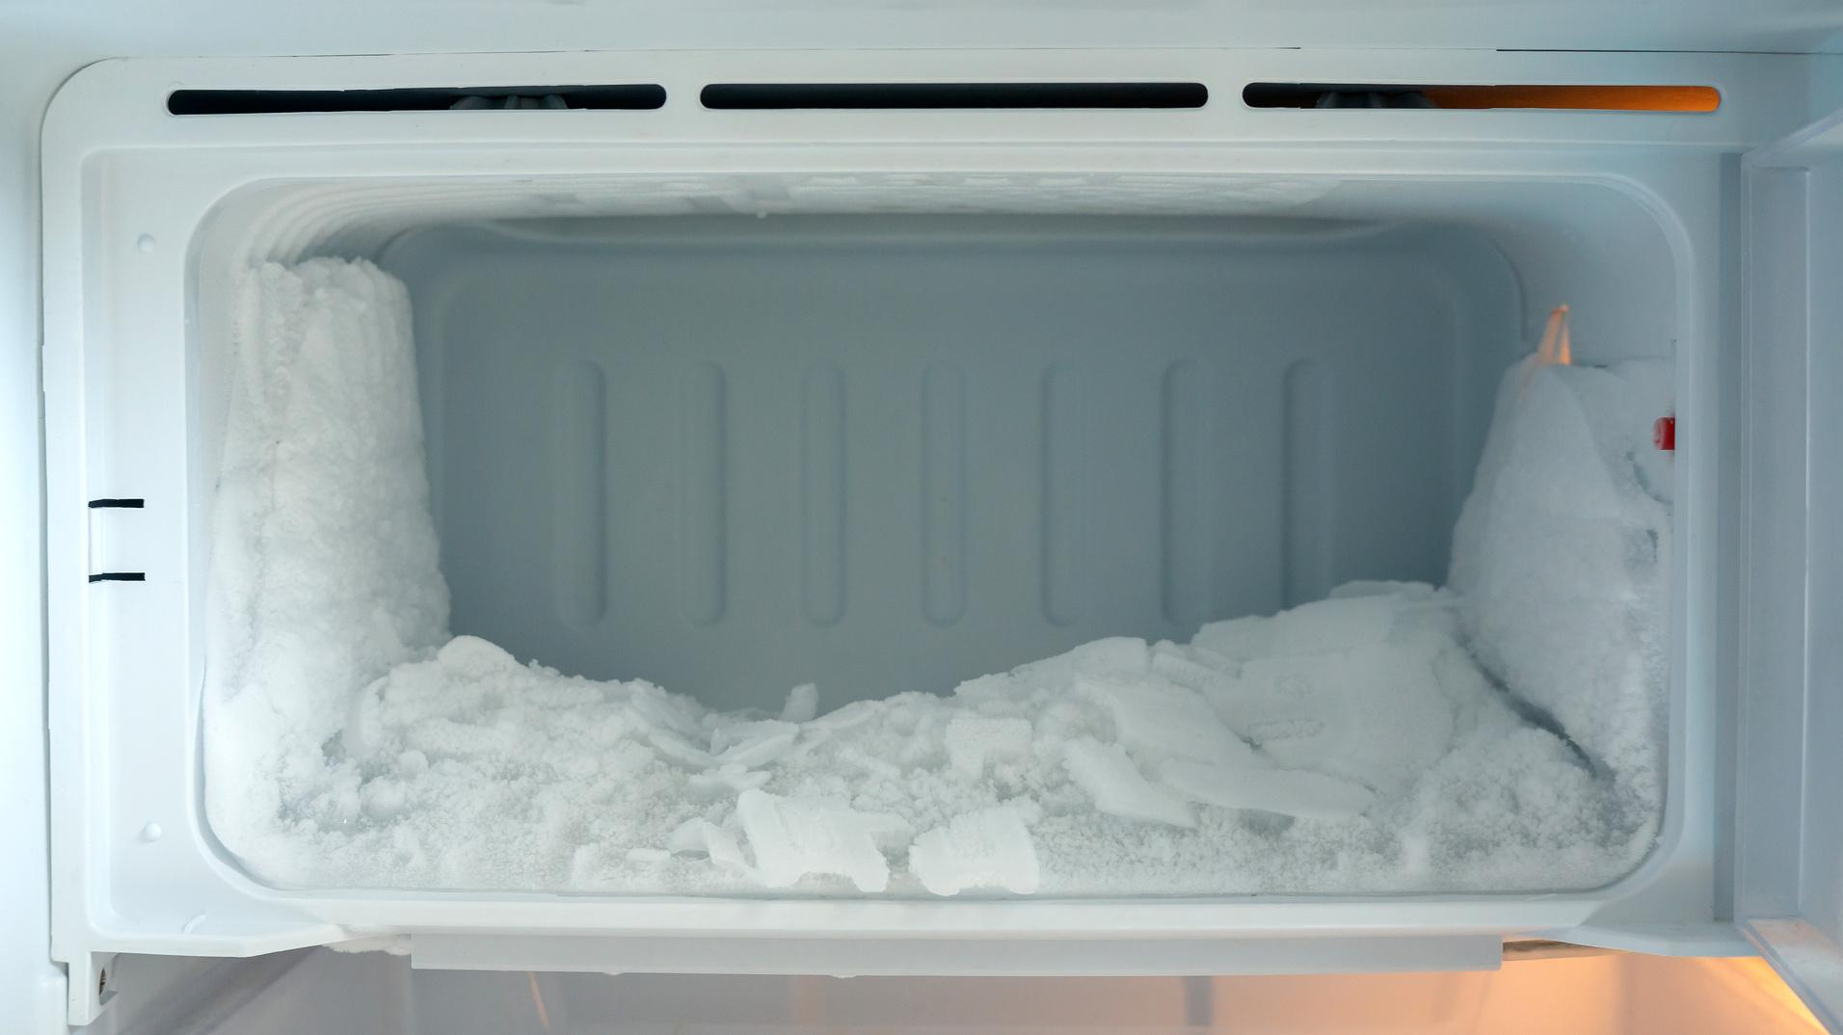
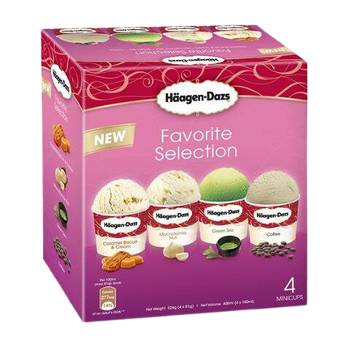
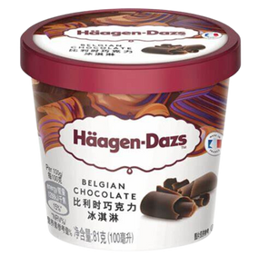
freezer
A container, operated by electricity, that stores food at a very cold temperature so that it becomes solid and can be kept safely for a long time

Slide 27
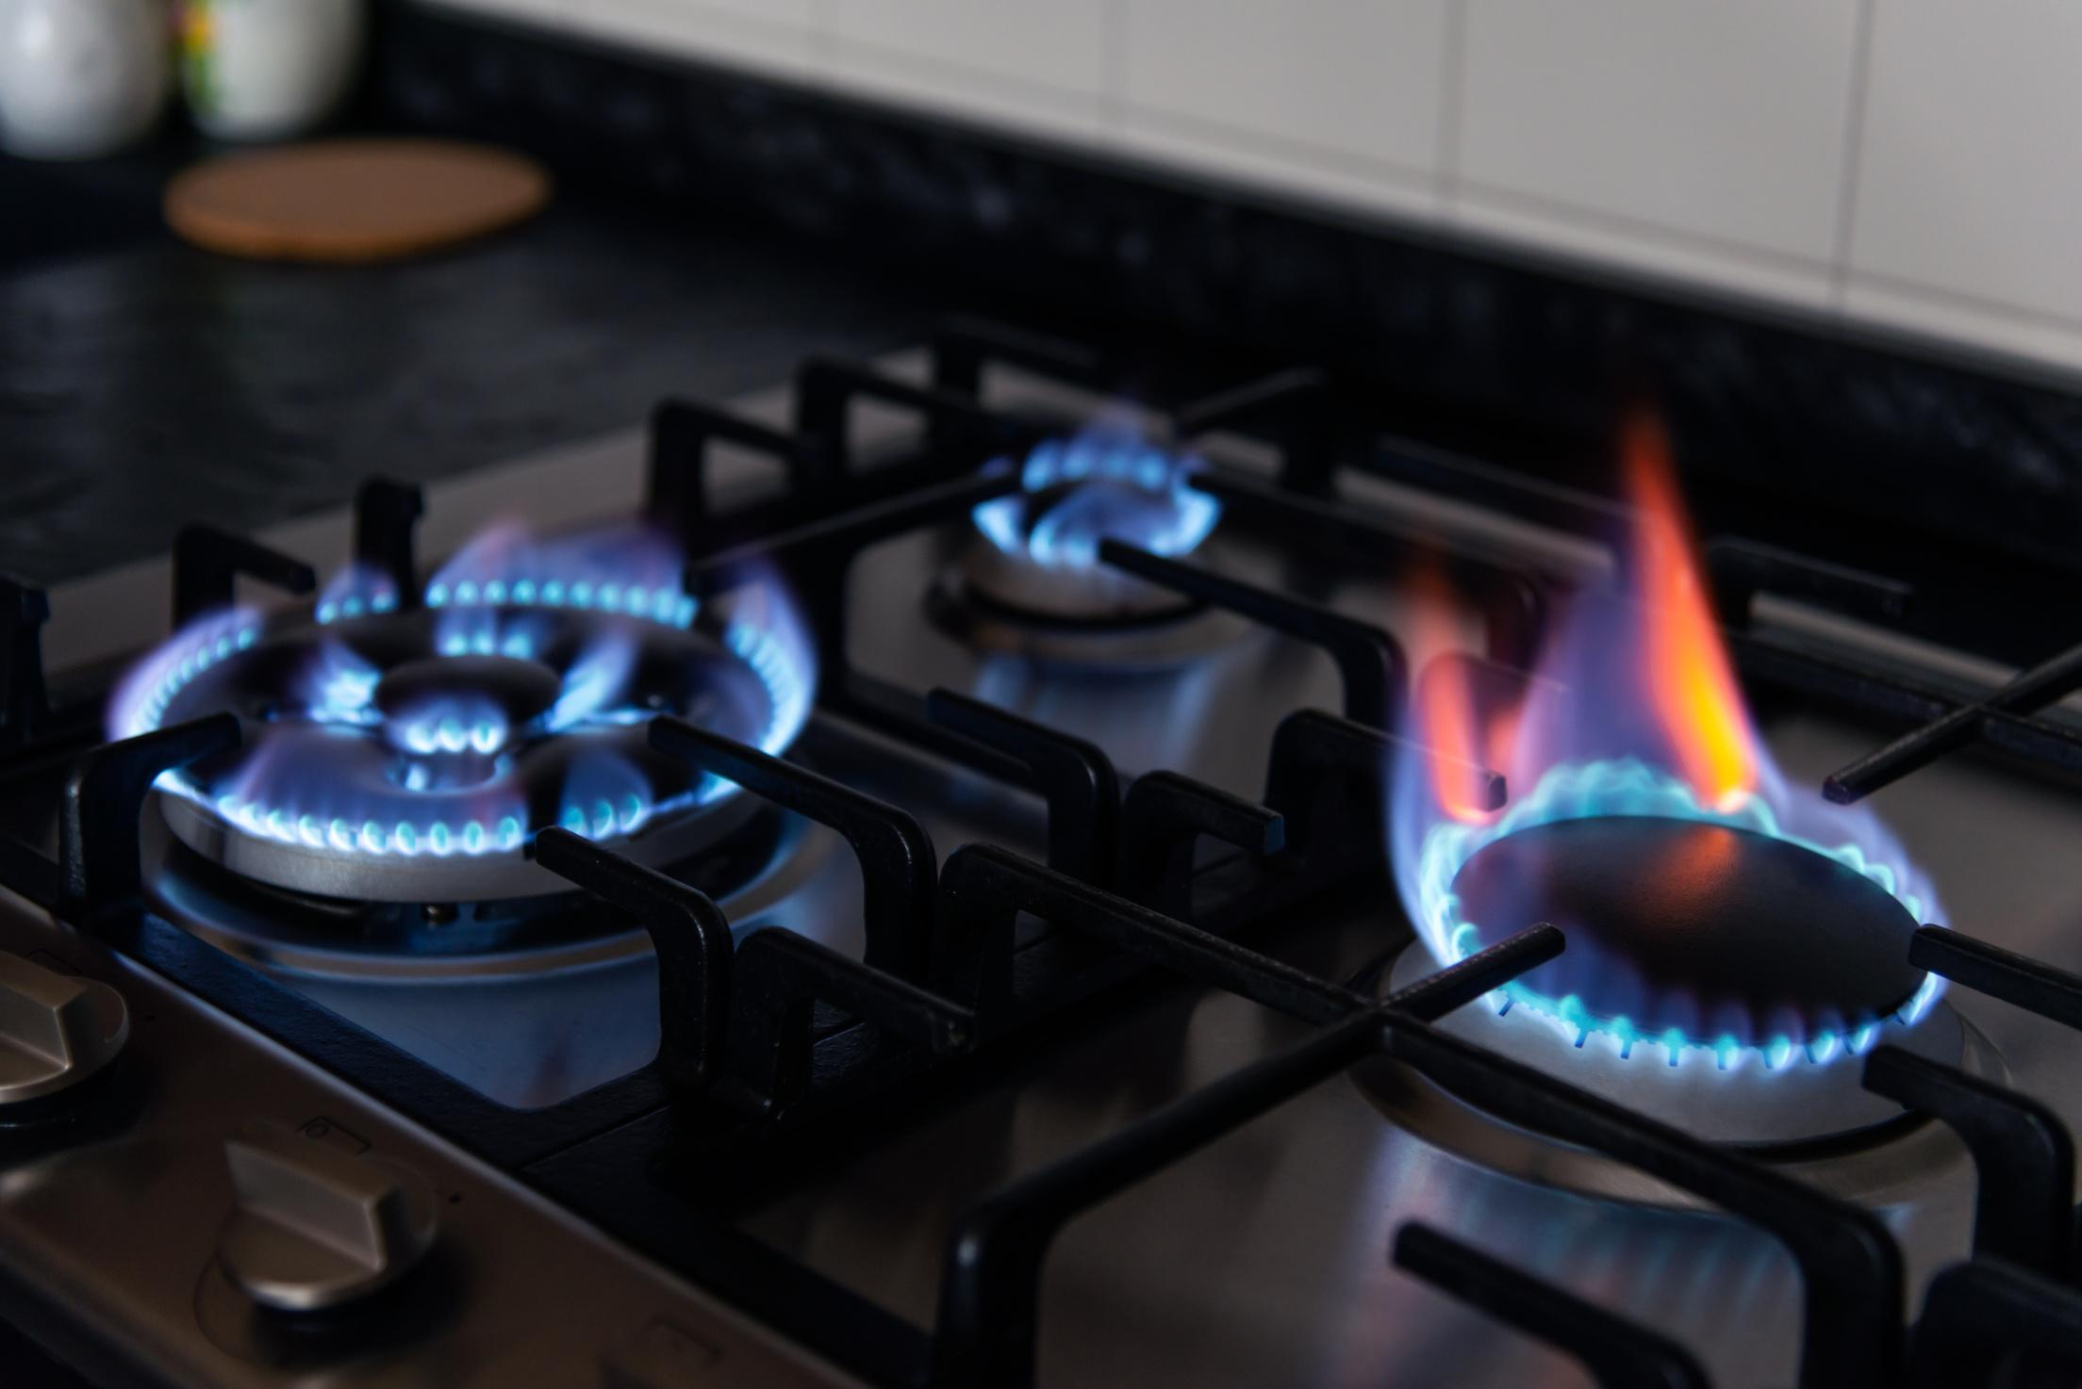
stove
A piece of kitchen equipment that uses electricity to preserve food at a cold temperature

Slide 28
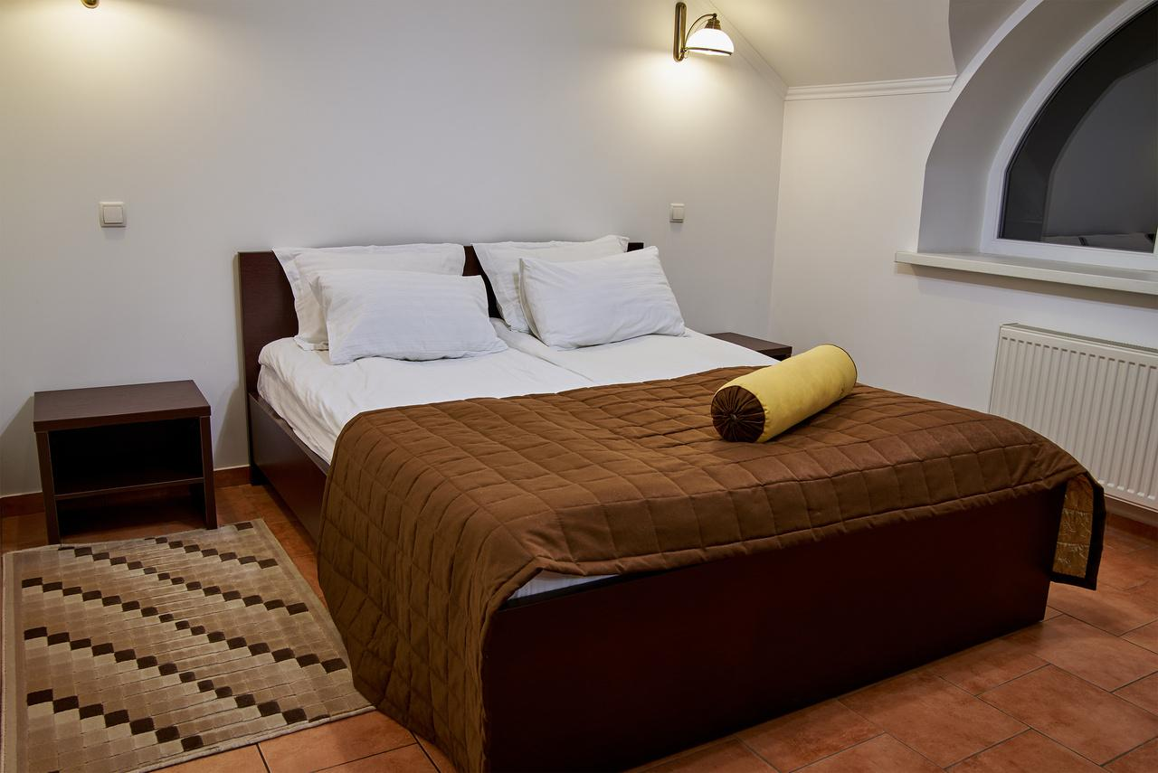
double bed
A bed big enough for two people to sleep in

Slide 29
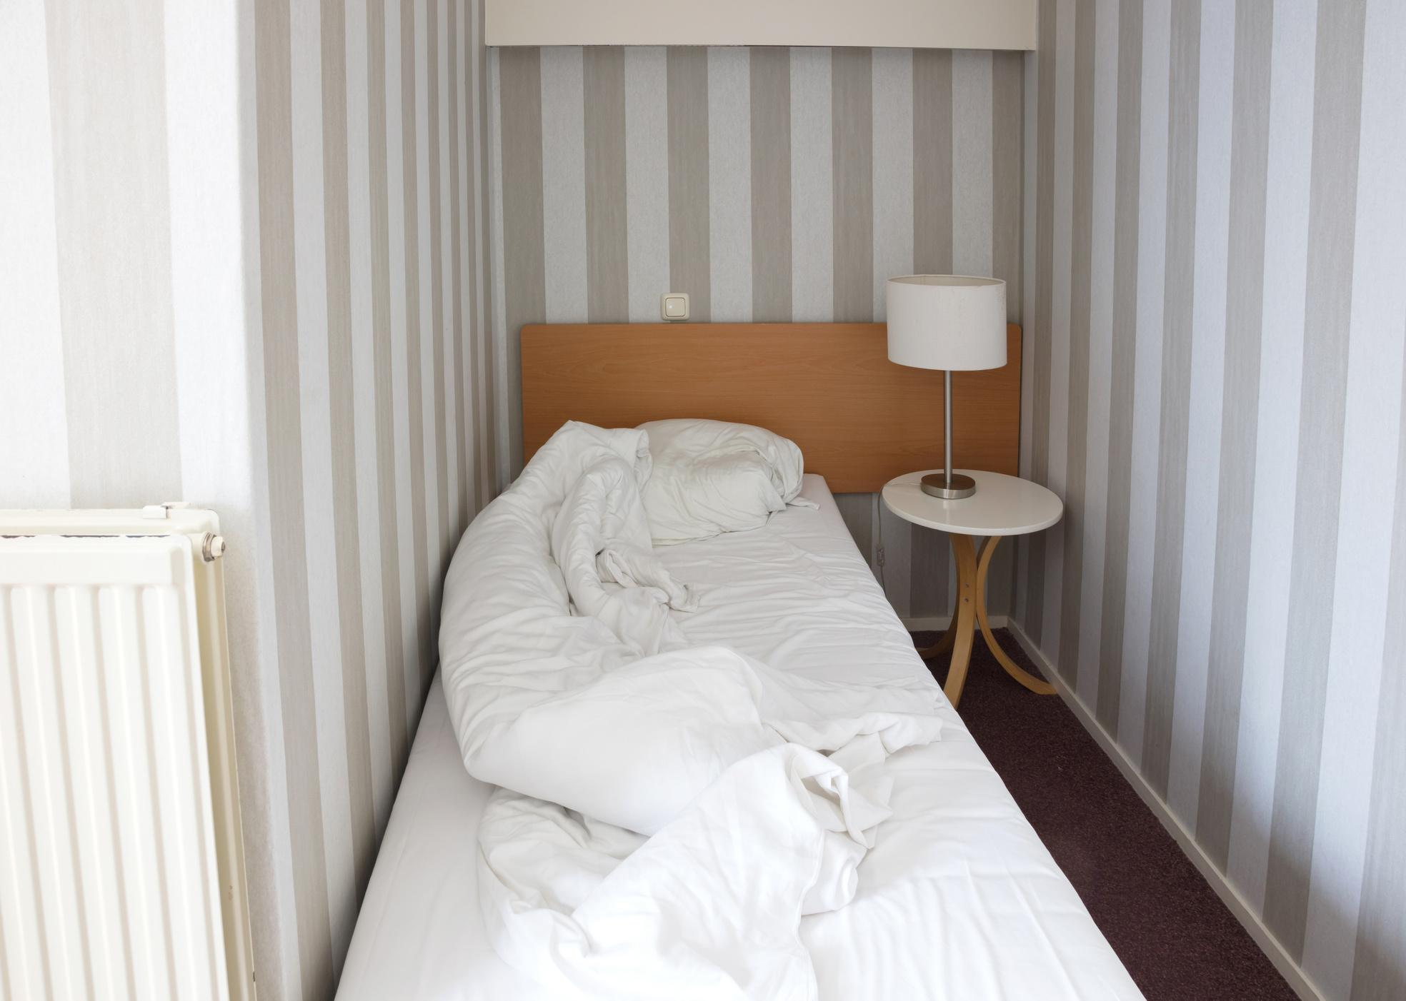
single bed
A bed for one person

Slide 30

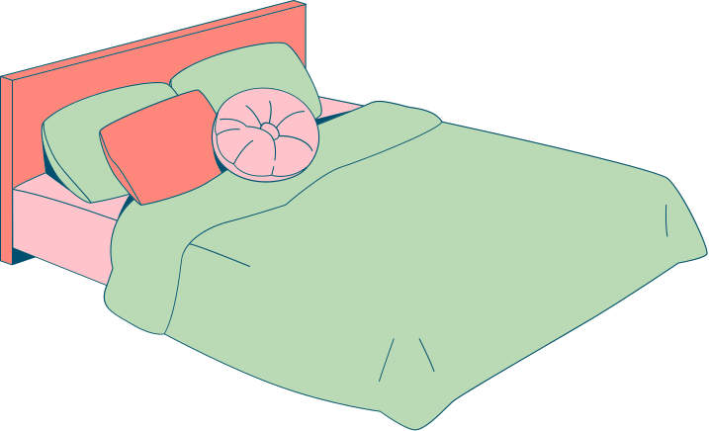
HIDE AND SEEK OBJECTS
Material
  mini picture of household object
  Hide mini pictures of household objects around the classroom
  Find the object
  Correctly identify them using “Point to the…” and “Touch the …”expression

Slide 31



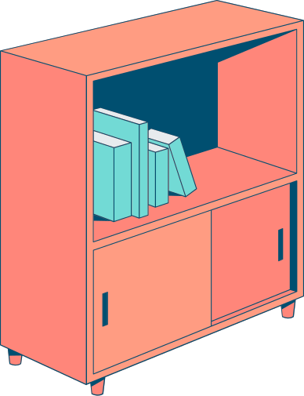
DIALOGUE PRACTICE 1
Pair up students and distribute a set of picture cards to each pair
Practise the dialogue,
“Point to the ….”, “ Touch the…”
Continue the dialogue practice using different picture cards

Slide 32
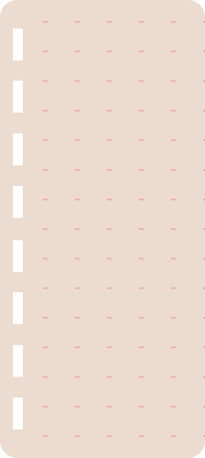
Material
PASS AND TELL
  Household object
  Sit in a circle
  Pass a household object around the circle
  When receives the object
  Must use “Give me the…”and “Show me the …” expressions to identify it

Slide 33
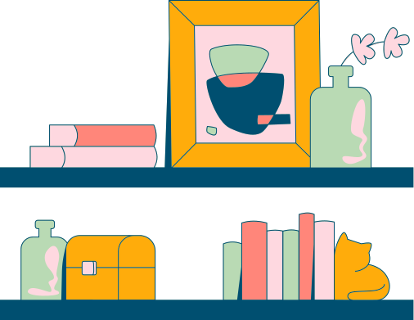
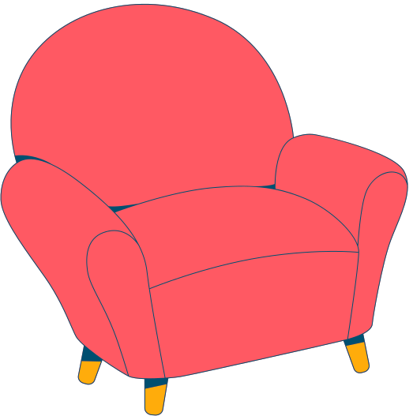
DIALOGUE PRACTICE 2
Pair the student and distribute a new set of picture card
Practice the dialogue ,”Give me the …”and “SHow me the…” using the picture in card
Continue the dialogue practice using different picture

Slide 34

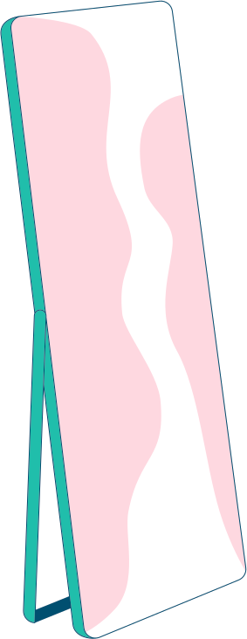

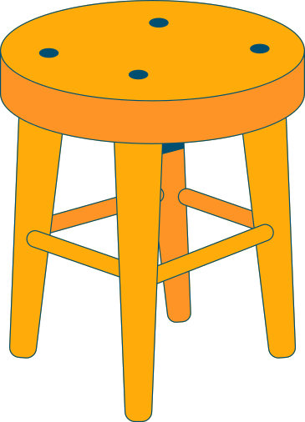
DRAW AND INTRODUCE
Instruct students to draw a room in their house on a piece of paper and label the objects in the room. Encourage each student to stand up, show their drawing , and describe it using the target language

Slide 35



LETS REVIEW!
  Number 1 - 20
  Point to the…
  Give me the…
  Touch the…
  Show me the…
  window, bed, shelf, cupboard, table, chair, sofa, TV, toilet, shower, door

Slide 36

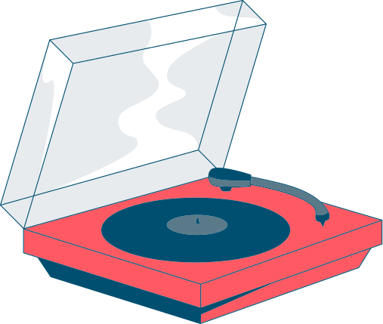

GREAT EFFORT!
See you next lesson!

