Slide 1




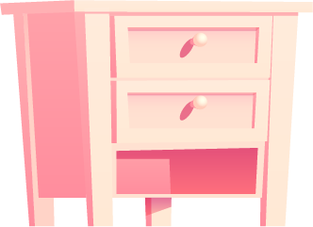
LESSON 5
Dream House Delight
Trinity GESE Grade 1 Prep
Prepared by Imperial Academy

Slide 2
Course: Trinity GESE Grade 1 Prep
Lesson 5: Dream House Delight
## Course Duration: 16 lessons
## Lesson Duration: 1.5 hours per lesson
## Age: ESL aged 6 to 8
## Class Size: 8 – 12
## Function: Describing my house
## Materials List:
1. Lesson PowerPoint
2. Lesson Worksheet
3. Pictures of household rooms and objects (windows, beds, shelves, cupboards, tables, chairs, doors)
## Target Language:
- What’s this? It’s …
- What are these? They’re …
- Show and tell: This is… There is/are… in ….
- Singular and plural: windows, beds, shelves, cupboards, tables, chairs, doors
- extension vocabulary: big (spacious), small (compact), beautiful, cosy, clean, messy, bright, colourful, comfortable
# Lesson Procedure:
## 1. Warm-up (10 mins)
Begin the lesson with an energetic greeting. Using the Lesson PowerPoint, introduce the topic and target language. Prompt students to listen and repeat phrases like "What's this? It's a...", "What are these? They're..." to practice pronunciation.
## 2. Vocabulary Introduction (10 mins)
Utilise the Lesson PowerPoint to introduce the vocabulary of the lesson in the target language. Display pictures of different rooms and objects one by one and say their names aloud. Encourage students to repeat after you.
## 3. Activity 1 (10 mins)
Initiate a 'Room and Objects Matching' game. Display pictures of rooms and objects separately. Students must match the objects with the rooms they would put them in, using the target language "What’s this? It’s …".
## 4. Dialogue Practice 1 (15 mins)
**Part 1:** Pair up students and distribute a set of room and object picture cards to each pair. Ask them to practice the dialogue, "What’s this? It’s …" using the pictures on the cards.
**Part 2:** Form small groups and encourage them to continue the dialogue practice with different picture cards. Provide correction and guidance as necessary.
## 5. Activity 2 (10 mins)
Begin a 'Things in the Room' game. Display a picture of a room, students must identify the objects in the room using the target language "What are these? They’re …".
## 6. Dialogue Practice 2 (15 mins)
**Part 1:** Pair the students again and distribute a new set of room and object picture cards to each pair. Instruct them to practice the dialogue, "What are these? They’re …" using the pictures on the cards.
**Part 2:** Form small groups and encourage them to continue the dialogue practice with different picture cards. Provide correction and guidance as necessary.
## 7. My Talking Time (10 mins)
Instruct students to draw their dream house on a piece of paper and label the rooms and objects. Remind them to use all the vocabulary learned in Lesson 3 and 4. Encourage each student to stand up, show their drawing, and describe it using the target language "This is… There is/are… in …".
## 8. My Review Time (10 mins)
Review the lesson by displaying different pictures and prompting the target questions, "What’s this? It’s …", "What are these? They’re …" to individual students. Encourage them to respond using the target language. Provide praise and correction as necessary.
# Remarks:
Teachers, please note that during the 'My Talking Time' activity, remind students that the dream house they share is not necessarily their actual home. This is important to respect the privacy of students. Additionally, remind all students to be a respectful audience during their classmates' presentations.
This plan aims to develop students' English language skills related to describing their dream houses. Activities are designed for the age and proficiency level, creating an engaging learning environment. The content aligns with the Trinity GESE Grade 1 exam requirements. The overall goal is to help students express themselves confidently in English.
Lesson Plan

Slide 3




Target Language
What’s this? It’s …
What are these? They’re …
Show and tell:
This is… There is/are… in …

Slide 4





extension vocabulary
big (spacious)
small (compact)
beautiful, cosy
clean, messy
bright
colourful
comfortable

Slide 5
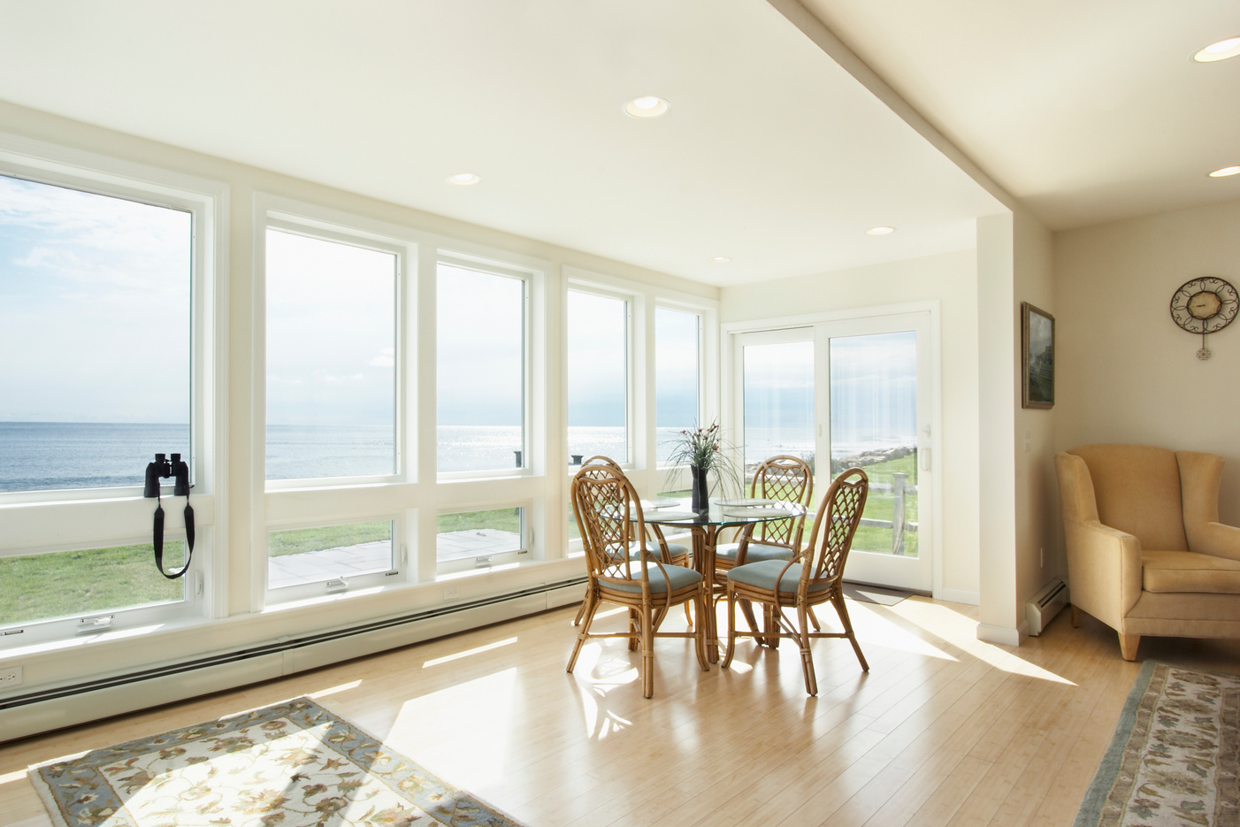
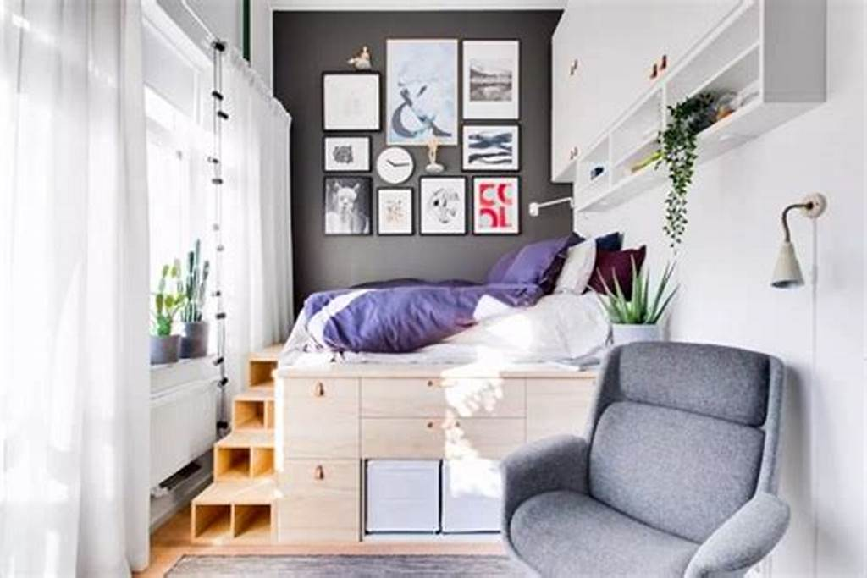
small(compact)
consisting of parts that are positioned
together closely or in a tidy way,
using very little space
big (spacious)
large and with a lot of space

Slide 6




beautiful
very attractive

Slide 7

cosy
comfortable and pleasant, especially (of a building)
because of being small and warm

Slide 8
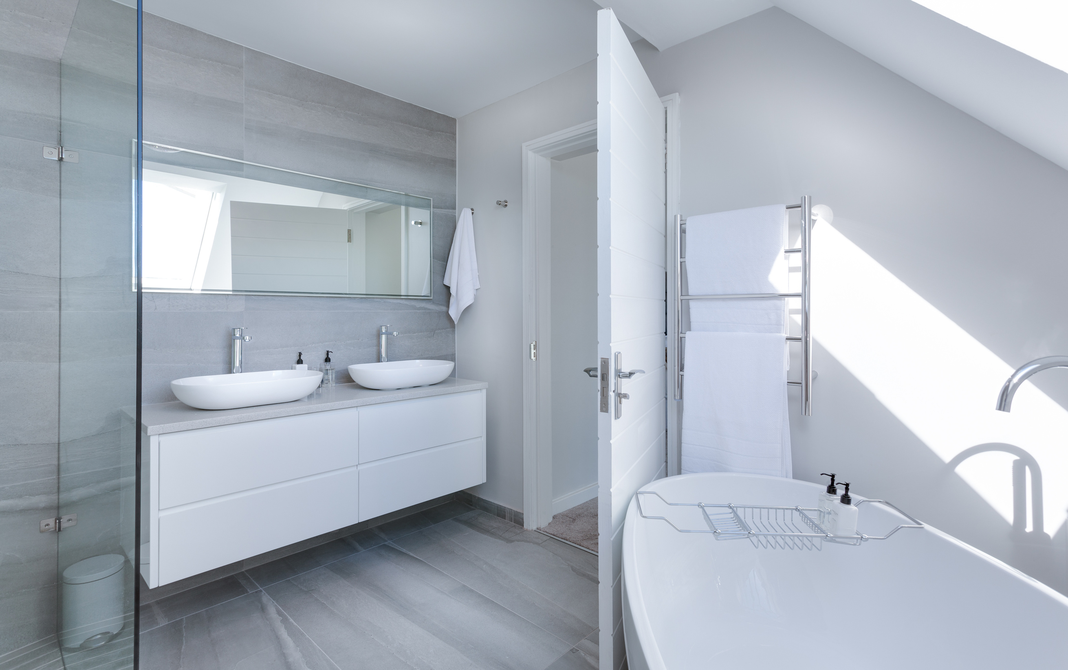

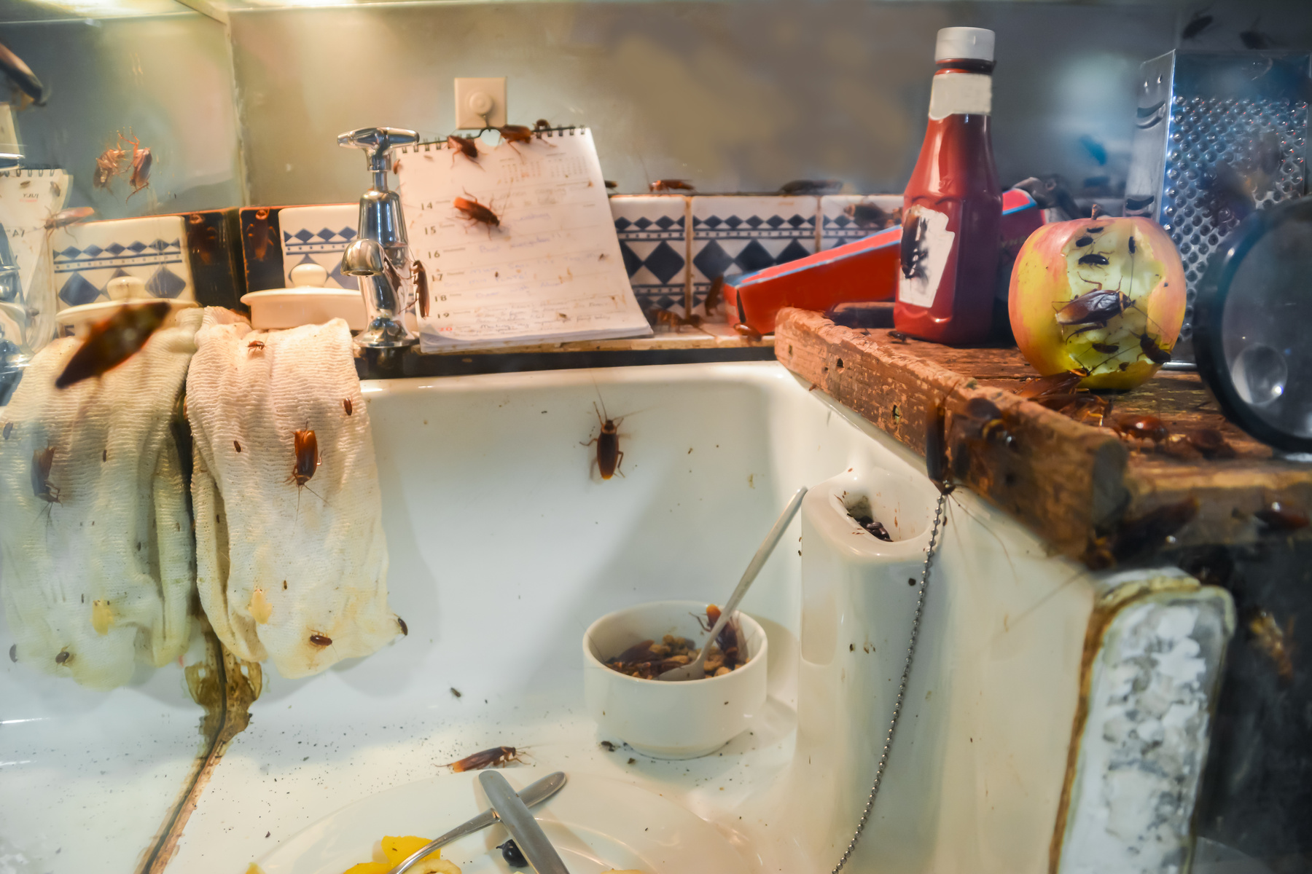
clean
free from any dirty marks,
pollution, bacteria, etc.

Slide 9
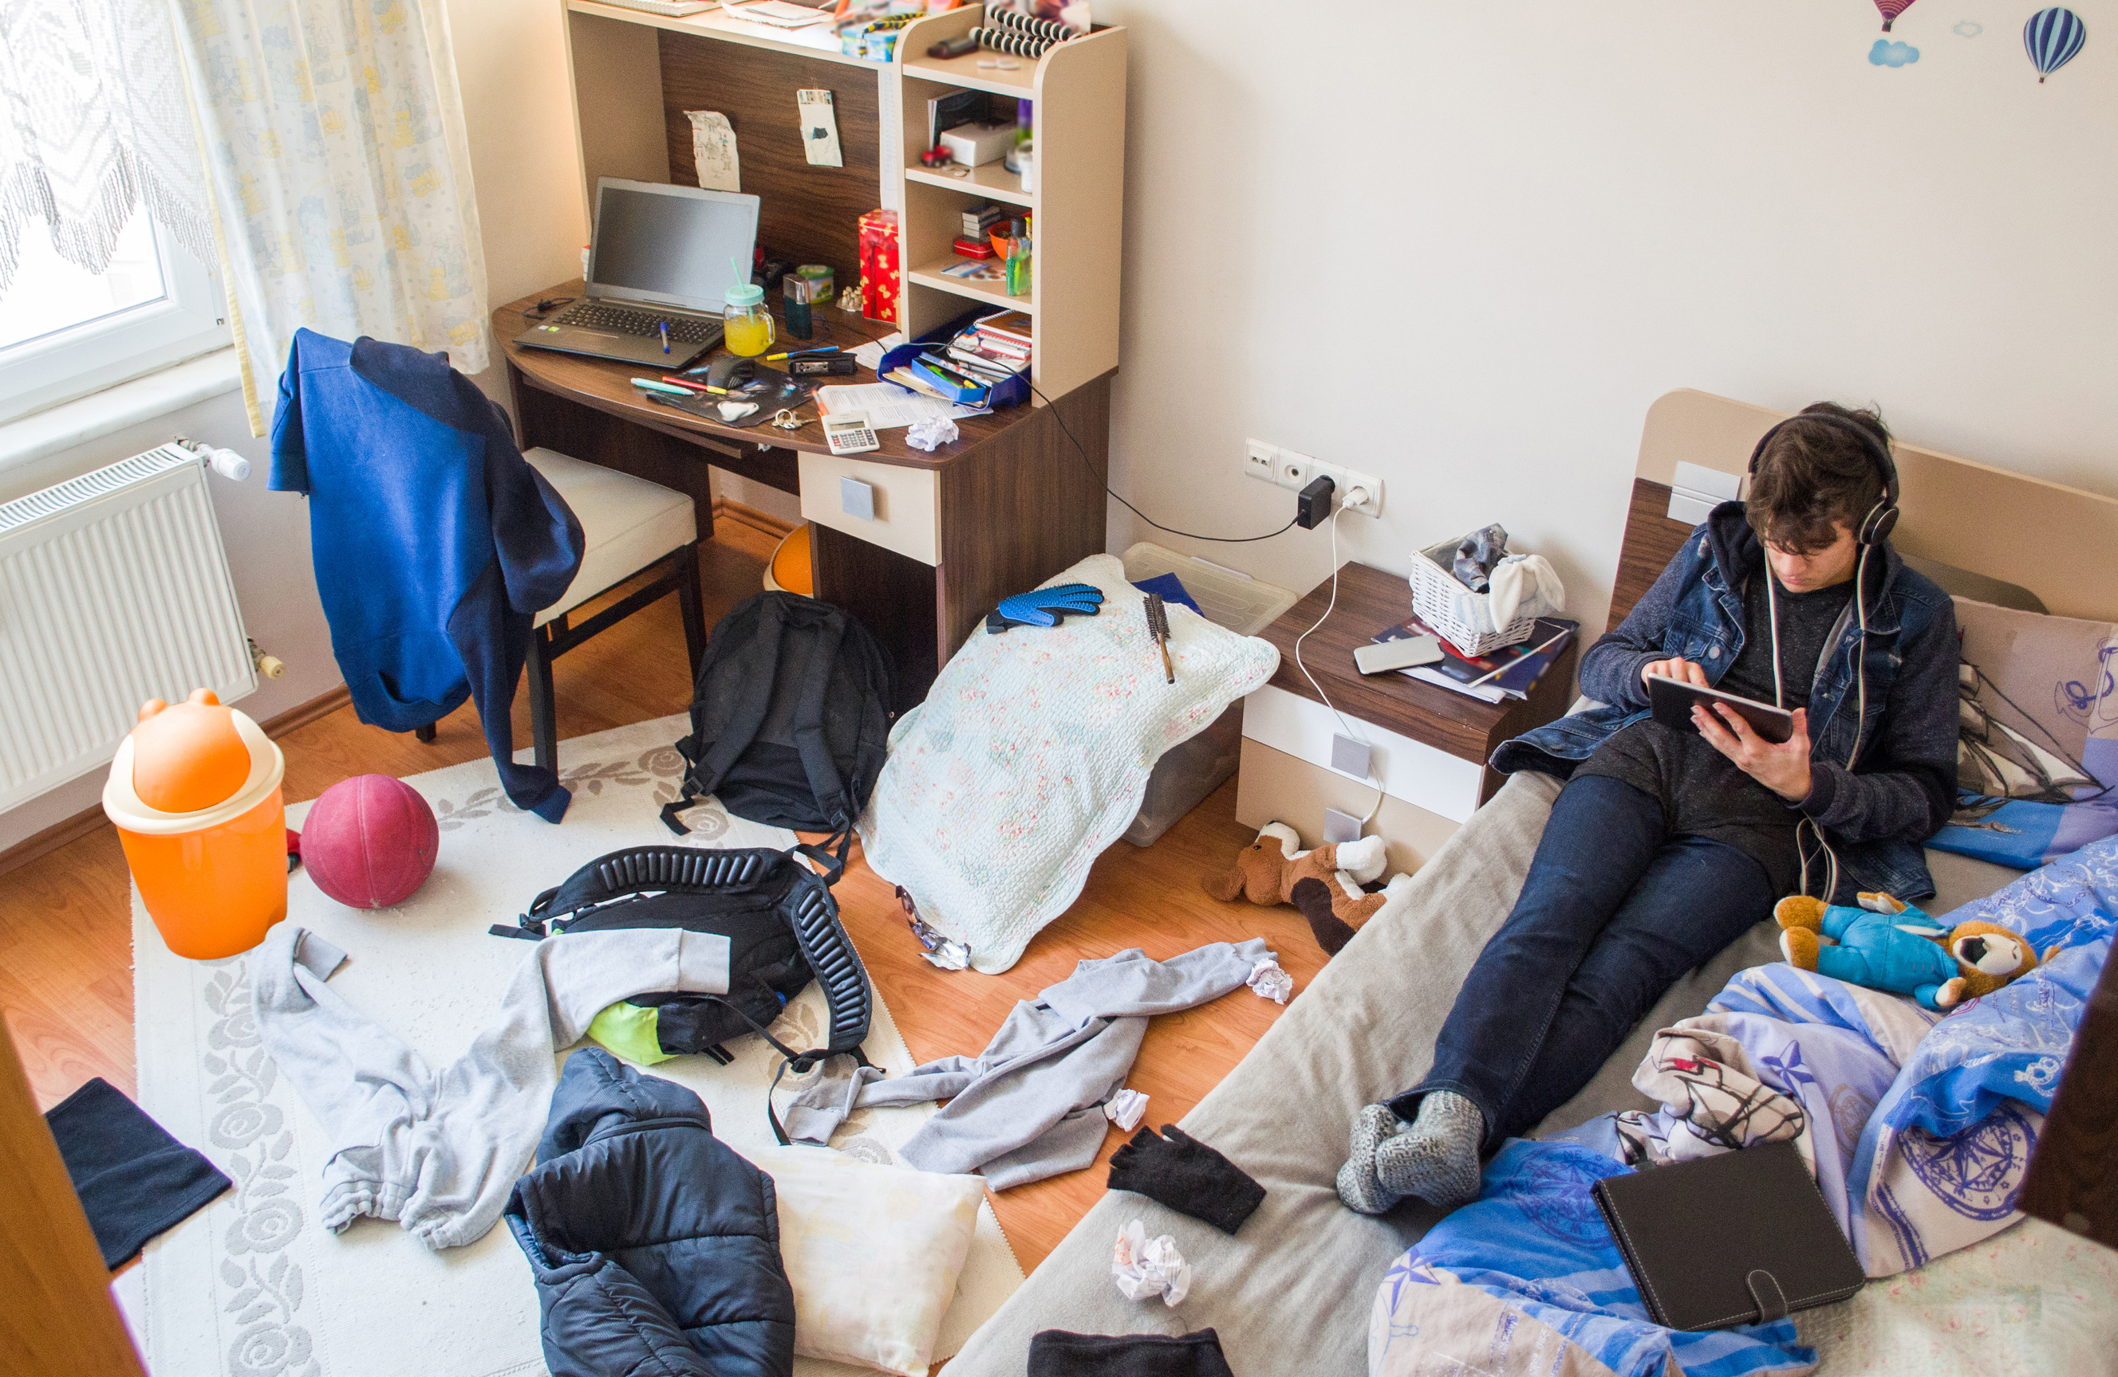
messy
untidy

Slide 10

colourful
having bright colours or a lot of different colours

Slide 11

comfortable
Comfortable furniture and clothes provide a pleasant
feeling and do not give you any physical problems

Slide 12


Activity 1: Room and Objects Matching
Display pictures of rooms and objects separately. Students must match the objects with the rooms they would put them in, using the target language "What’s this? It’s …".

Slide 13


Dialogue Practice 1
01
Pair up students and distribute a set of room and object picture cards to each pair. Ask them to practice the dialogue, "What’s this? It’s …" using the pictures on the cards.
02
Form small groups and encourage them to continue the dialogue practice with different picture cards. Provide correction and guidance as necessary.

Slide 14
Activity 2: Things in the Room
Display a picture of a room, students must identify the objects in the room using the target language "What are these? They’re …".

Slide 15
Dialogue Practice 2
Pair the students again and distribute a new set of room and object picture cards to each pair. Instruct them to practice the dialogue, "What are these? They’re …" using the pictures on the cards.
01
02
Form small groups and encourage them to continue the dialogue practice with different picture cards. Provide correction and guidance as necessary.

Slide 16

Draw and Introduce
Instruct students to draw their dream house on a piece of paper and label the rooms and objects. Remind them to use all the vocabulary learned in Lesson 3 and 4. Encourage each student to stand up, show their drawing, and describe it using the target language "This is… There is/are… in …".

Slide 17

Lets Review!
What’s this? It’s …
What are these? They’re …
Show and tell: This is… There is/are… in ….
Singular and plural: windows, beds, shelves, cupboards, tables, chairs, doors
extension vocabulary: big (spacious), small (compact), beautiful, cosy, clean, messy, bright, colourful, comfortable

Slide 18






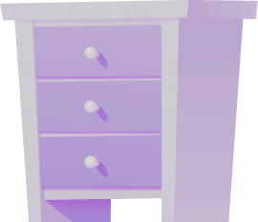

Great Effort!
SEE YOU NEXT LESSON

