Slide 1






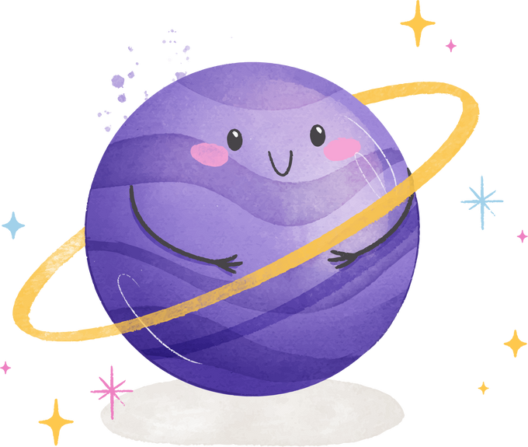
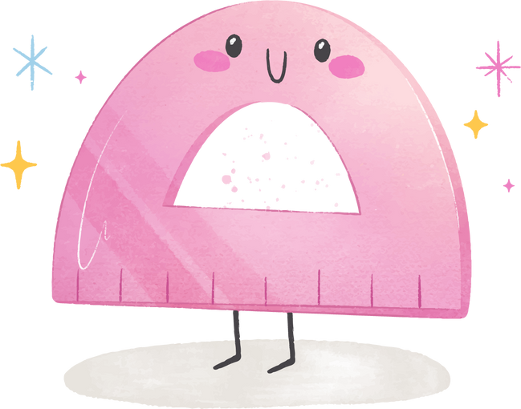

Lesson 6
My Special Things
Trinity GESE Grade 1 Prep
Prepared by Imperial Academy

Slide 2
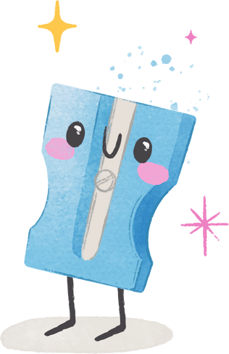



Target Language
- This is / These are my…
- my/your/his/her/our/their
- Is this my/your …?
- Yes, they are. / No, they aren’t.
- ball, hat, doll, bag, books, eraser, pen, watch

Slide 3




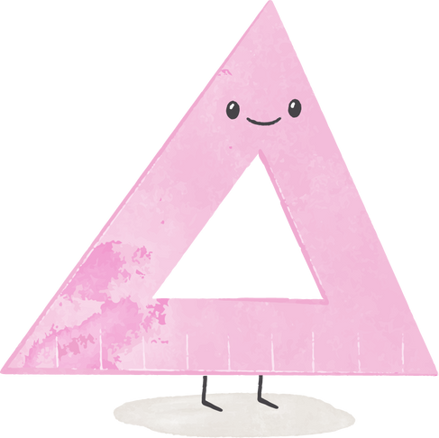





Target
Vocabulary
books
eraser
pen
watch
ball
hat
doll
bag

Slide 4
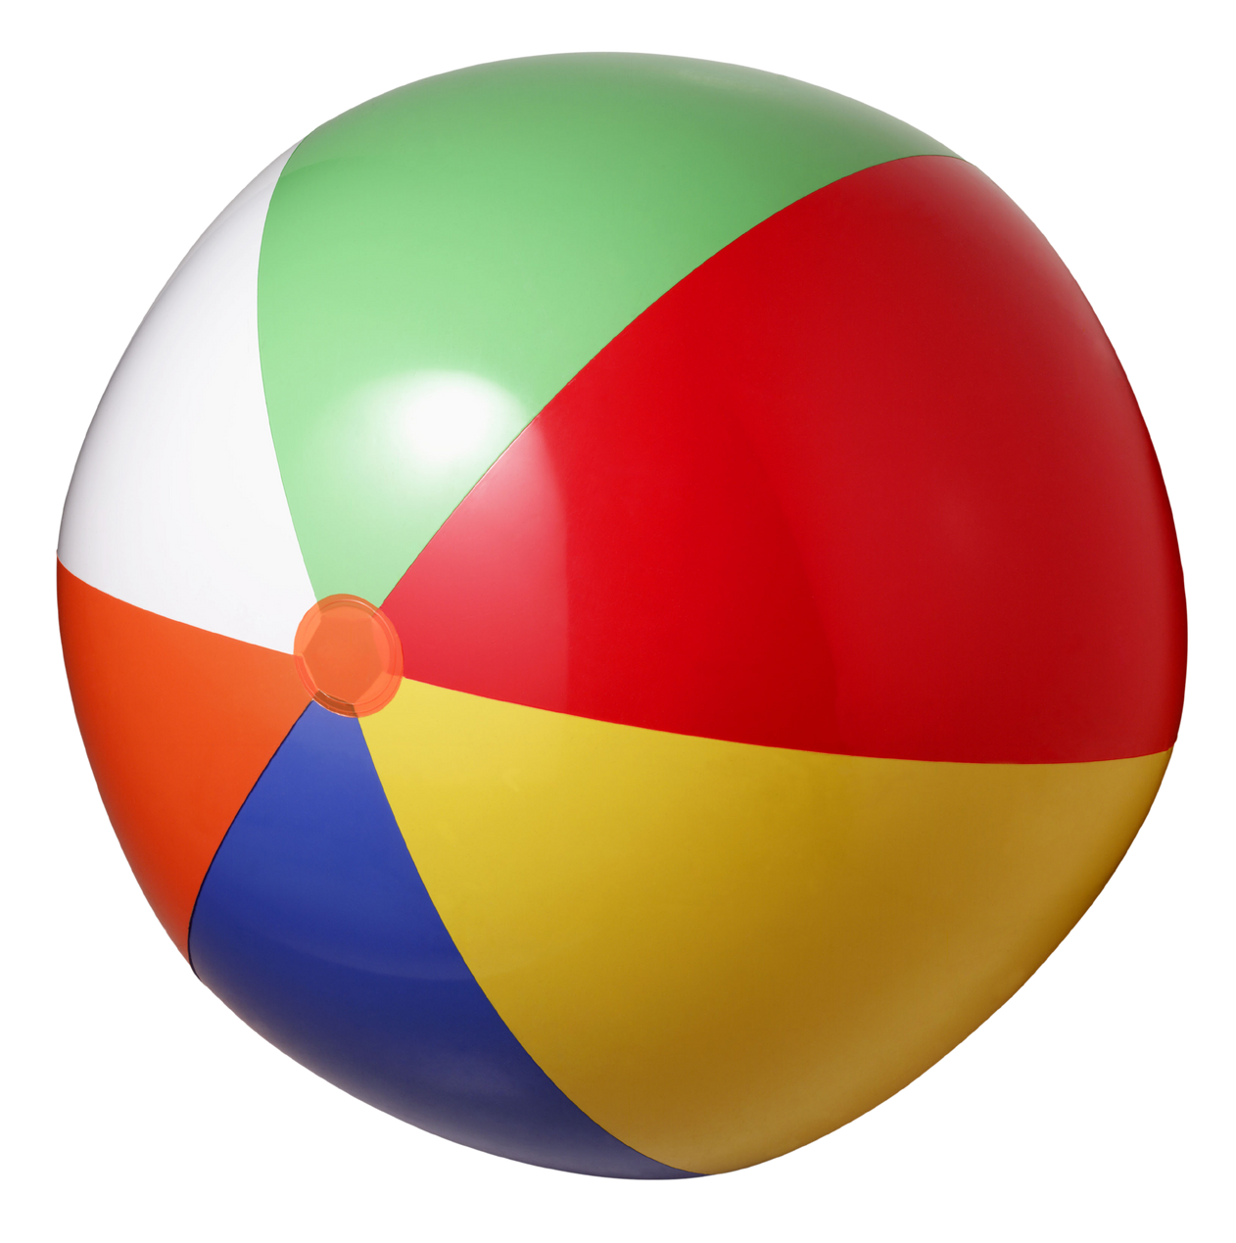
ball
A round object that you throw, kick, or hit in a game,
or something with this shape

Slide 5
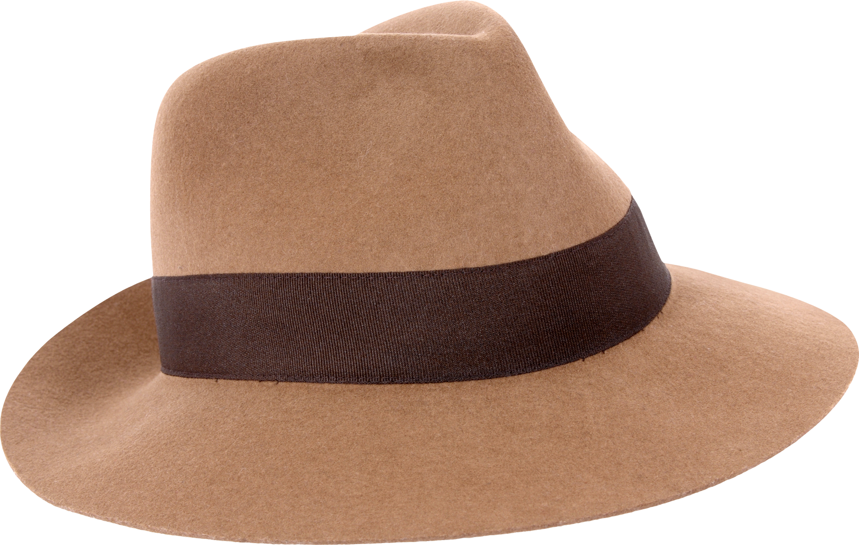
hat
Something you wear to cover your head,
for fashion or protection

Slide 6
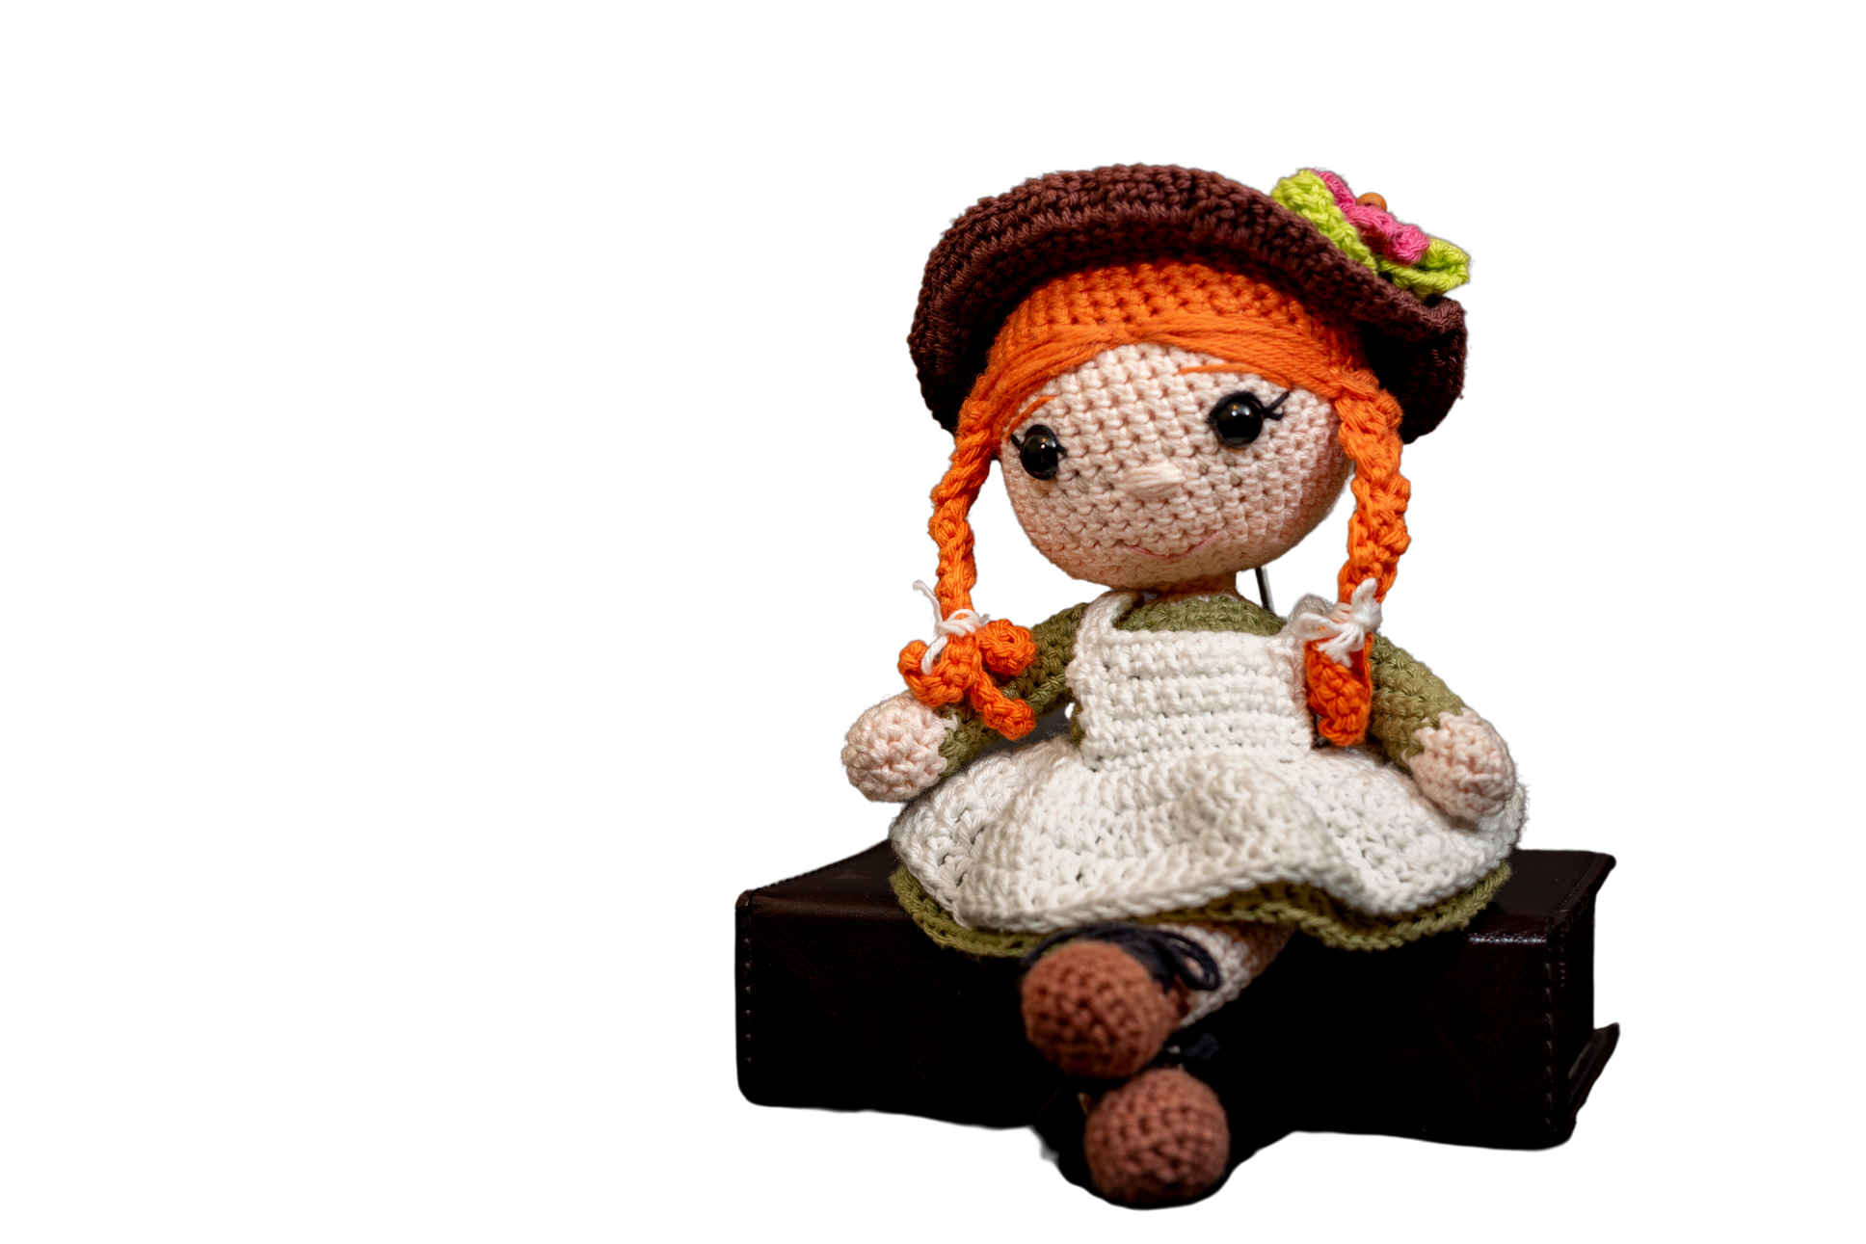
doll
A child's toy that looks like a small person

Slide 7
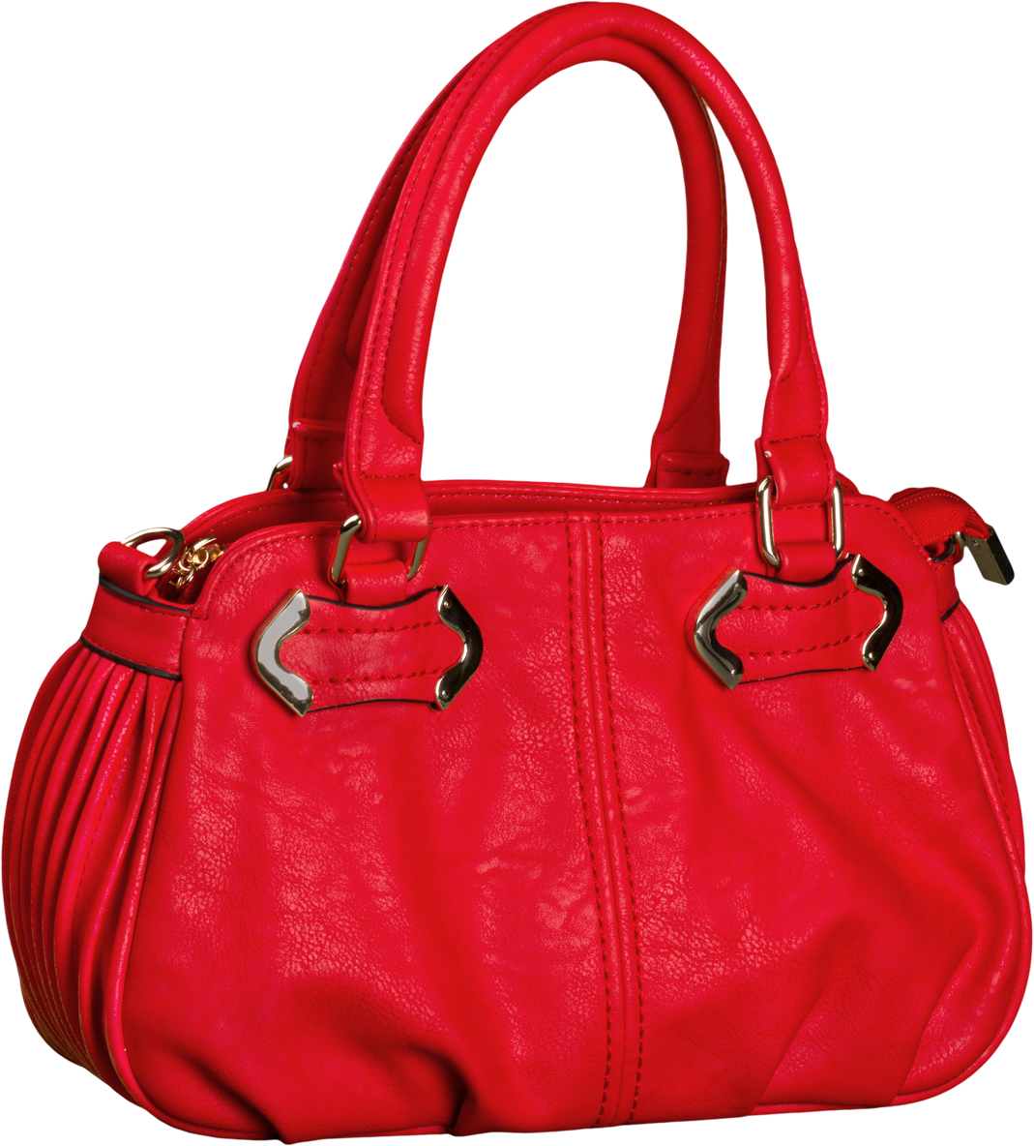
bag
A container made of paper, plastic, etc,
used for carrying things

Slide 8

books
the written financial records of a business or organization

Slide 9
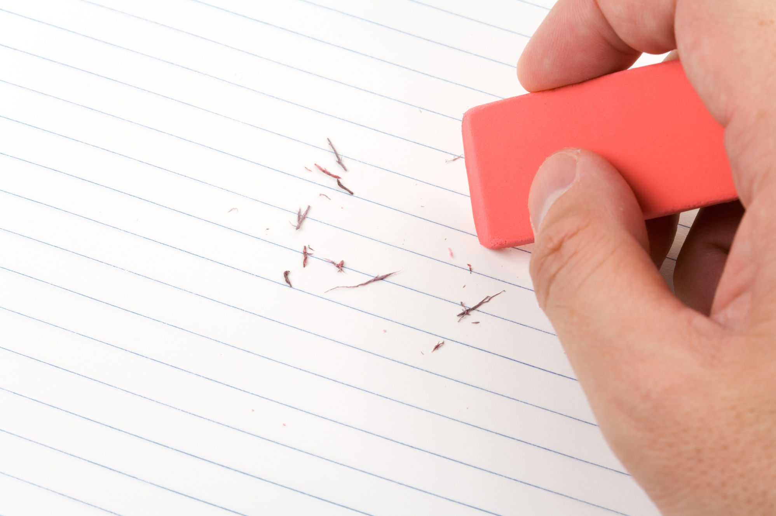
eraser
A small object that is used to remove pencil marks from paper

Slide 10
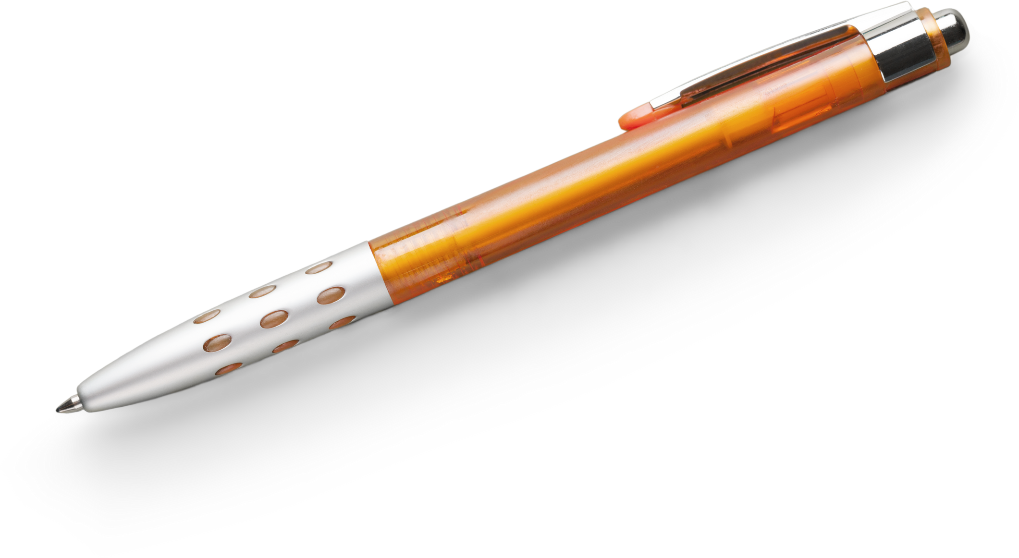
pen
A long, thin object that you use to write or draw in ink

Slide 11
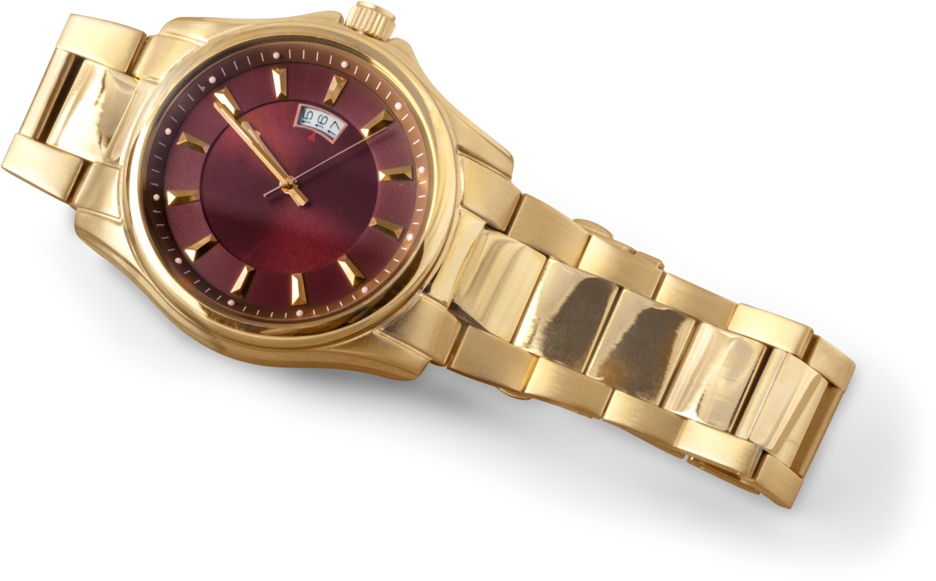
watch
To look at something for a period of time

Slide 12



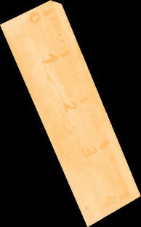
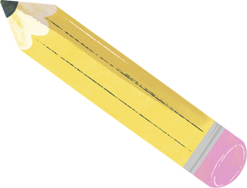




Vocabulary Extension
backpack
pencil
notebook
keys
calculator
tablet
mobile phones
water bottle
lunch box
sunglasses
hairbrush
toothbrush
bicycle
scooter
wallet
headphones

Slide 13
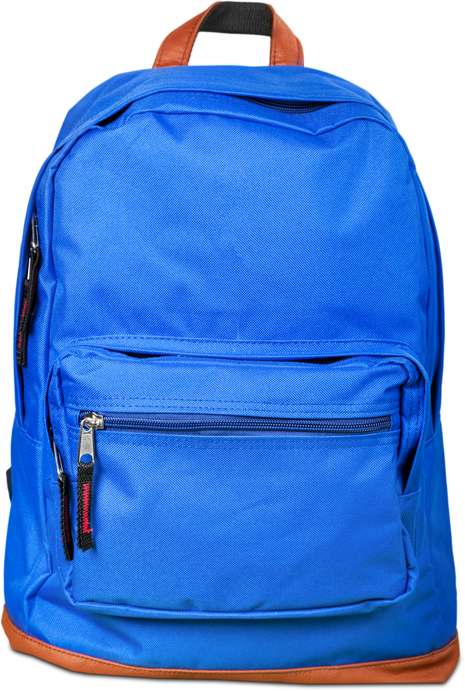
backpack
A bag that you carry on your back

Slide 14
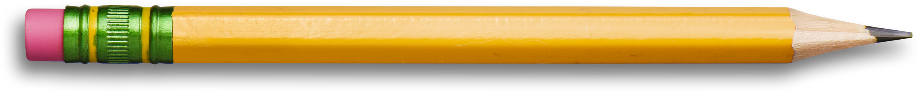
pencil
A long, thin wooden object with a black or
coloured point that you write or draw with

Slide 15

notebook
A book with empty pages that you can write in

Slide 16
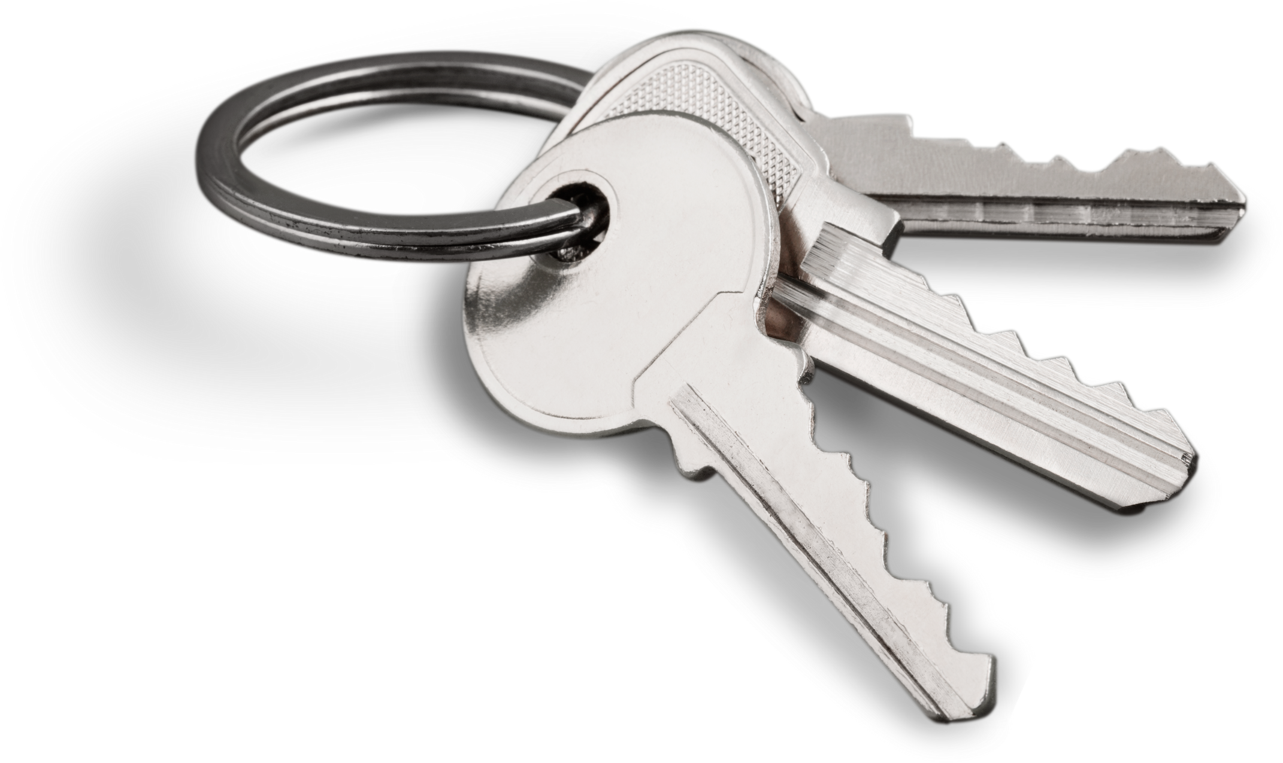
keys
A metal cut into a particular shape and used for locking things such as doors, or for starting an engine

Slide 17
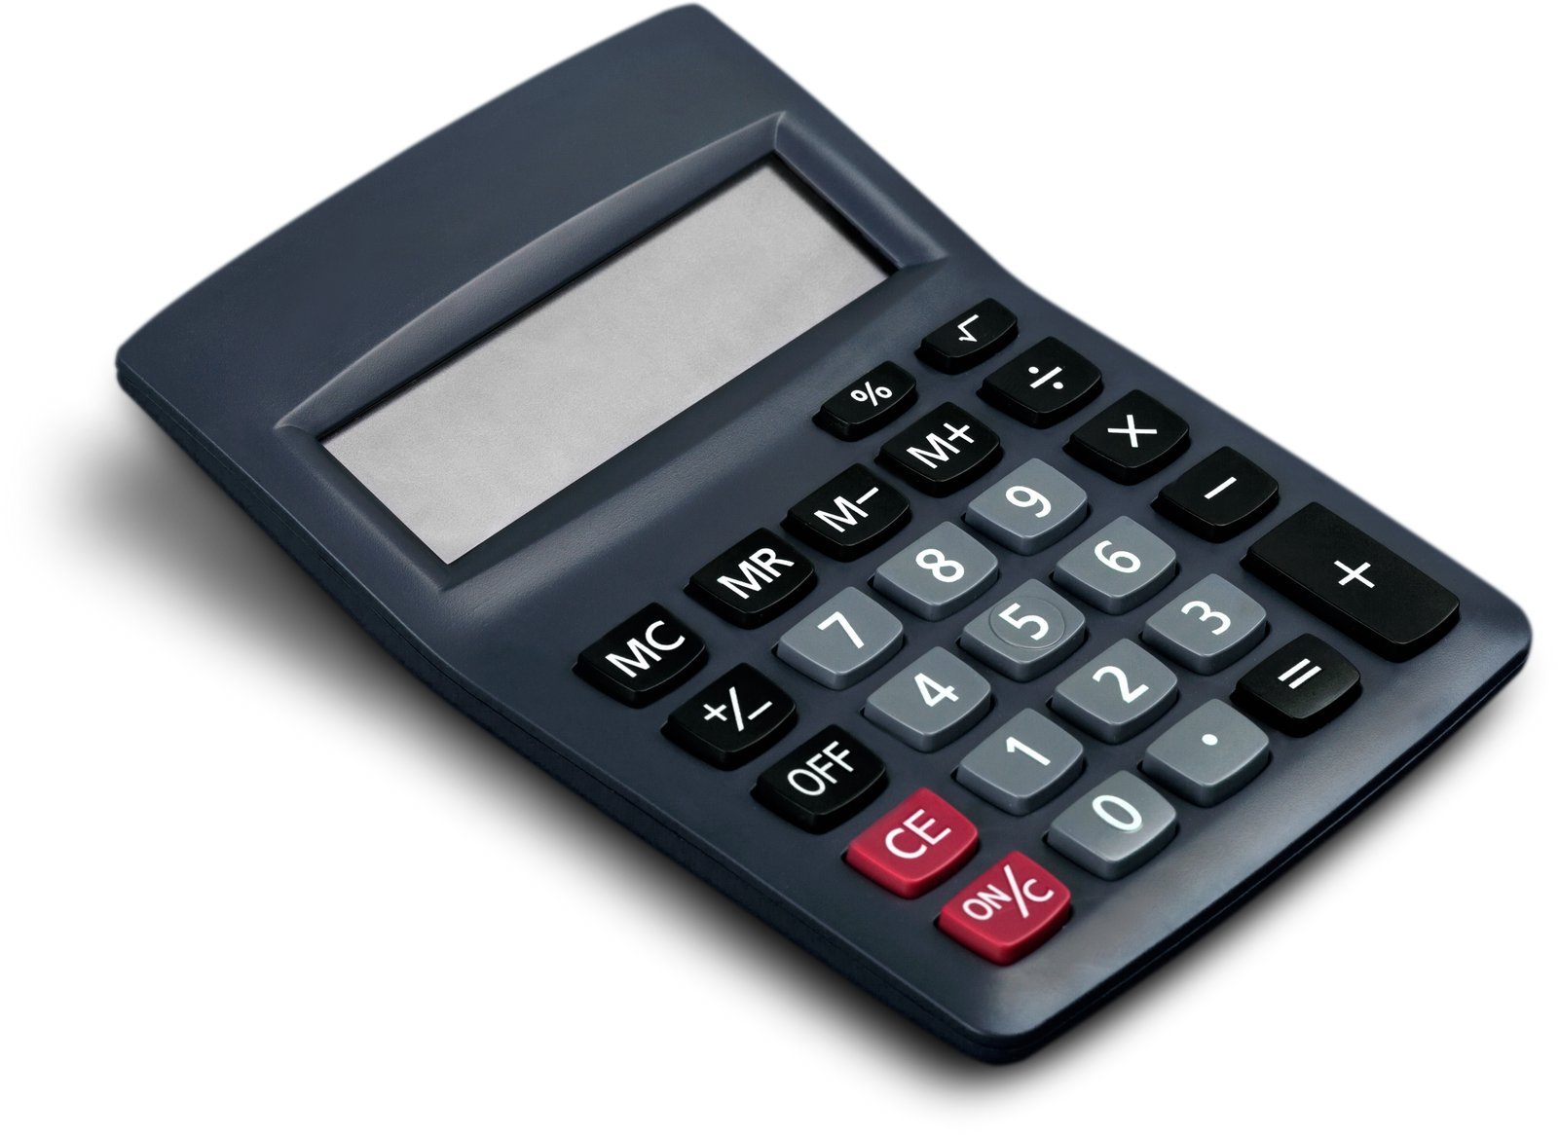
calculator
A piece of electronic equipment that you use to do mathematical calculations

Slide 18
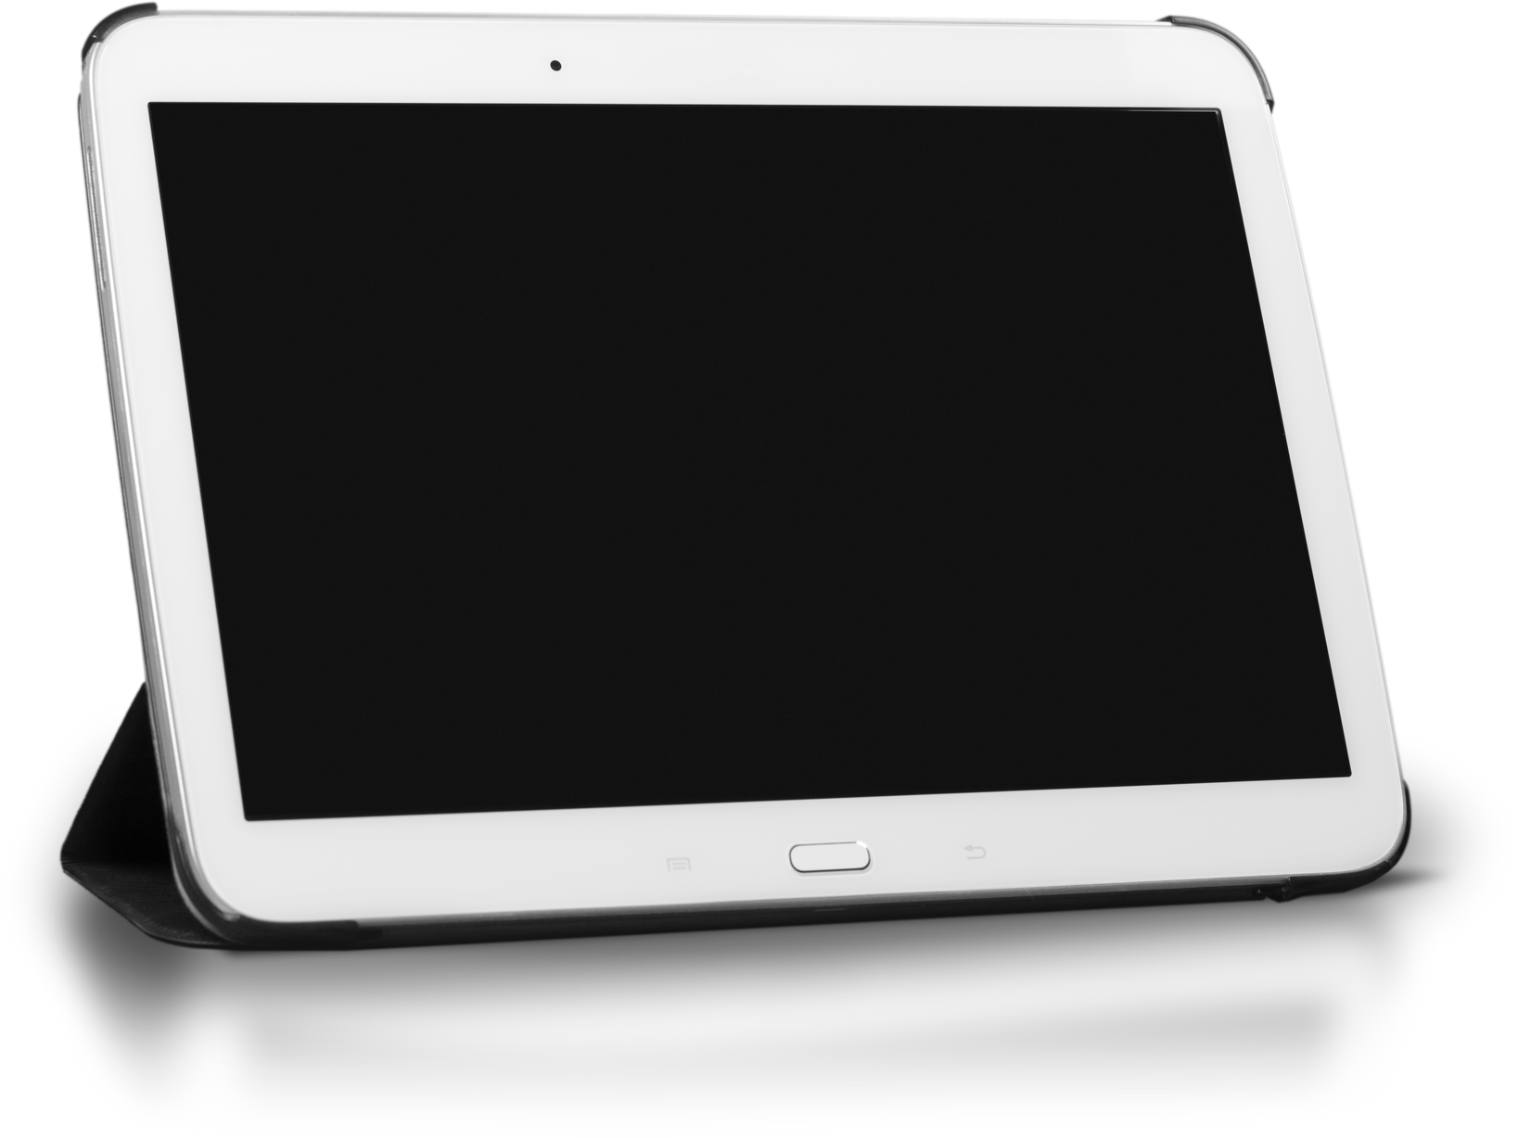
tablet
A small computer that you use by touching the screen

Slide 19
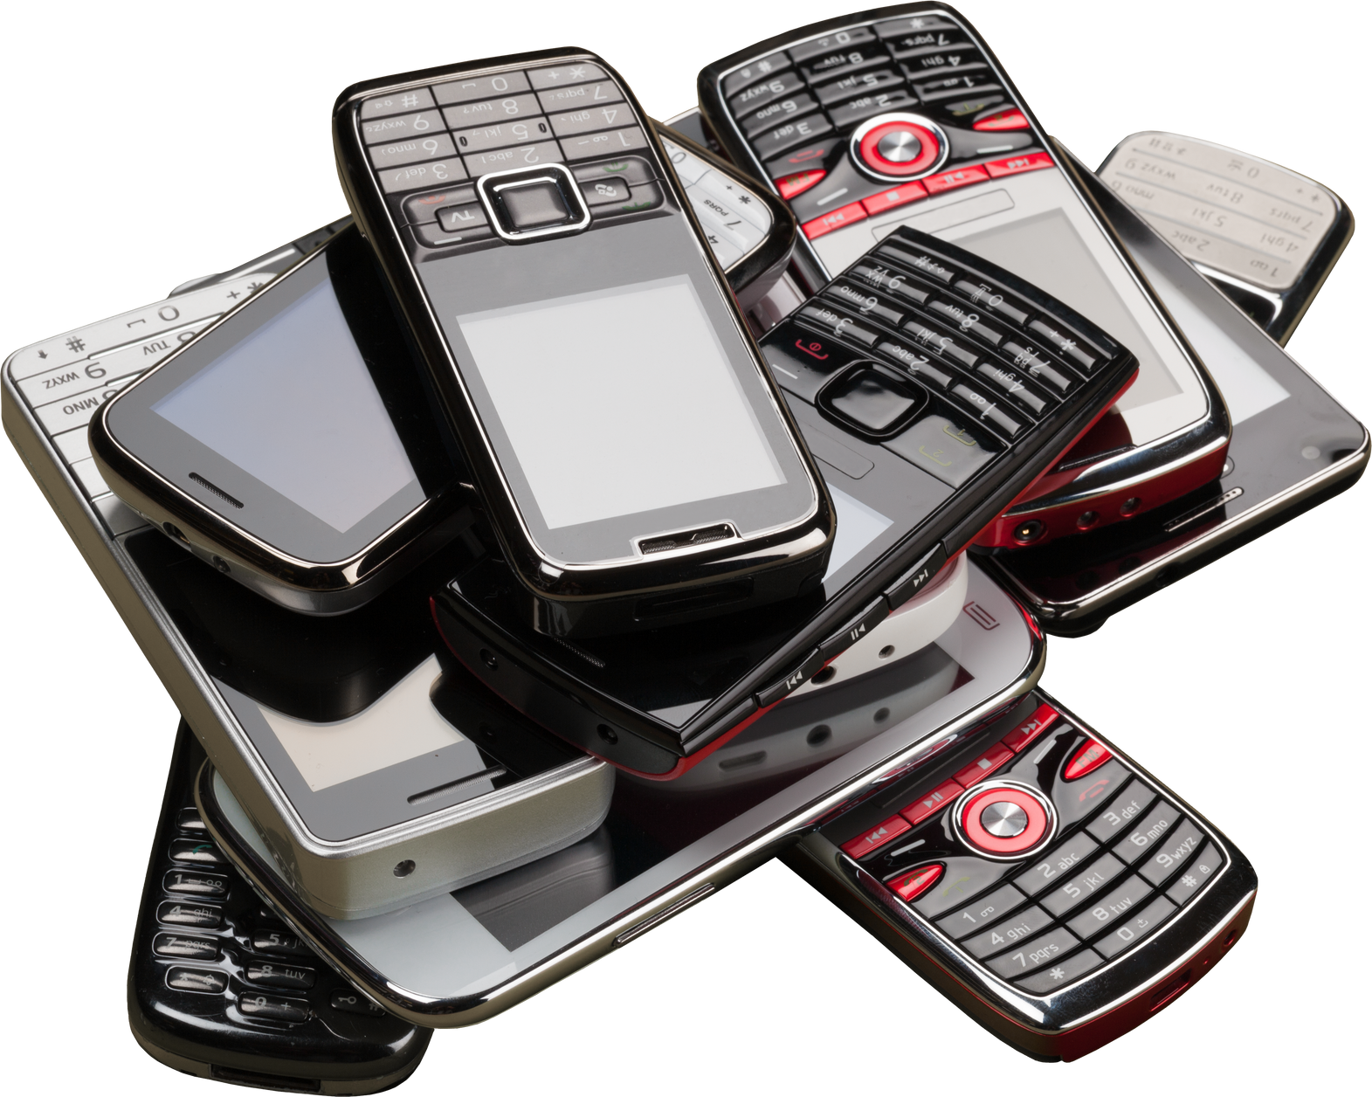
mobile phones
A telephone that you can carry everywhere with you

Slide 20
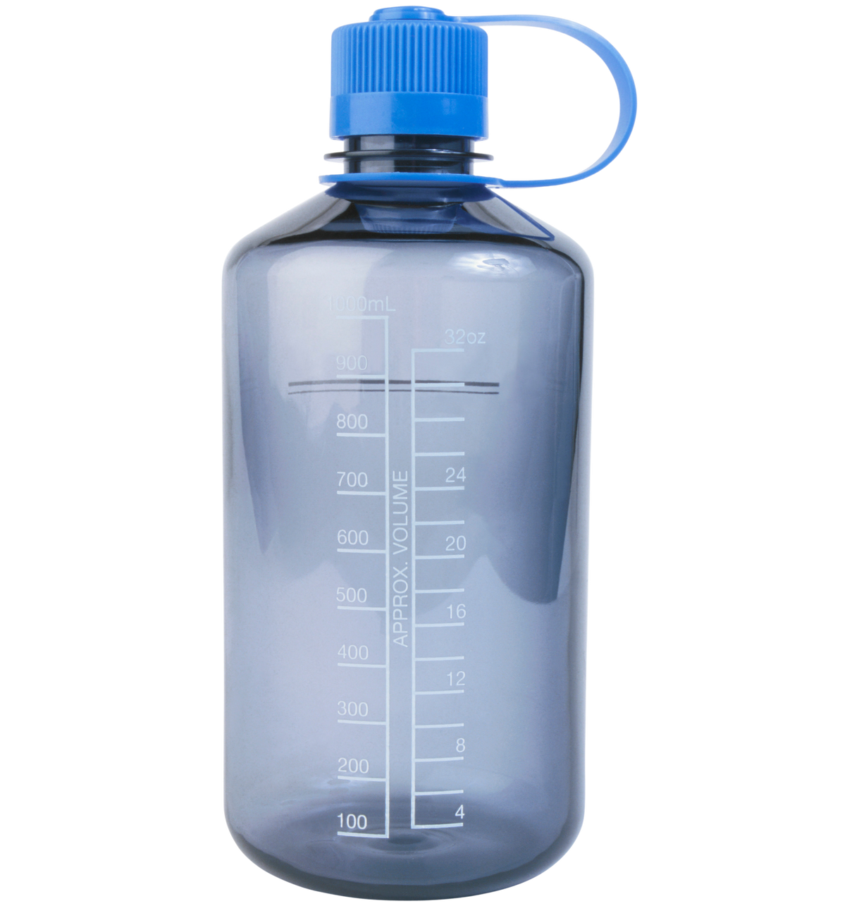
water bottle
A container for liquids, usually made of glass
or plastic, with a narrow top

Slide 21
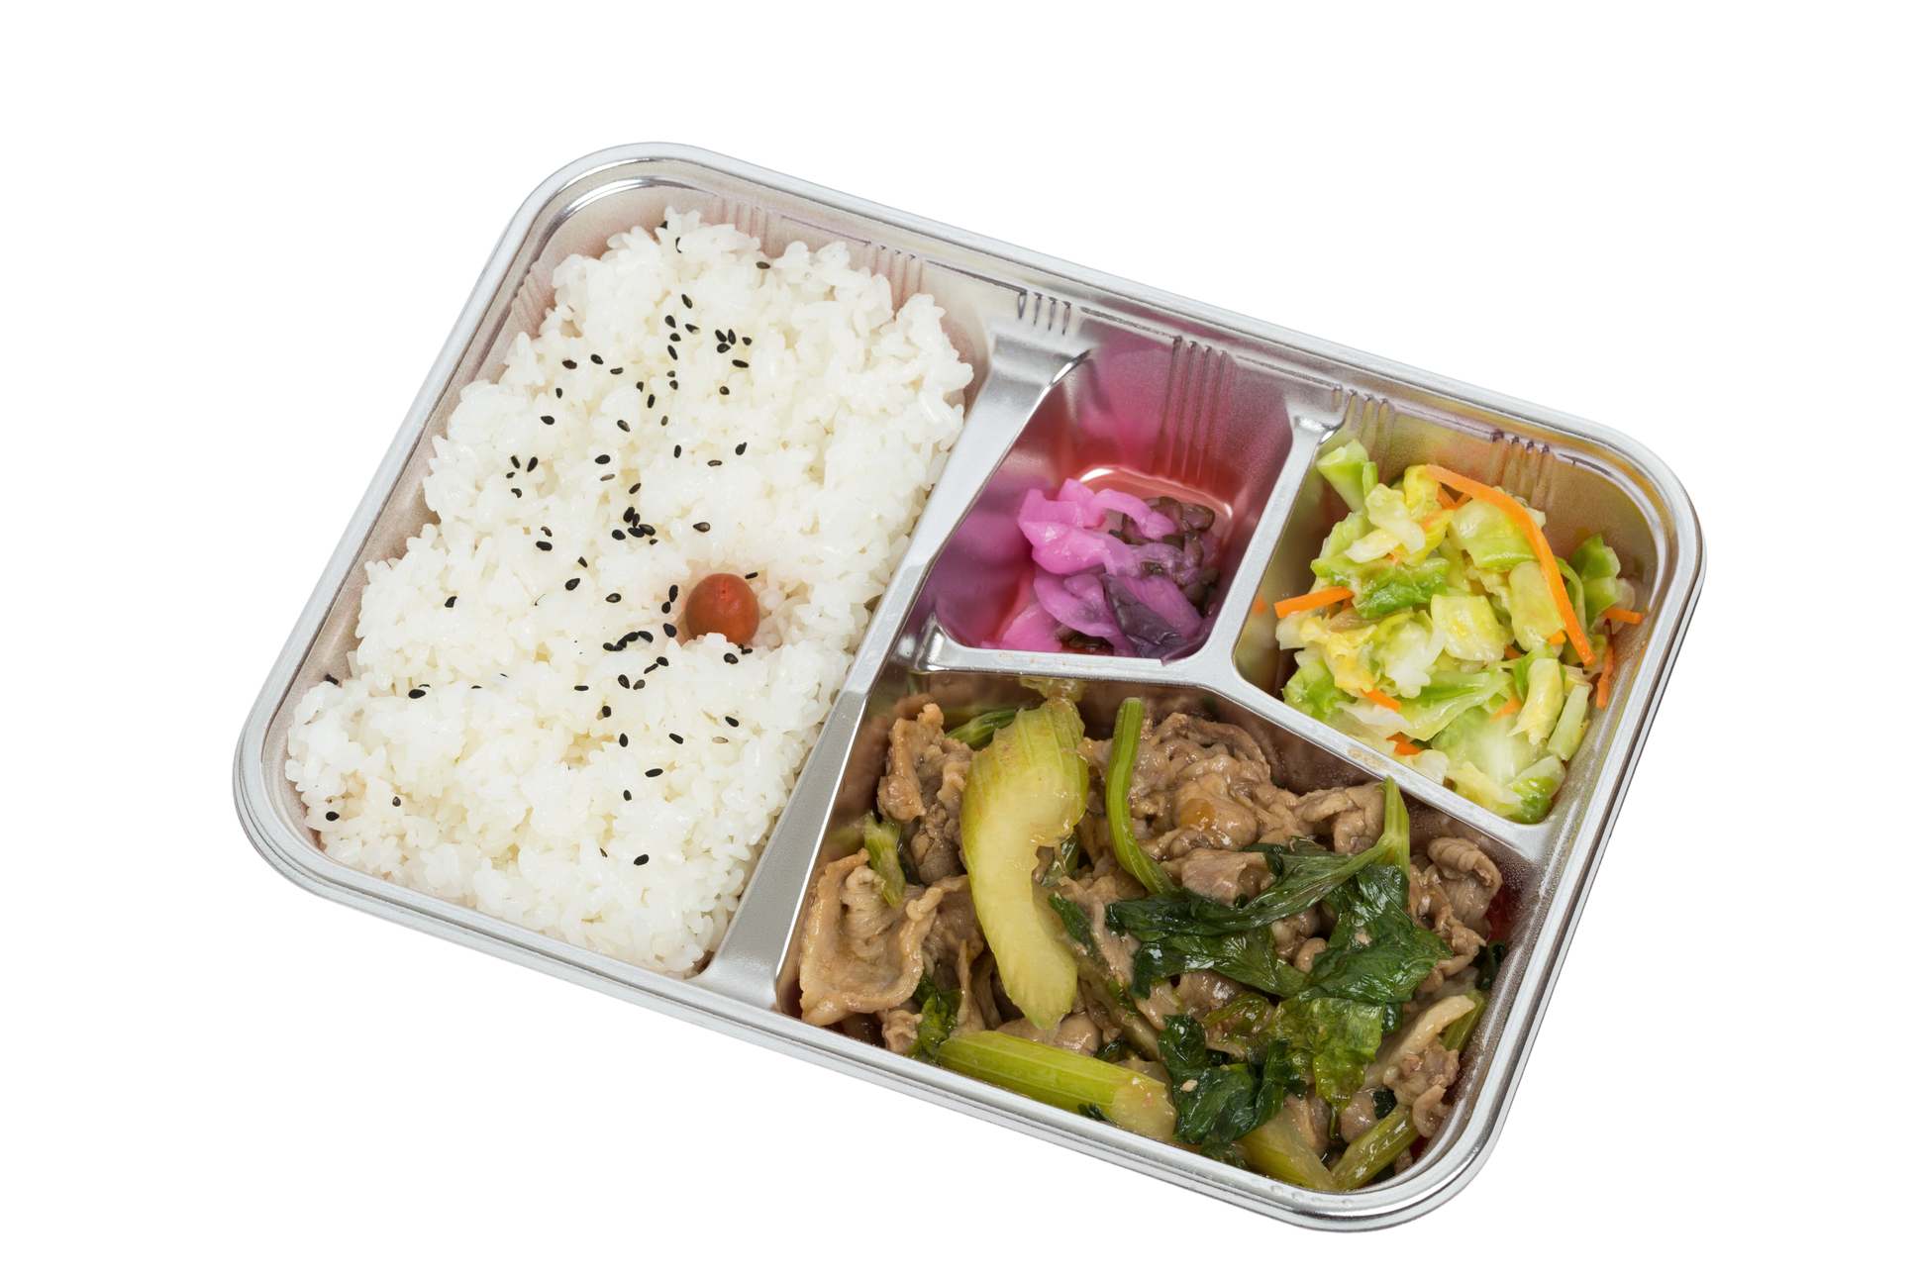
lunch box
A light meal put in a container, that you take with
you to be eaten later, for example at school or work

Slide 22
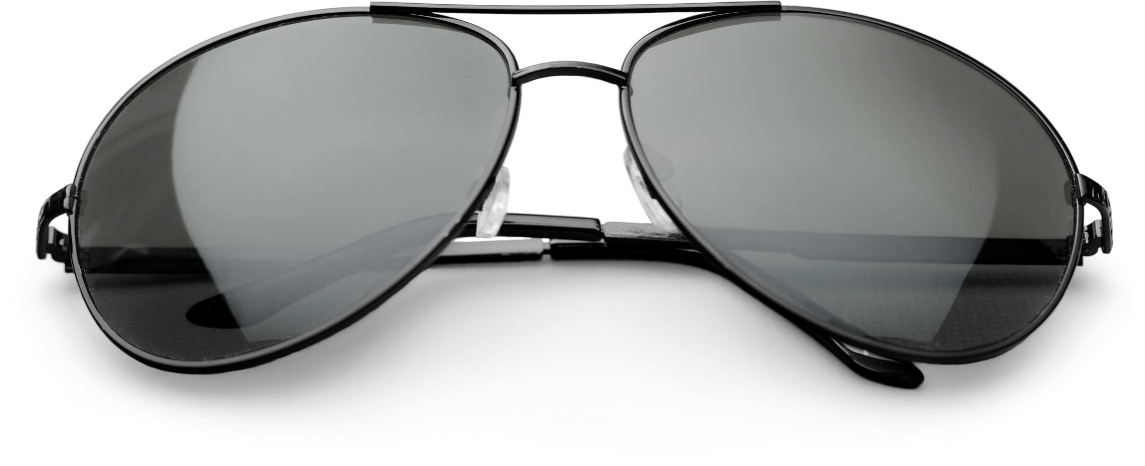
sunglasses
Dark glasses that you wear to protect your eyes
from bright light from the sun

Slide 23
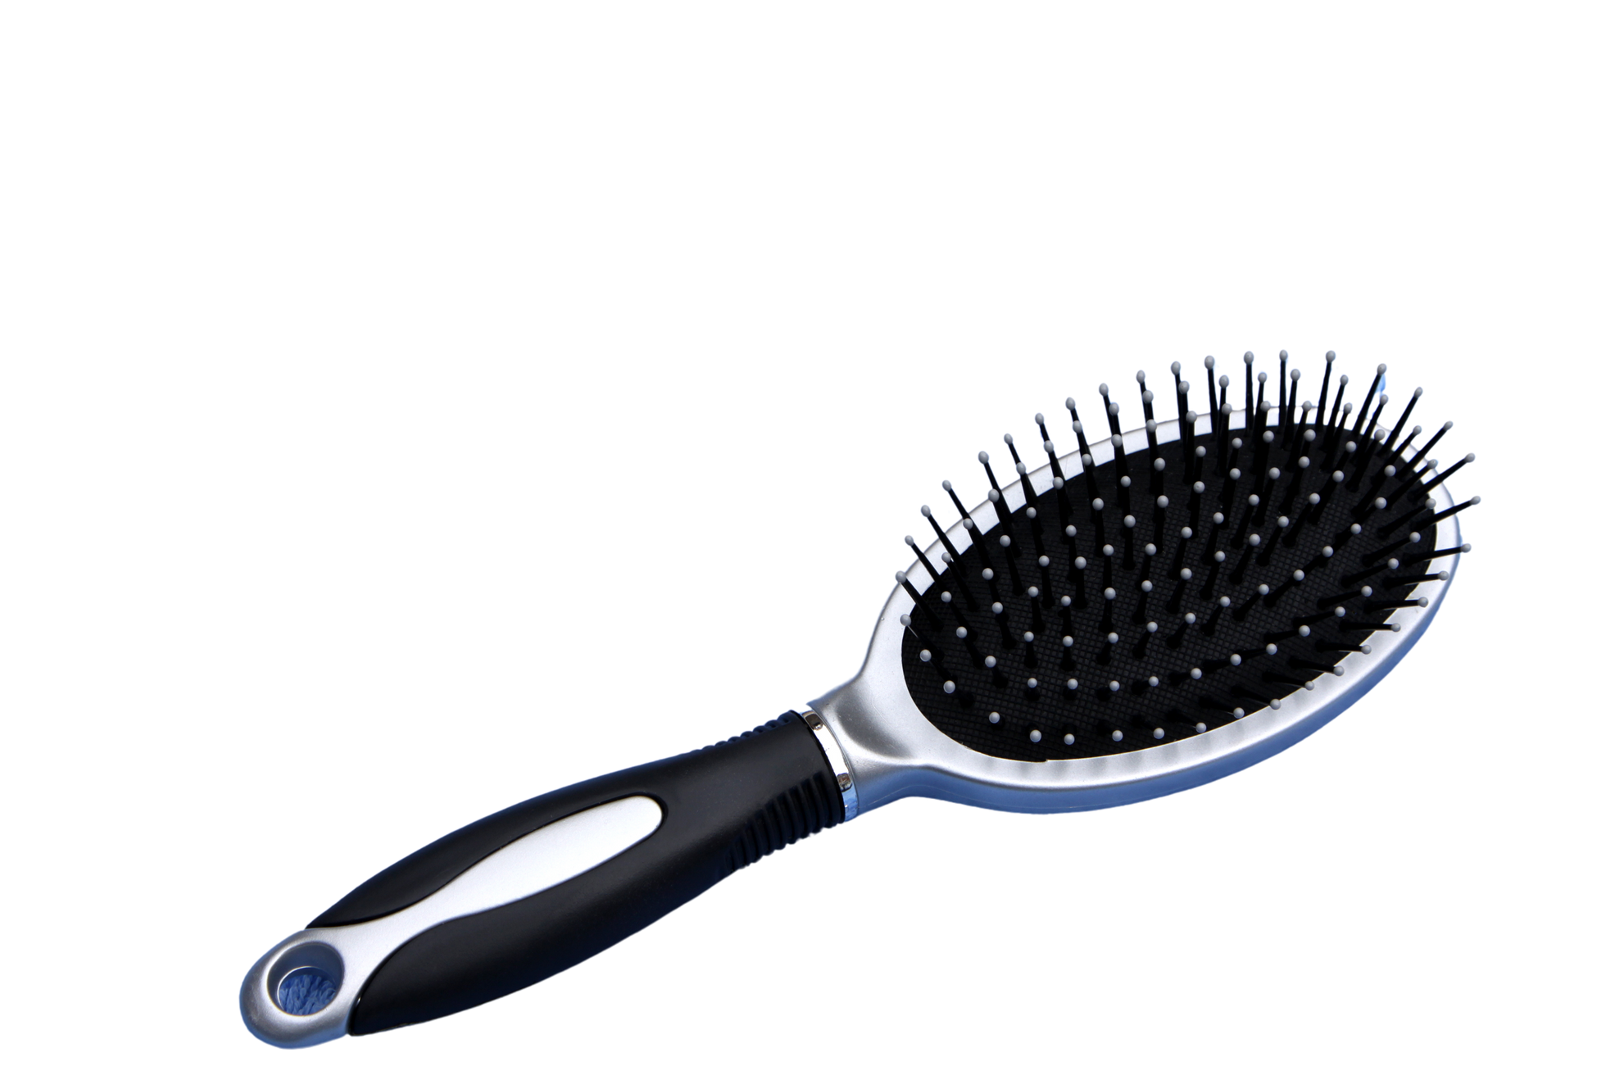
hairbrush
A brush used for making the hair on your head neat and smooth

Slide 24
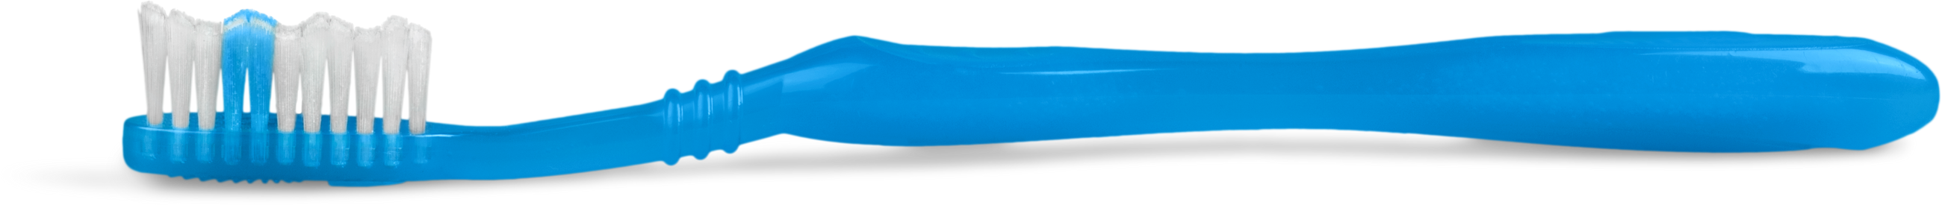
toothbrush
A small brush with a long handle that you use to clean your teeth

Slide 25
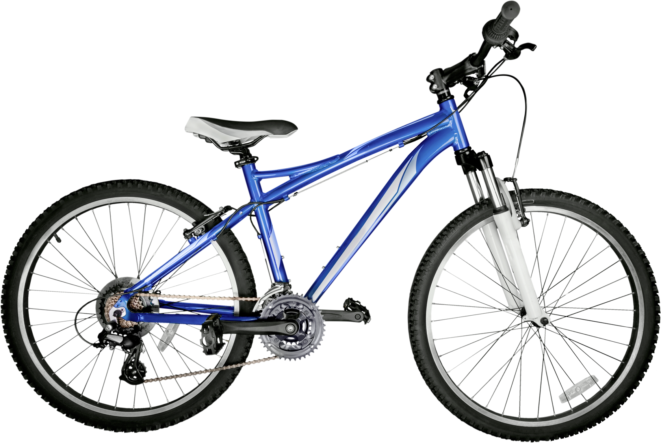
bicycle
A two-wheeled vehicle that you sit on and move by
turning the two pedals (= flat parts you press with your feet)

Slide 26
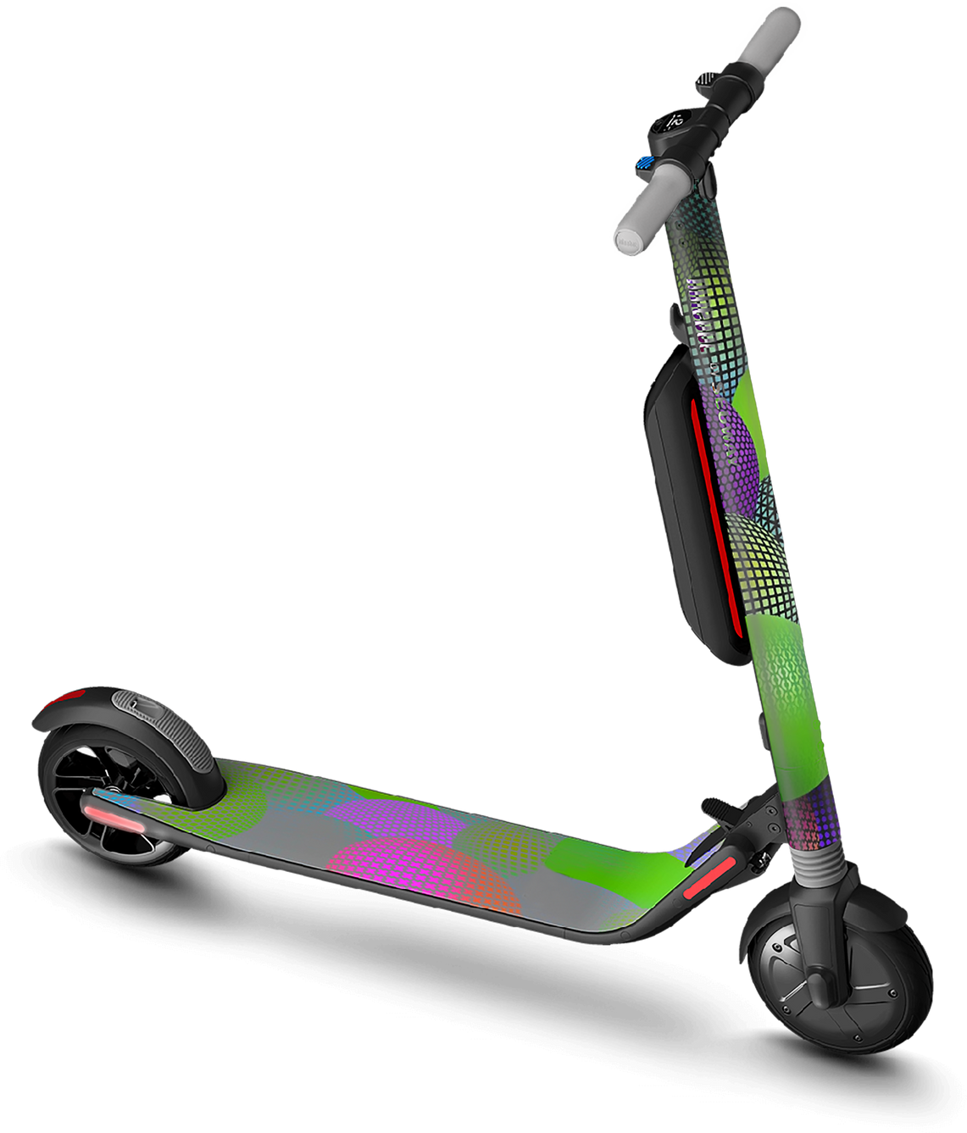
scooter
A child's vehicle with two or three small wheels joined to the bottom of a narrow board and a long vertical handle attached to the front wheel. It is ridden by standing with one foot on the board and pushing against the ground with the other foot

Slide 27
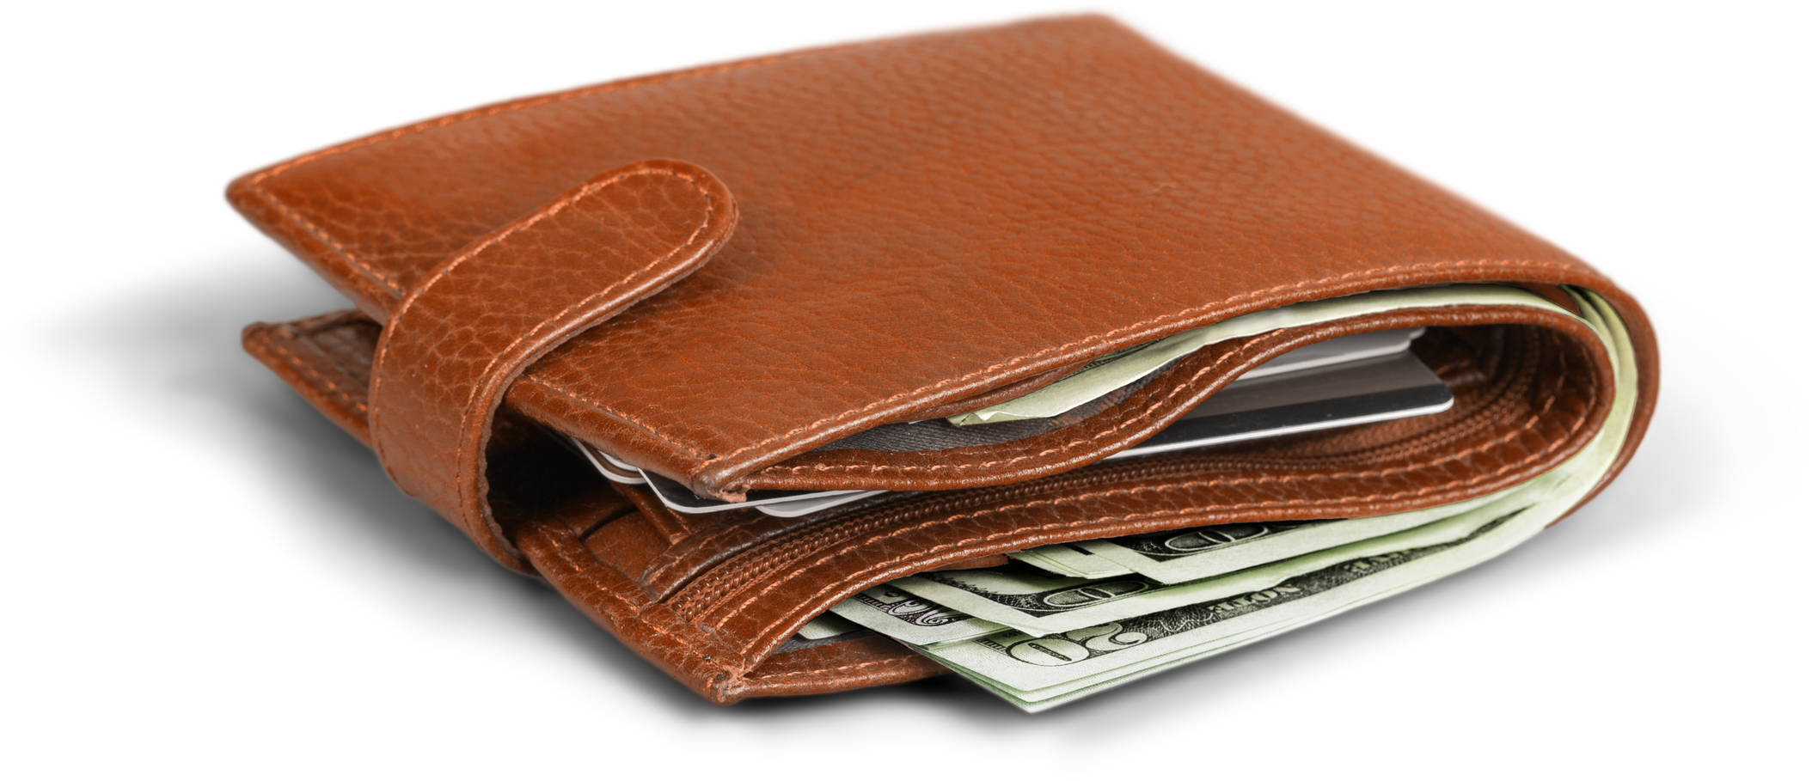
wallet
A small folding case for carrying paper money, credit cards and other flat objects, that can be carried in a pocket and is used especially by men

Slide 28
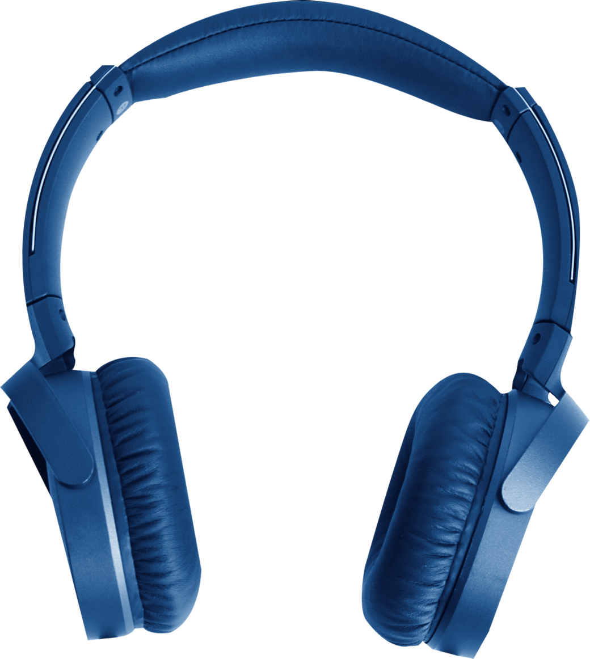
headphones
A device with a part to cover each ear through which you can listen to music, radio broadcasts, etc. without other people hearing

Slide 29


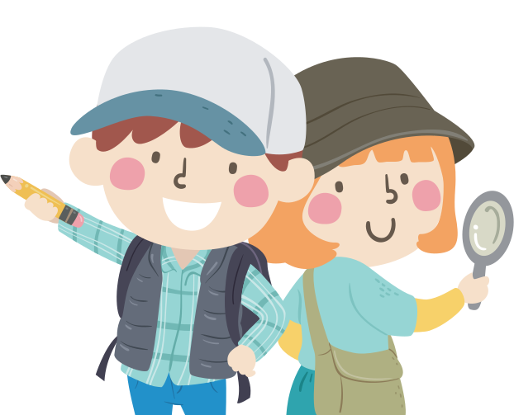

Activity 1 - Treasure Hunt
Organise a treasure hunt game where students have to find pictures of belongings hidden around the classroom. Once found, they must identify them using "This is my/your…" and "These are my/your…" expressions.

Slide 30
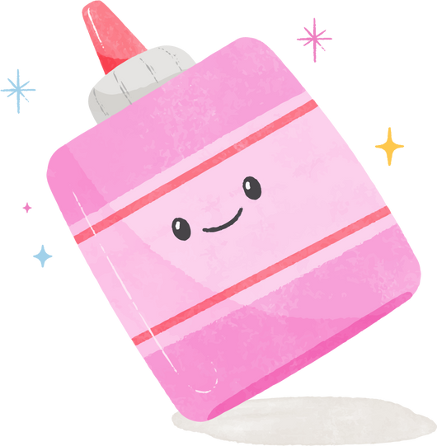







Dialogue
Practice 1
Pair up students and provide each pair with a set of picture cards.
They practice the dialogue "This is my…" and "These are my…" using the picture cards.
Form small groups and have them continue the dialogue practice using different picture cards. Provide correction and guidance as necessary.

Slide 31

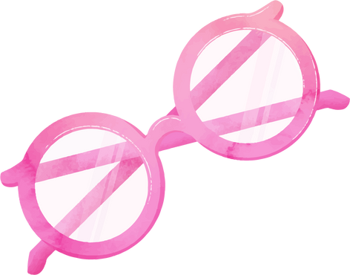



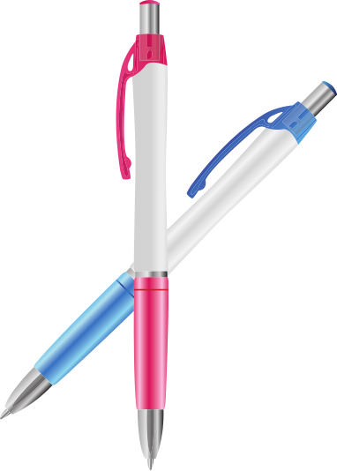




Example
This is my…
These are my…

Slide 32

Activity 2 -
Magic Bag Description
Introduce the 'Magic Bag Description' game. Students take turns to pick a vocabulary card from a bag without showing it to anyone. They then describe the item and the rest of the class tries to guess what it is.

Slide 33
Dialogue
Practice 2
Pair the students again and provide each pair with a new set of picture cards.
They practice the dialogue "Is this my/your …?" and the responses "Yes, they are." / "No, they aren’t." with the picture cards.
Form small groups and have them continue the dialogue practice using different picture cards. Provide correction and guidance as necessary.

Slide 34



Example
Is this my/your …?
Yes, they are." / "No, they aren’t.

Slide 35




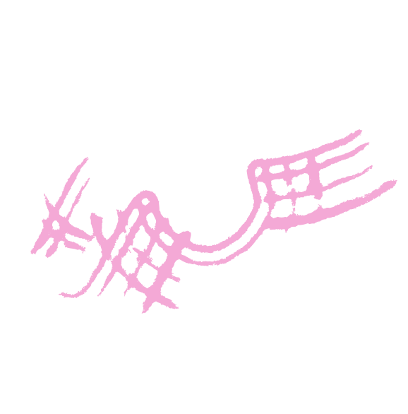
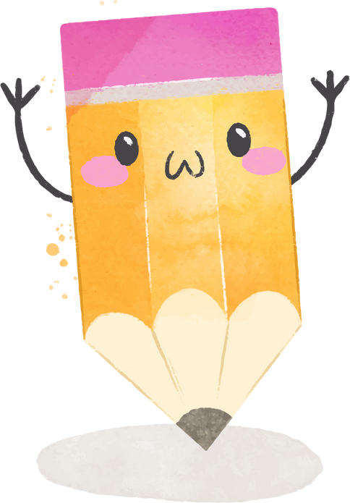

Draw and Introduce
Draw a picture of their favourite belongings and label them. Each student then stands up, shows their drawing, and describes it using the target language.

Slide 36





Lets Review!
This is / These are my…
my/your/his/her/our/their
Yes, they are. / No, they aren’t
Is this my/your …?

Slide 37


Great Effort!
See You Next Lesson

