Slide 1





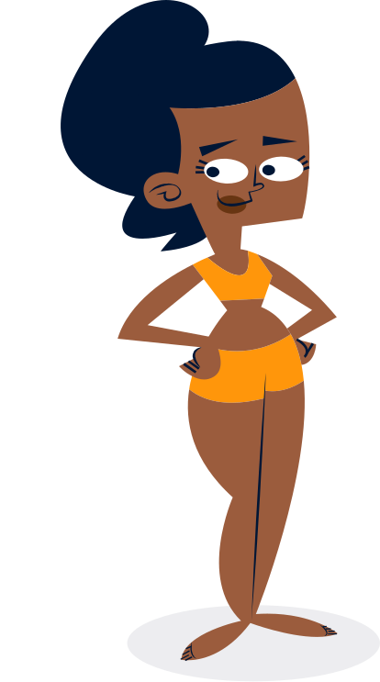


Lesson 7
Body Parts Adventure Human Body
Trinity GESE Grade 1 Prep
Prepared by Imperial Academy

Slide 2



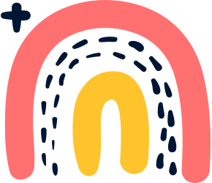
Target Language
Is Sam tall?
Yes, he is. / No, he isn’t.
01
Is his head big?
Are they …?
02

Slide 3



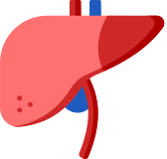

Target Vocabulary
tall
short
fat
thin
big
small
long
wide
arm
feet
fingers
hands
head
legs

Slide 4

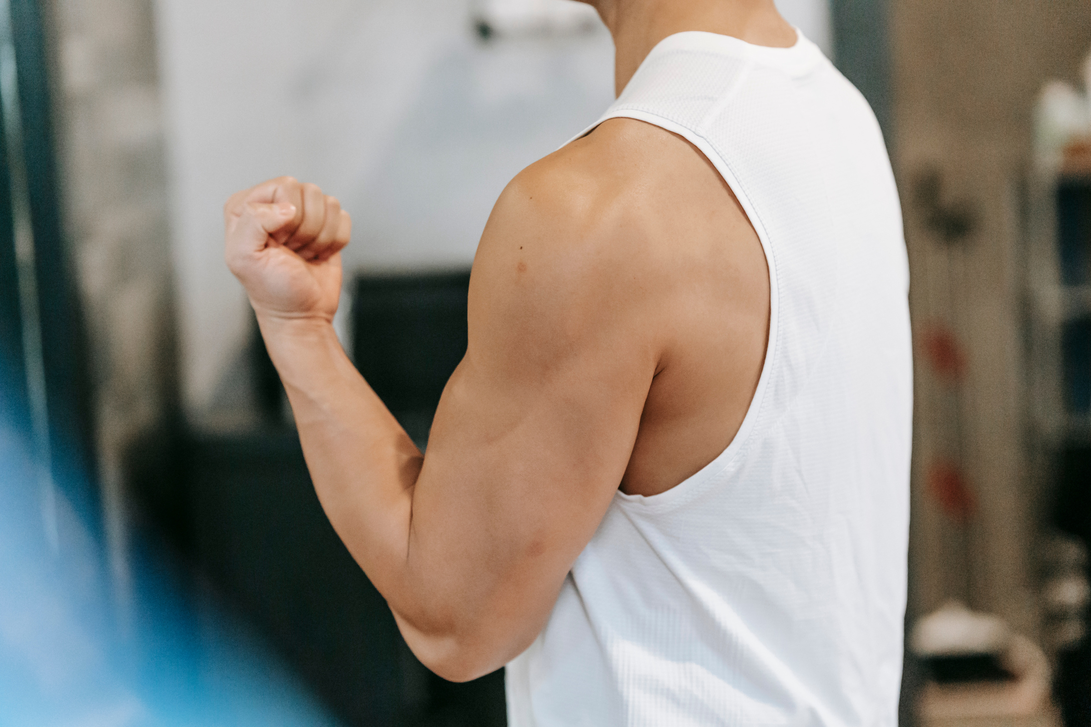



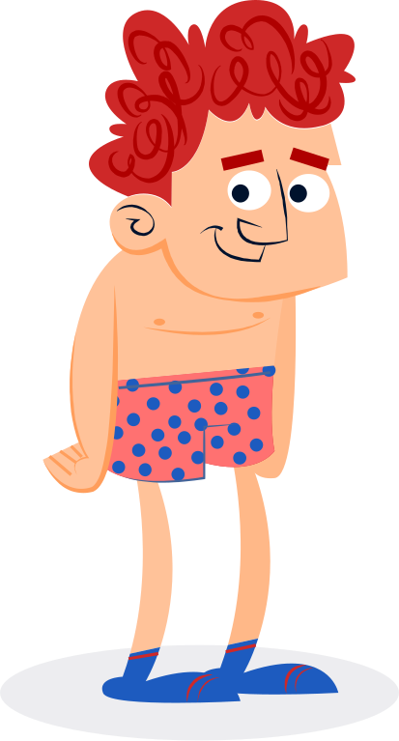


arm
The long part at each side of the human body, ending in a hand

Slide 5
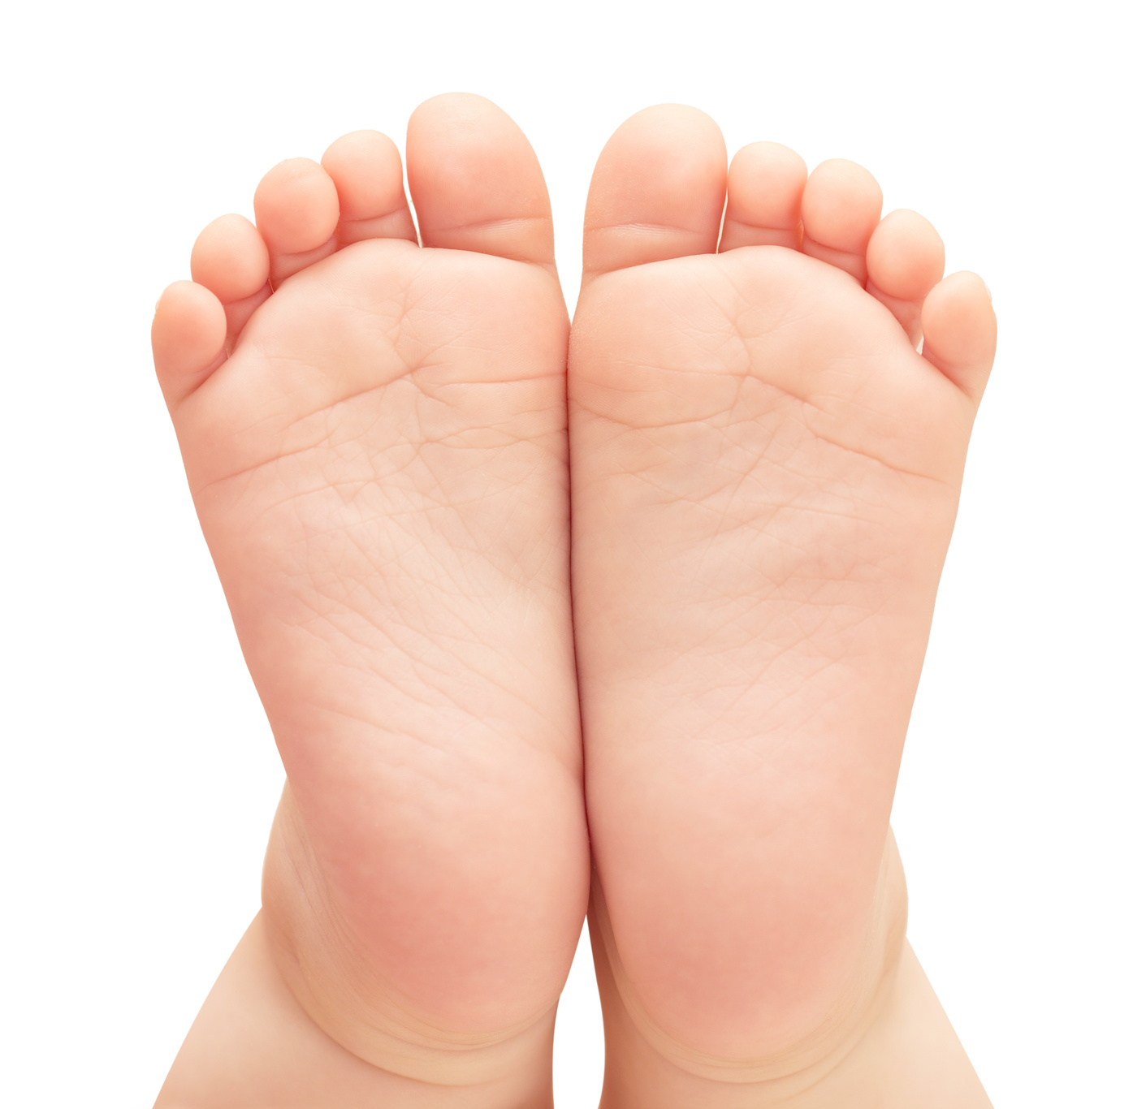
feet
plural of foot
one of the two flat parts on the ends of your legs that you stand on

Slide 6
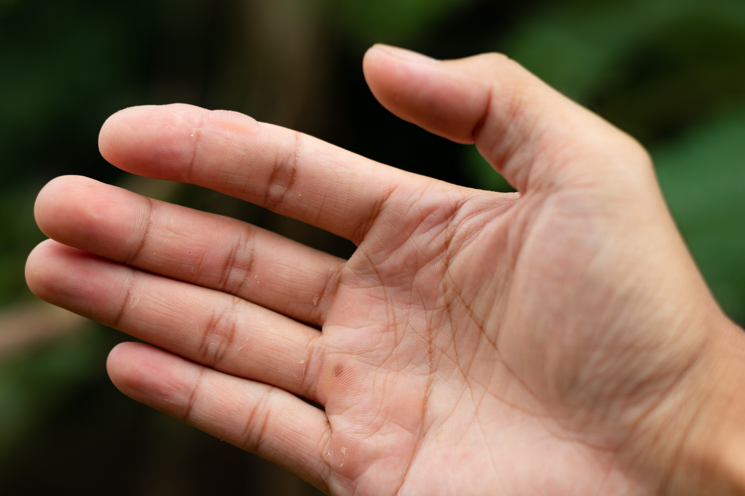
fingers
One of the five, long, separate parts at the end of your hand, including your thumb

Slide 7
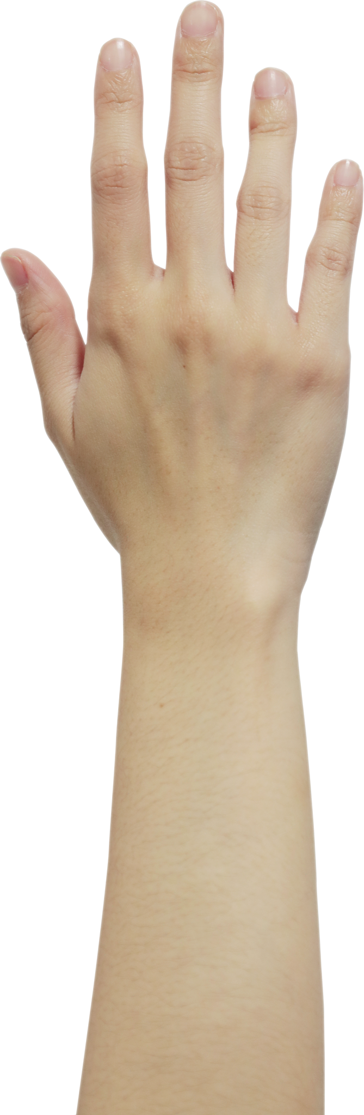
hands
The part of your body on the end of your arm that has fingers and a thumb

Slide 8
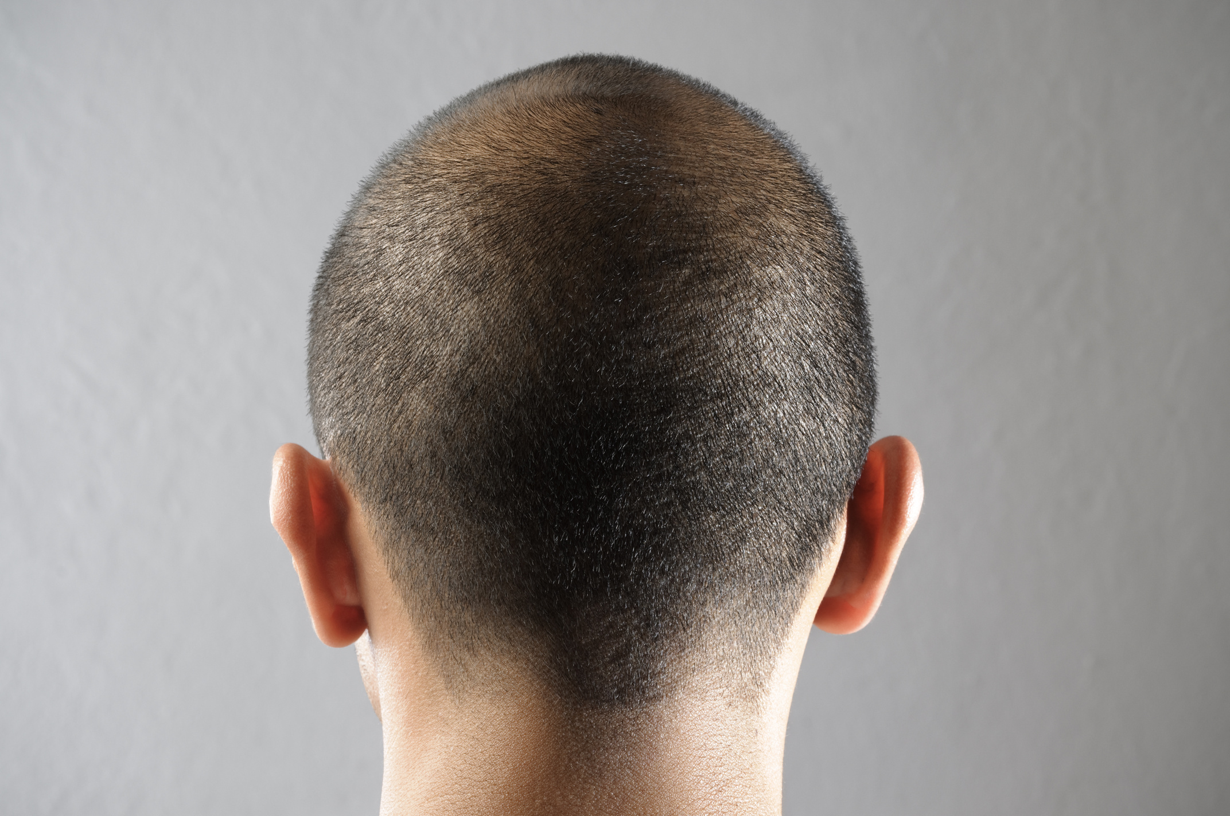
head
The part of your body above your neck that contains your brain, eyes, ears, mouth, nose, etc and on which your hair grows.

Slide 9
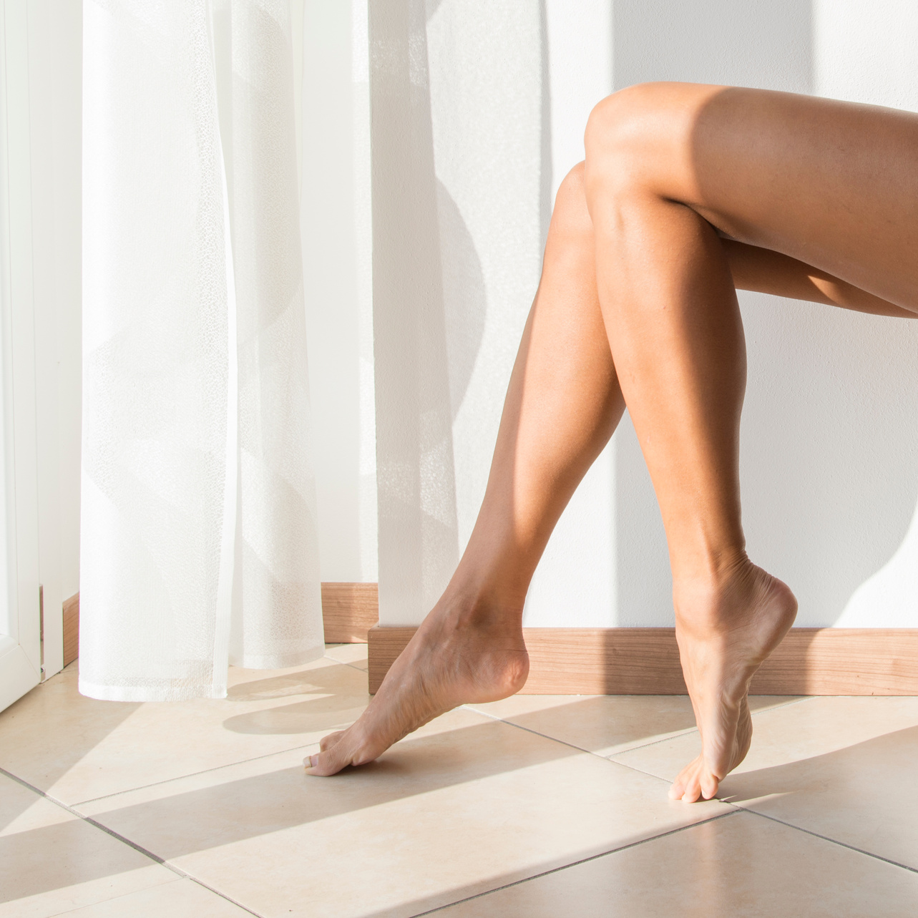
legs
One of the parts of the body of a human or animal that is used for standing and walking

Slide 10
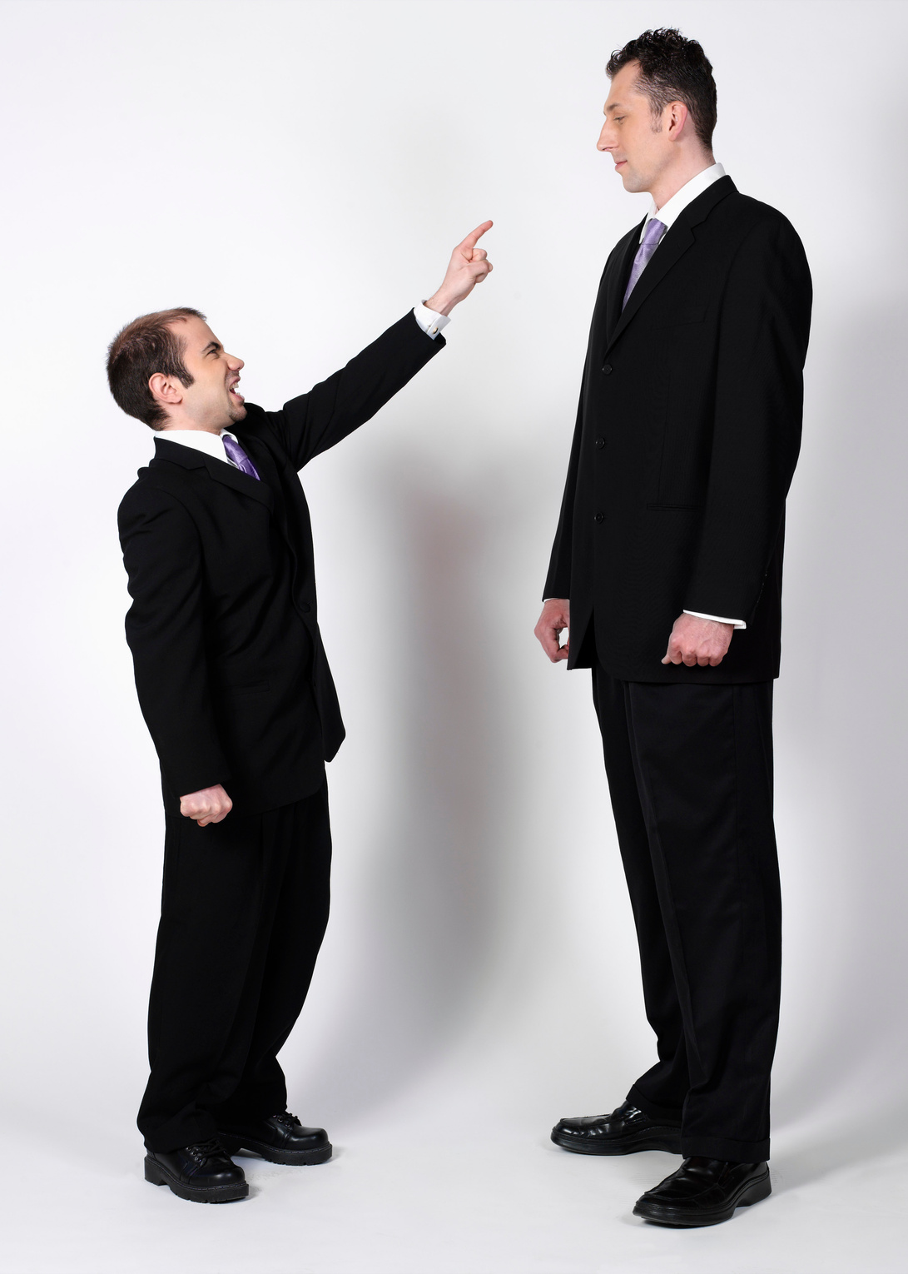
tall
Having a greater than average height

Slide 11
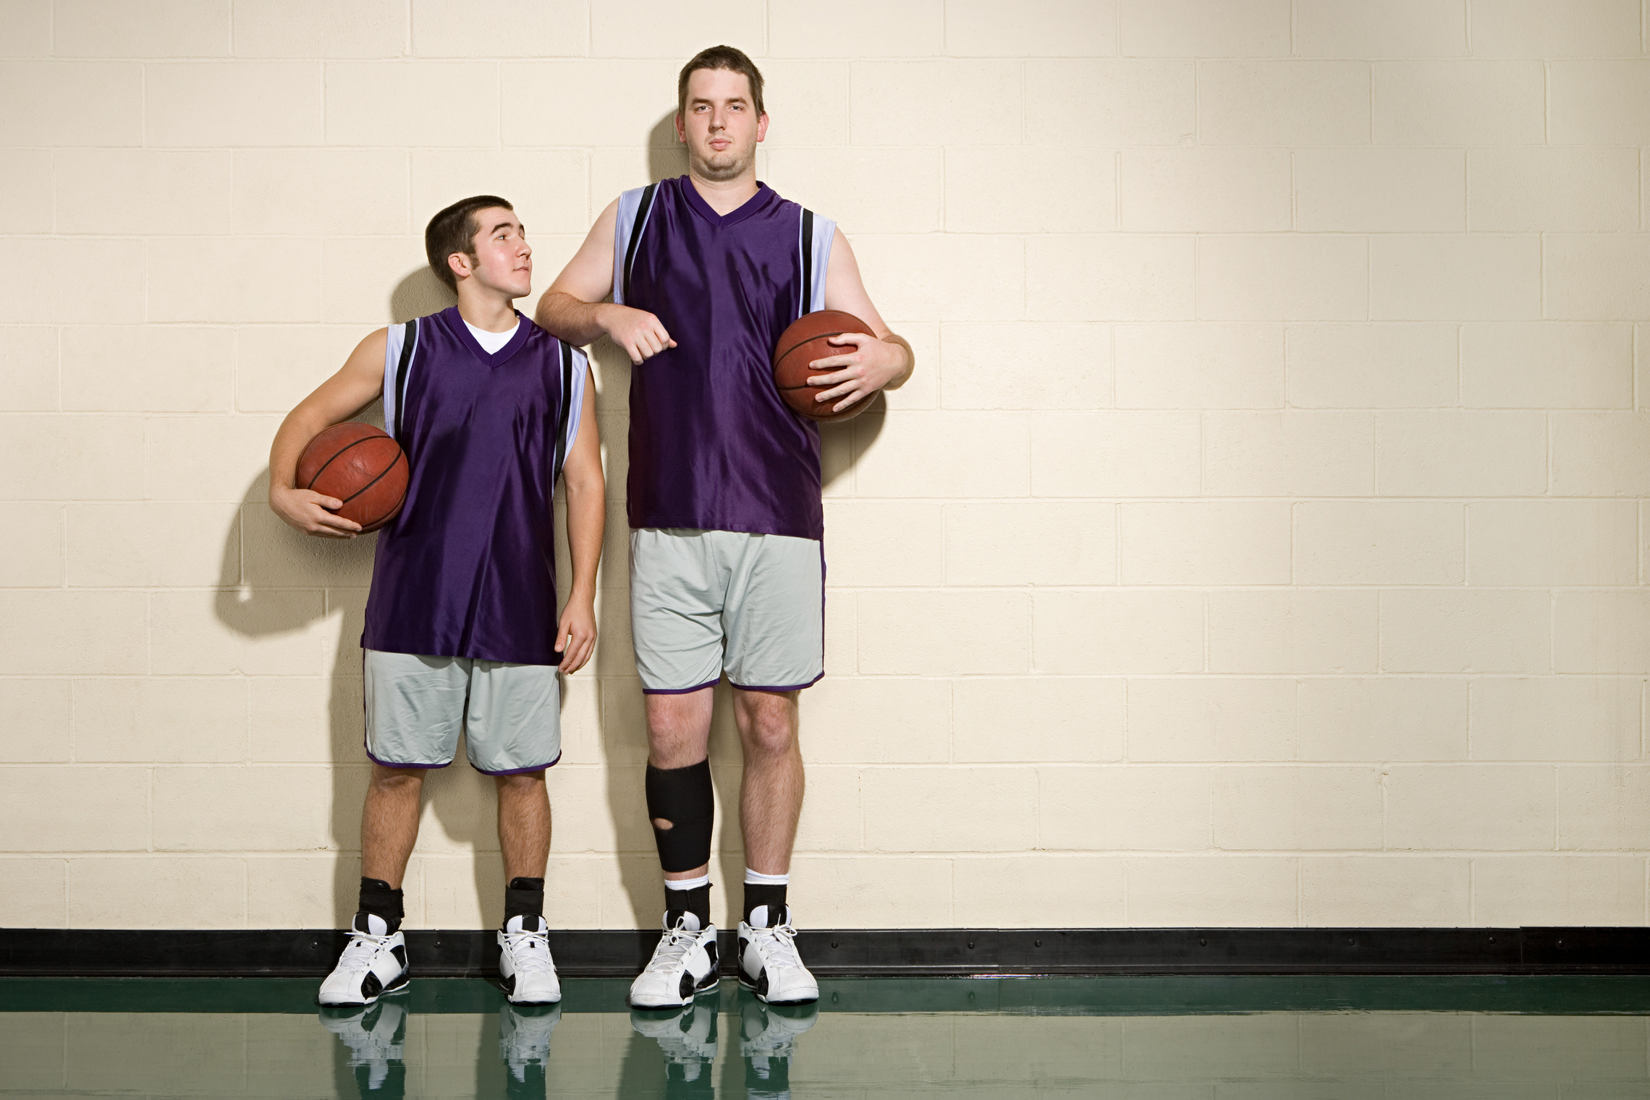
short
Having a small distance from one end to the other

Slide 12
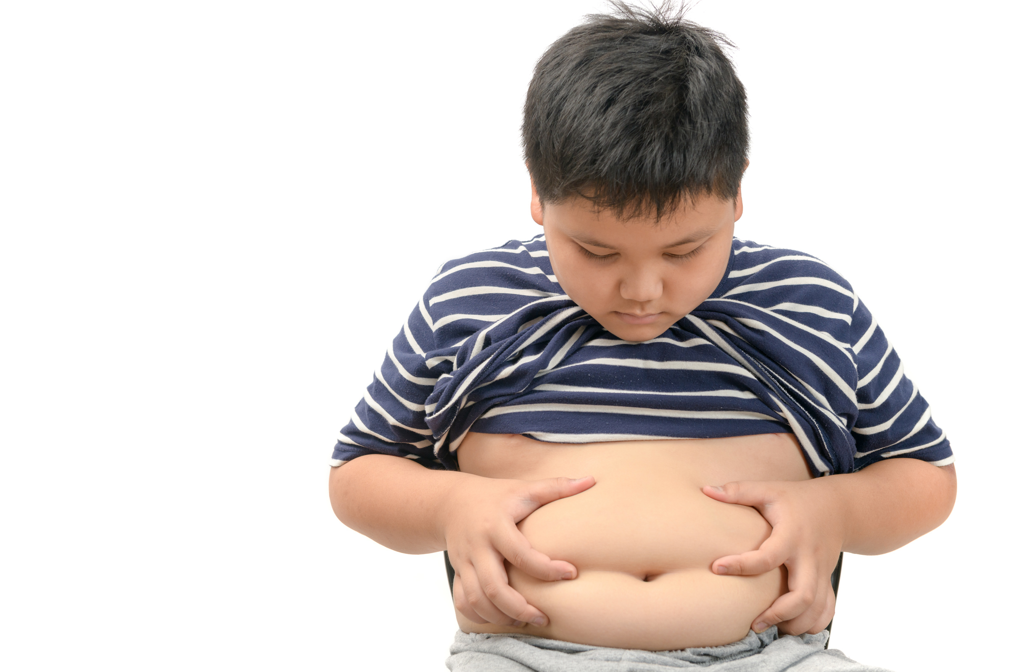
fat
Someone who is fat weighs too much

Slide 13
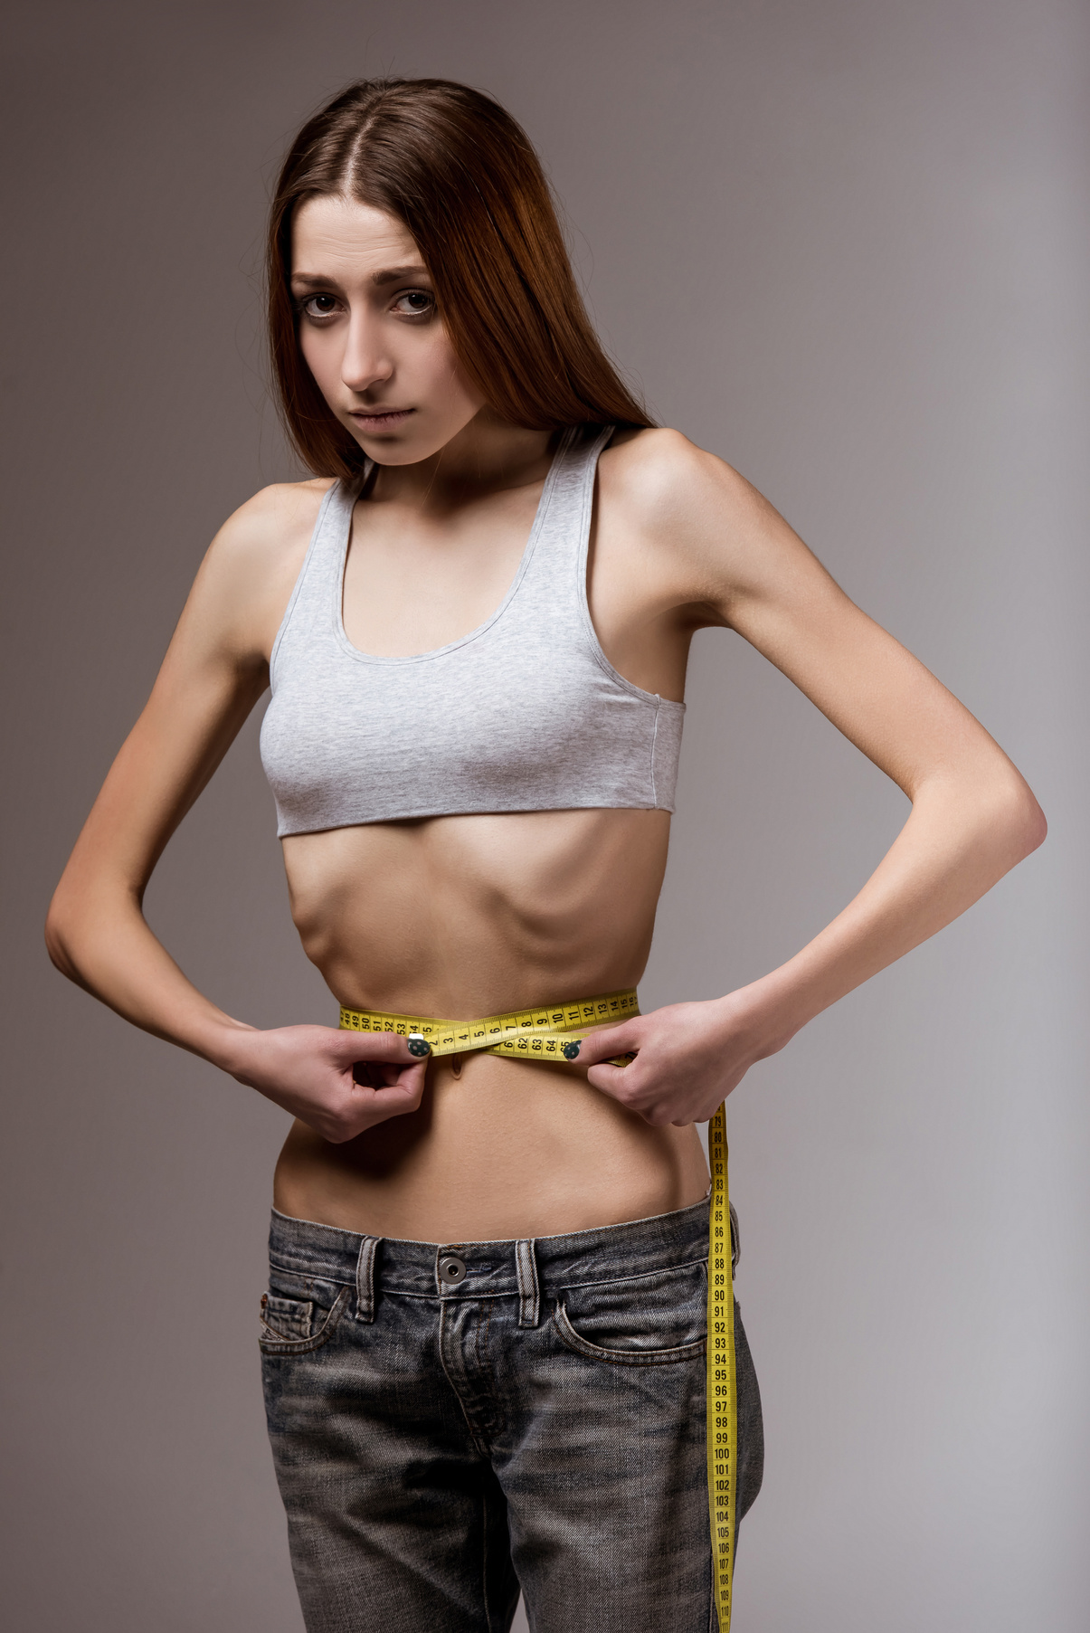
thin
Something that is thin is smaller than usual between its opposite sides

Slide 14
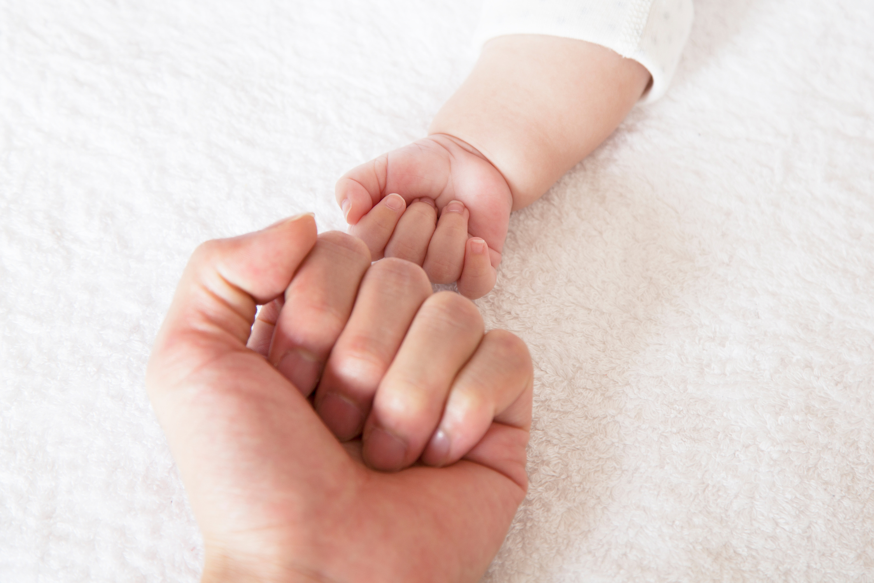

big
Large in size or amount

Slide 15
small
Little in size or amount

Slide 16
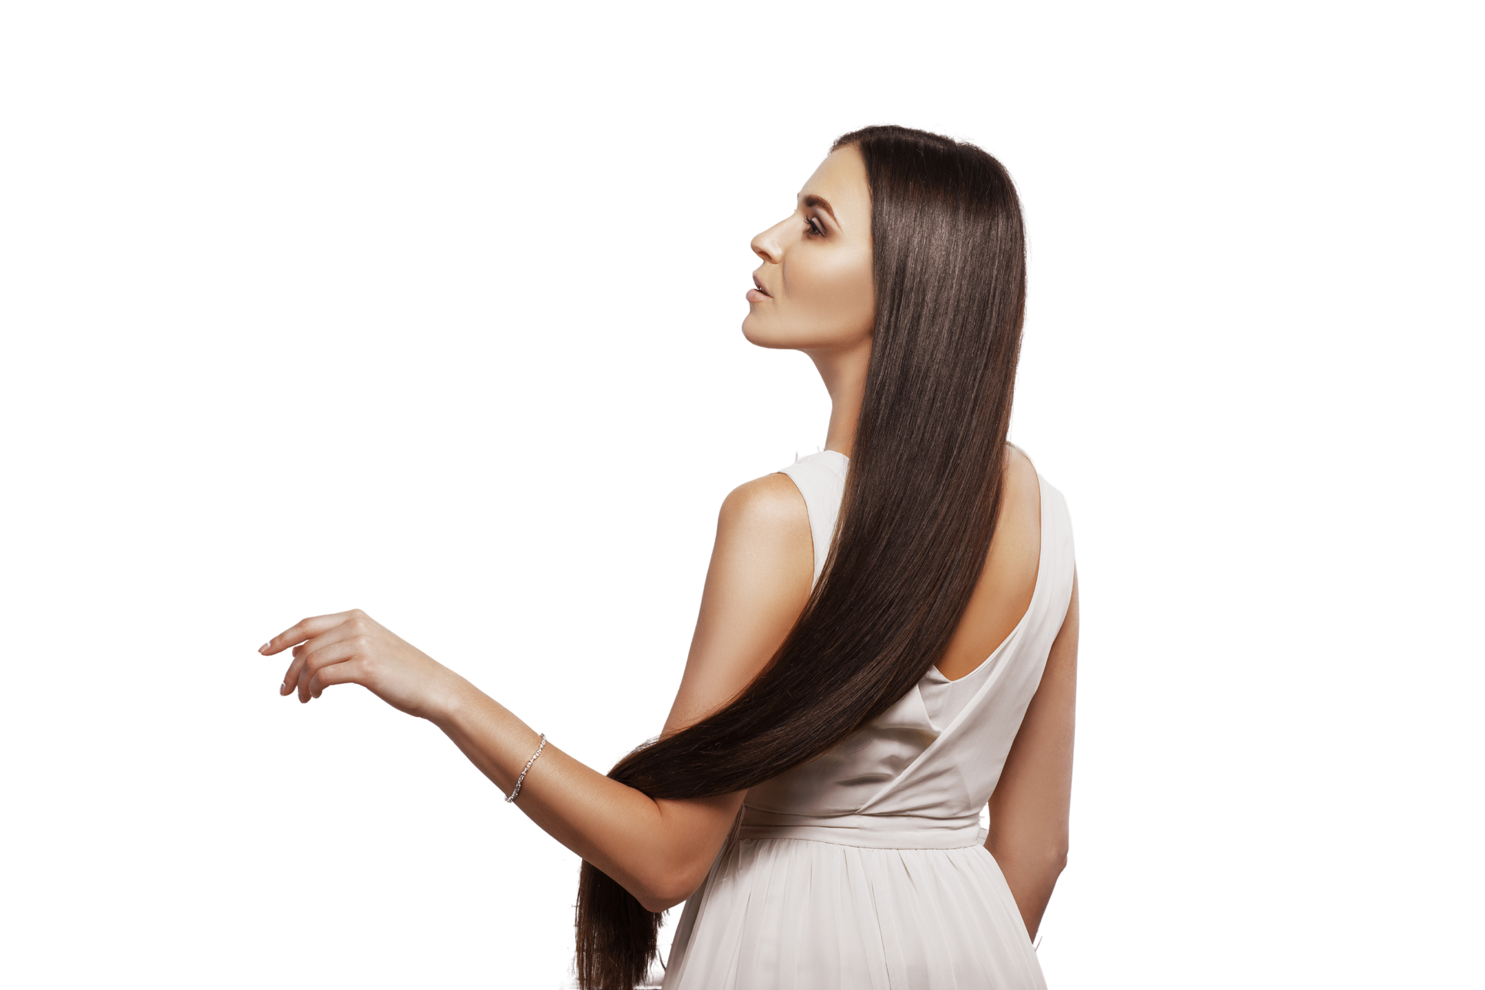
long
Having a large distance from one end to the other

Slide 17
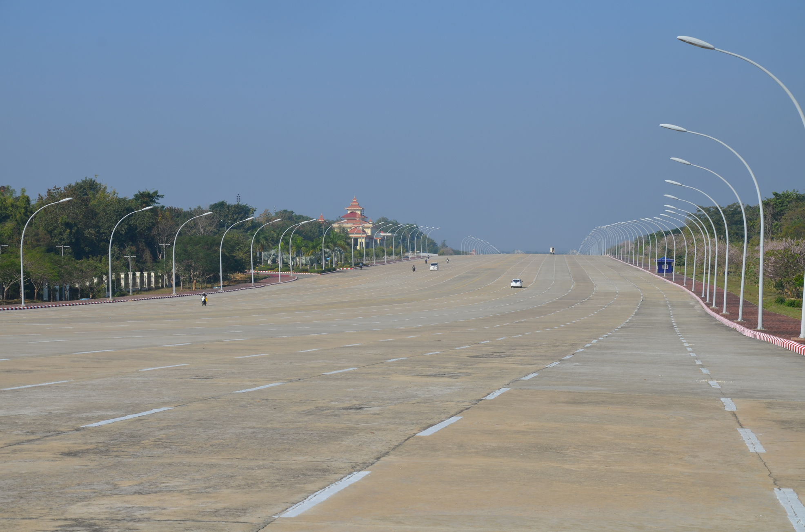
wide
Measuring a long distance or longer than usual from one side to the other

Slide 18
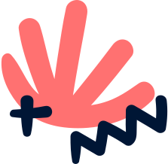




Vocabu﻿lary Extension
forehead
toes
heel
waist
palm
elbow
knee
ankle
shoulder
wrist

Slide 19

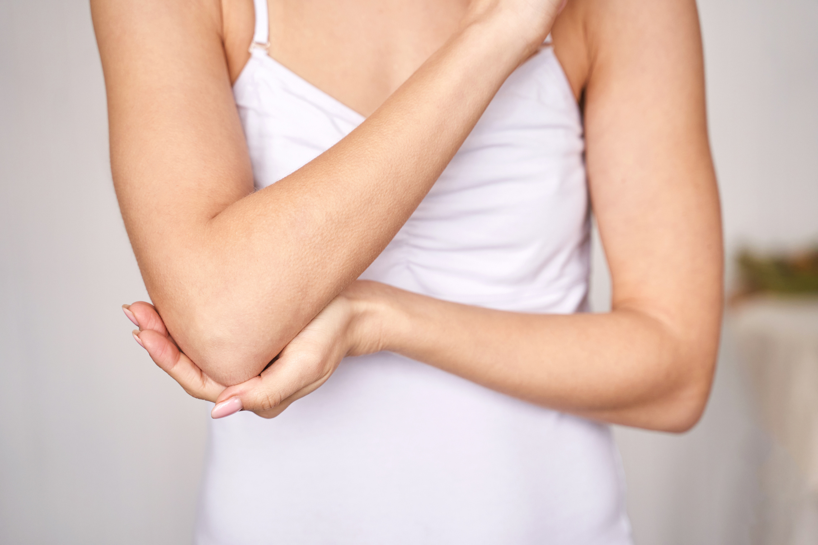


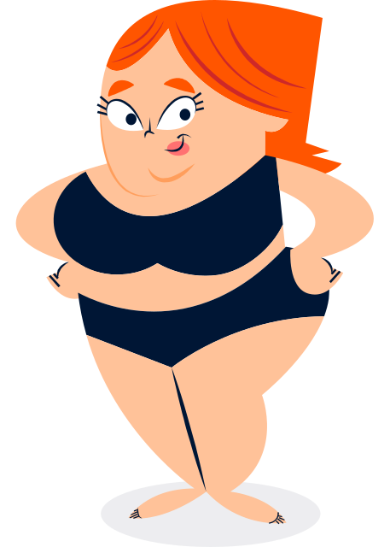



elbow
The part in the middle of your arm where it bends

Slide 20
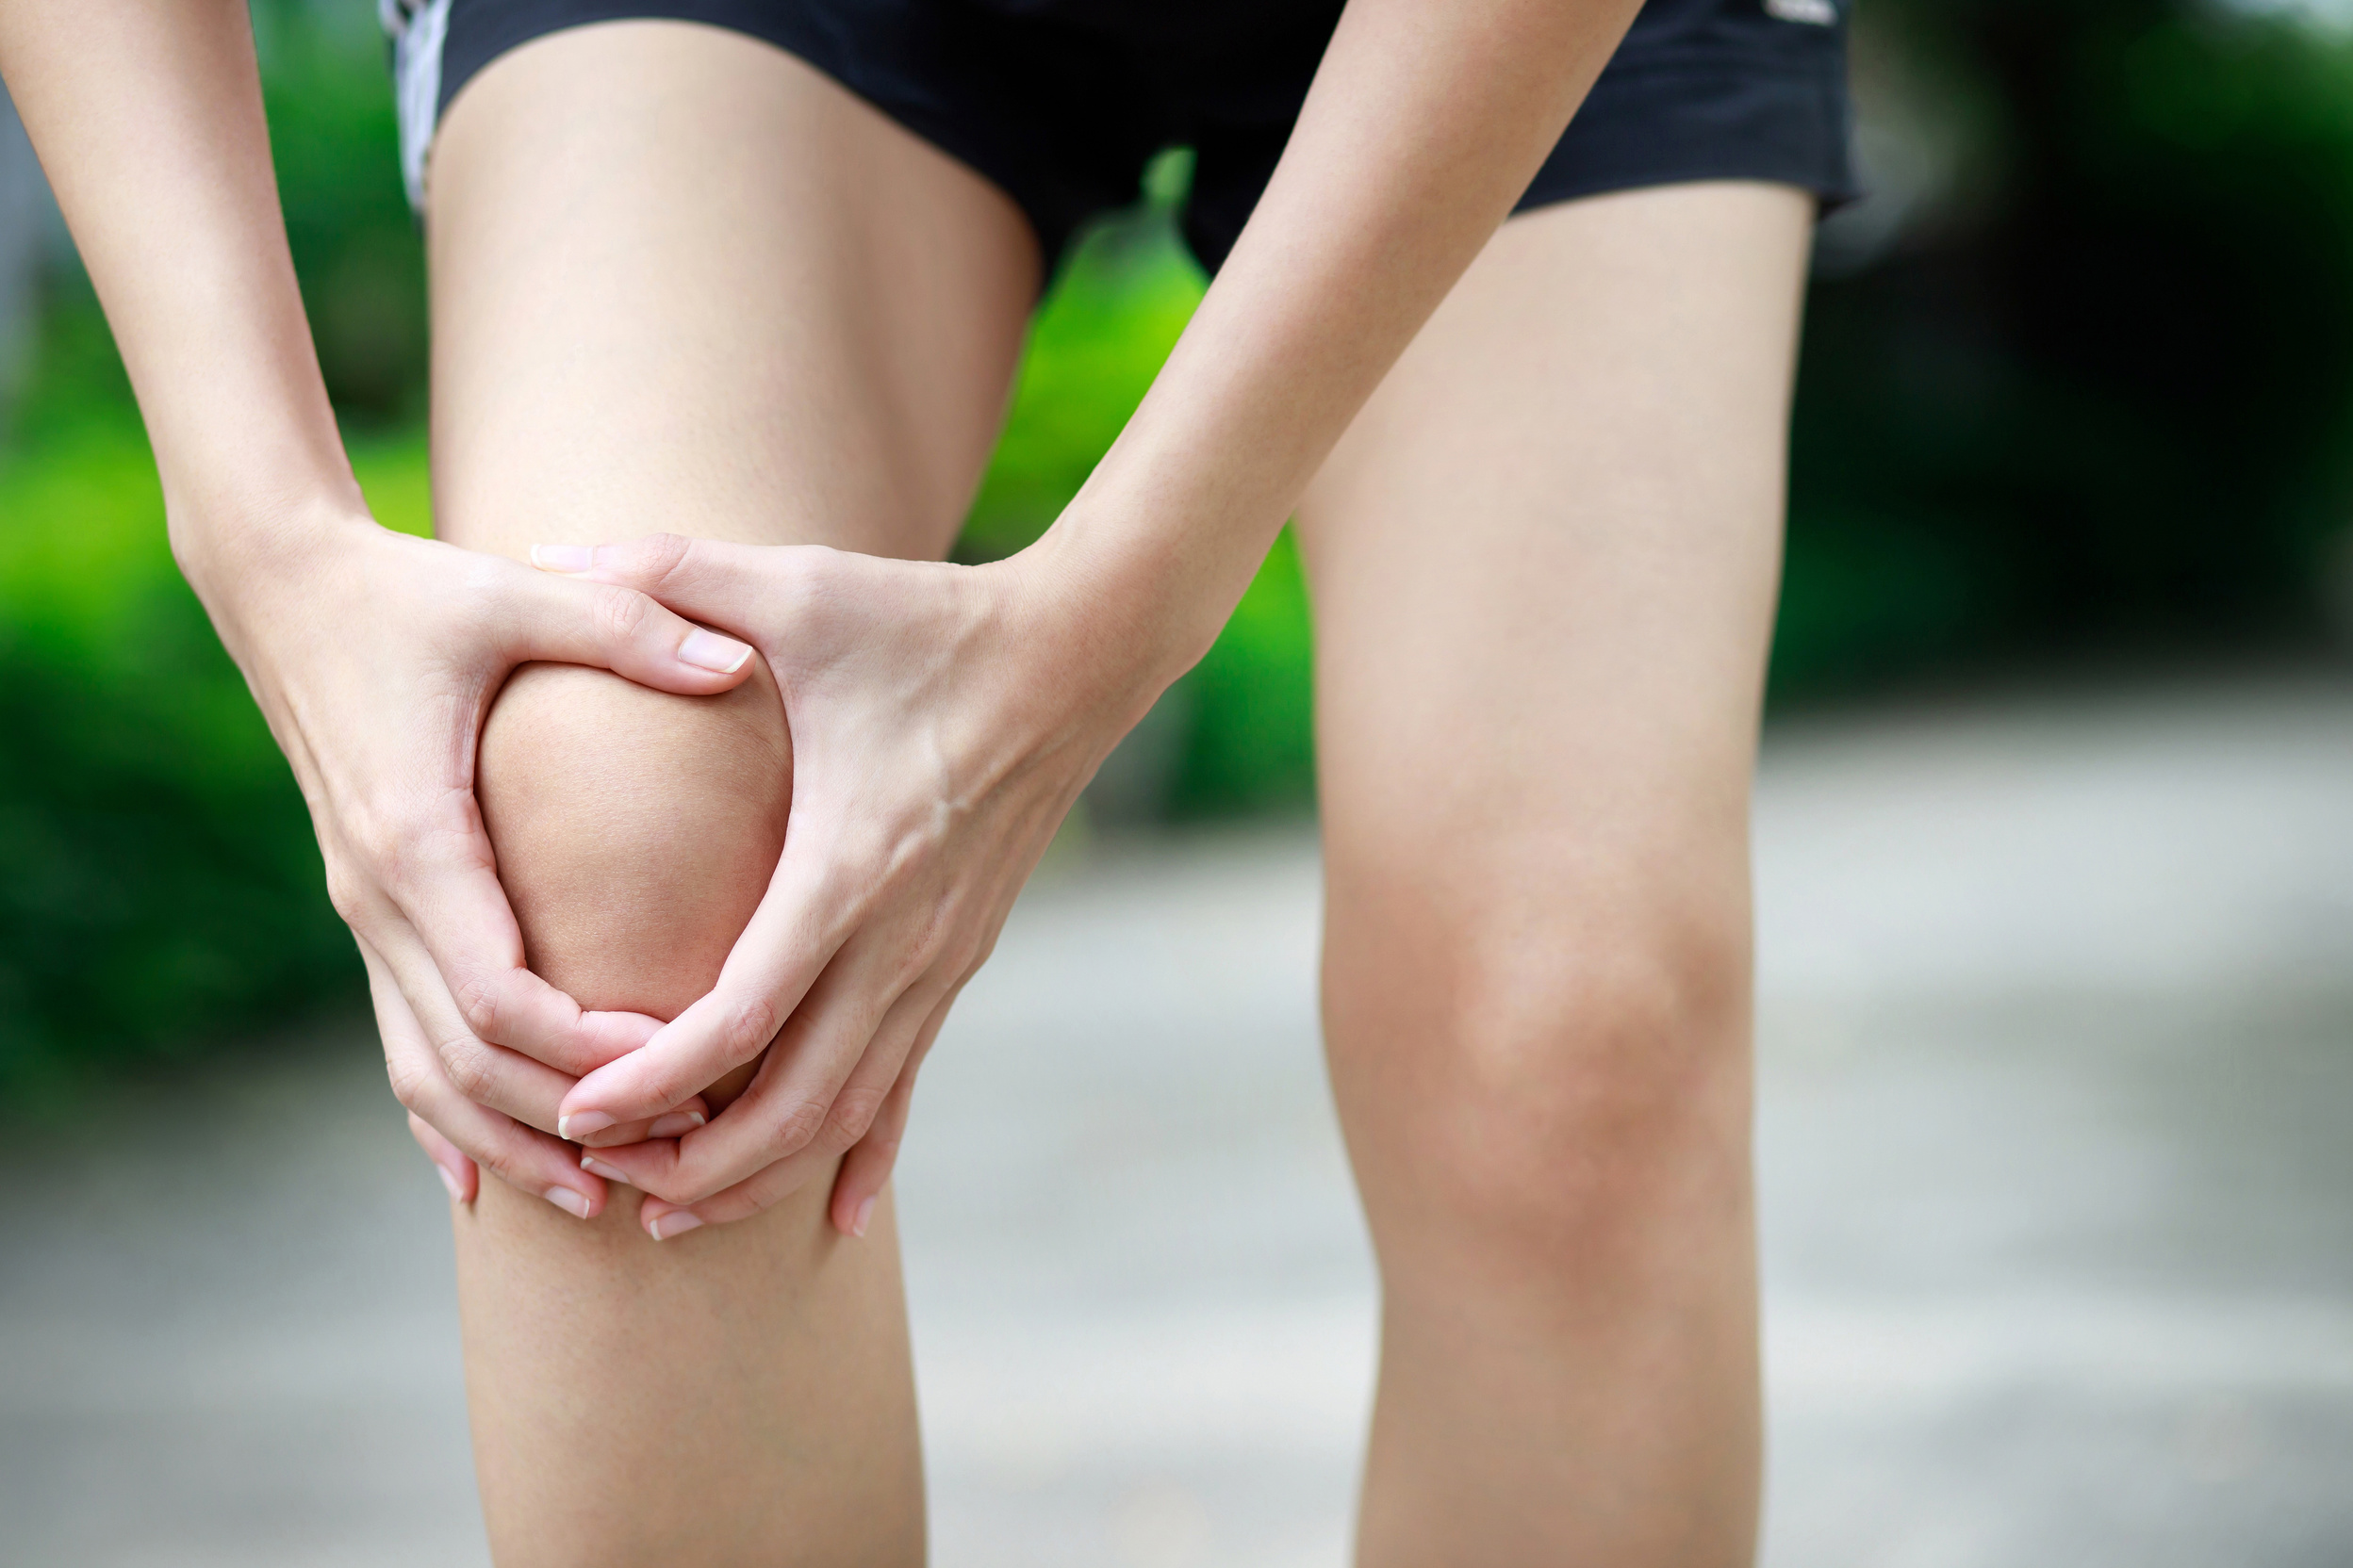
knee
The middle part of your leg where it bends

Slide 21
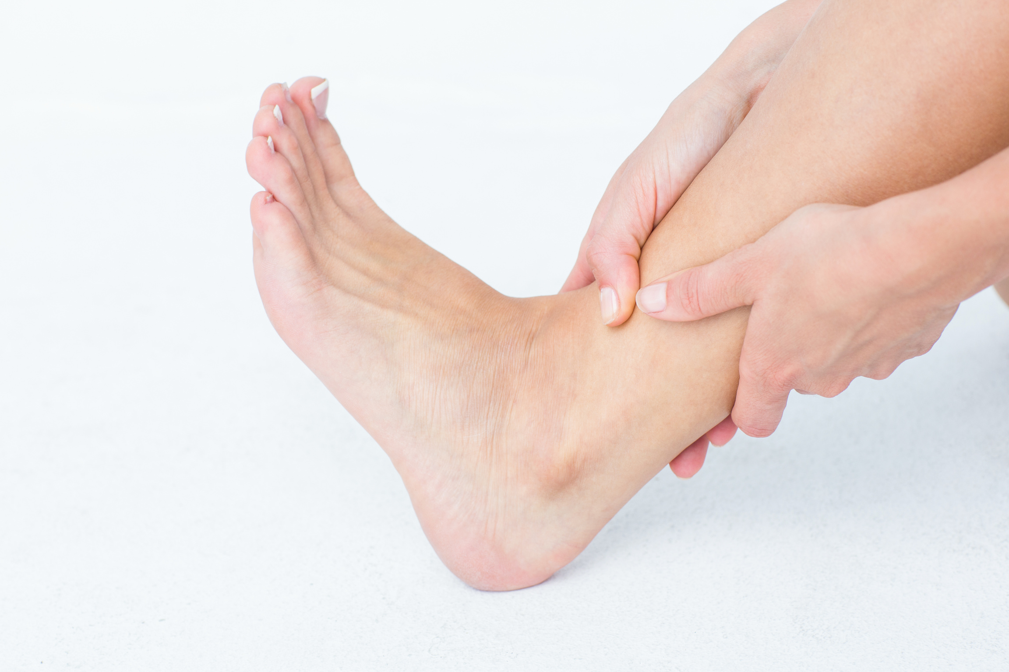
ankle
The part of your leg that is just above your foot

Slide 22
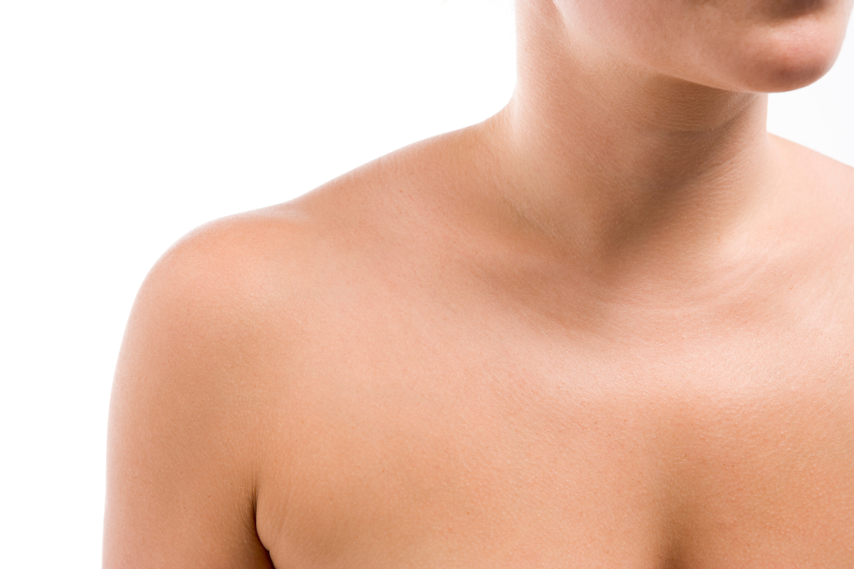
shoulder
Where your arm joins your body next to your neck

Slide 23
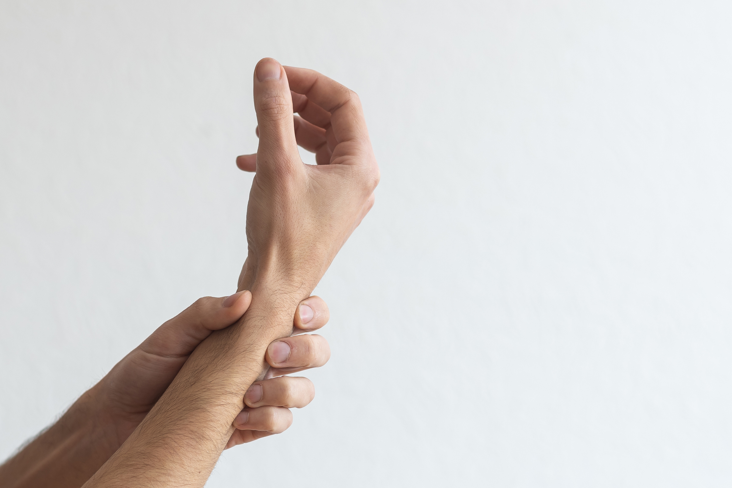
wrist
The part of your body between your hand and your arm.

Slide 24
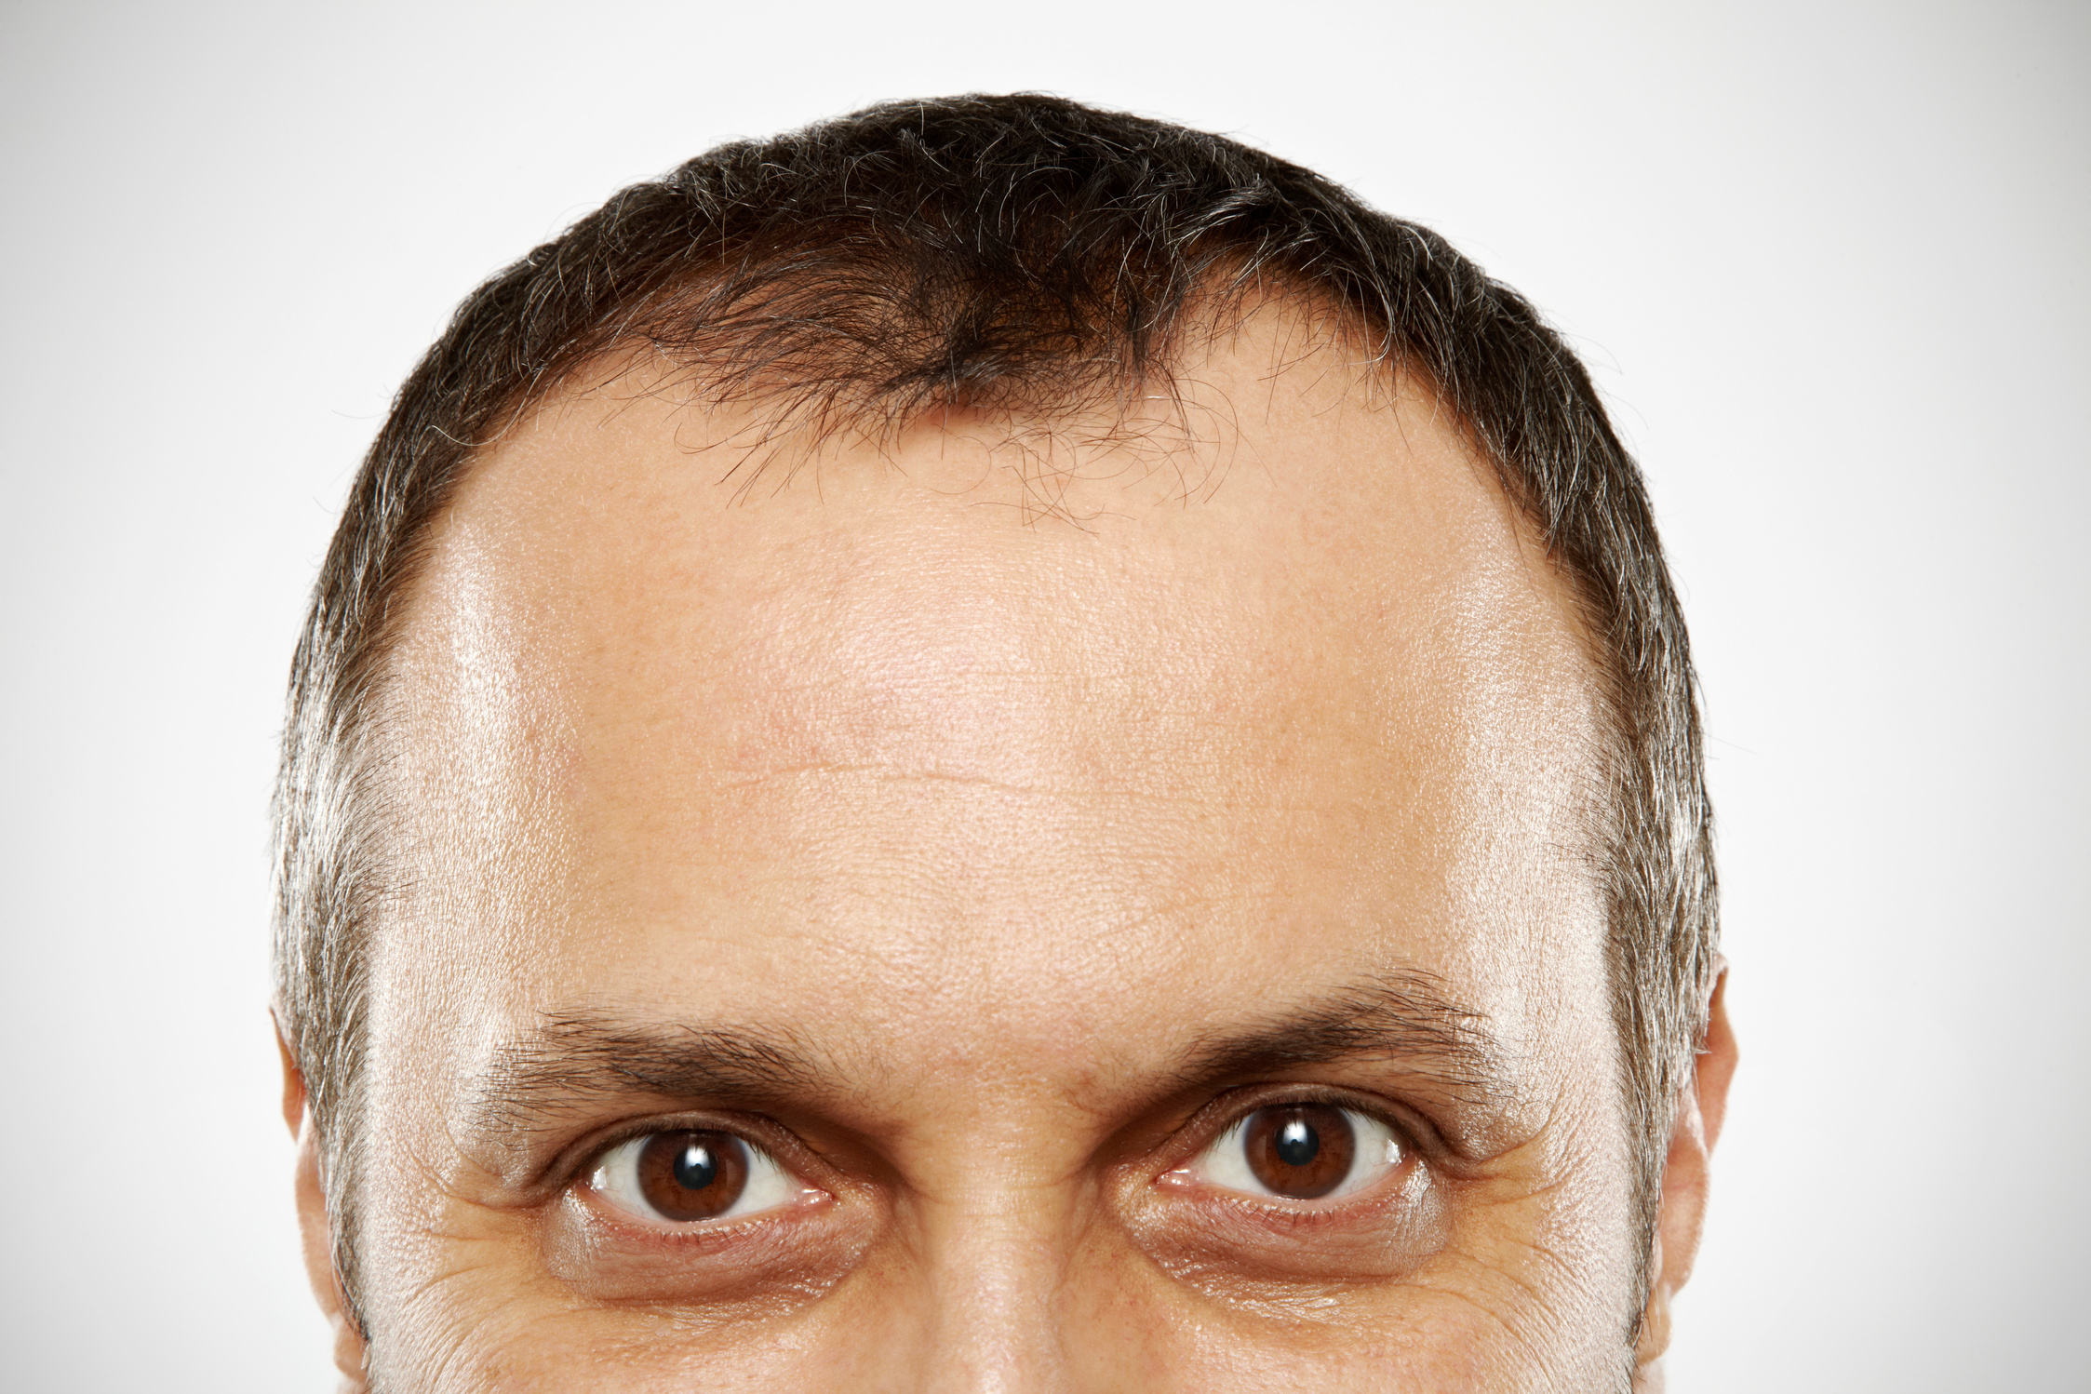
forehead
The part of your face between your eyes and your hair

Slide 25
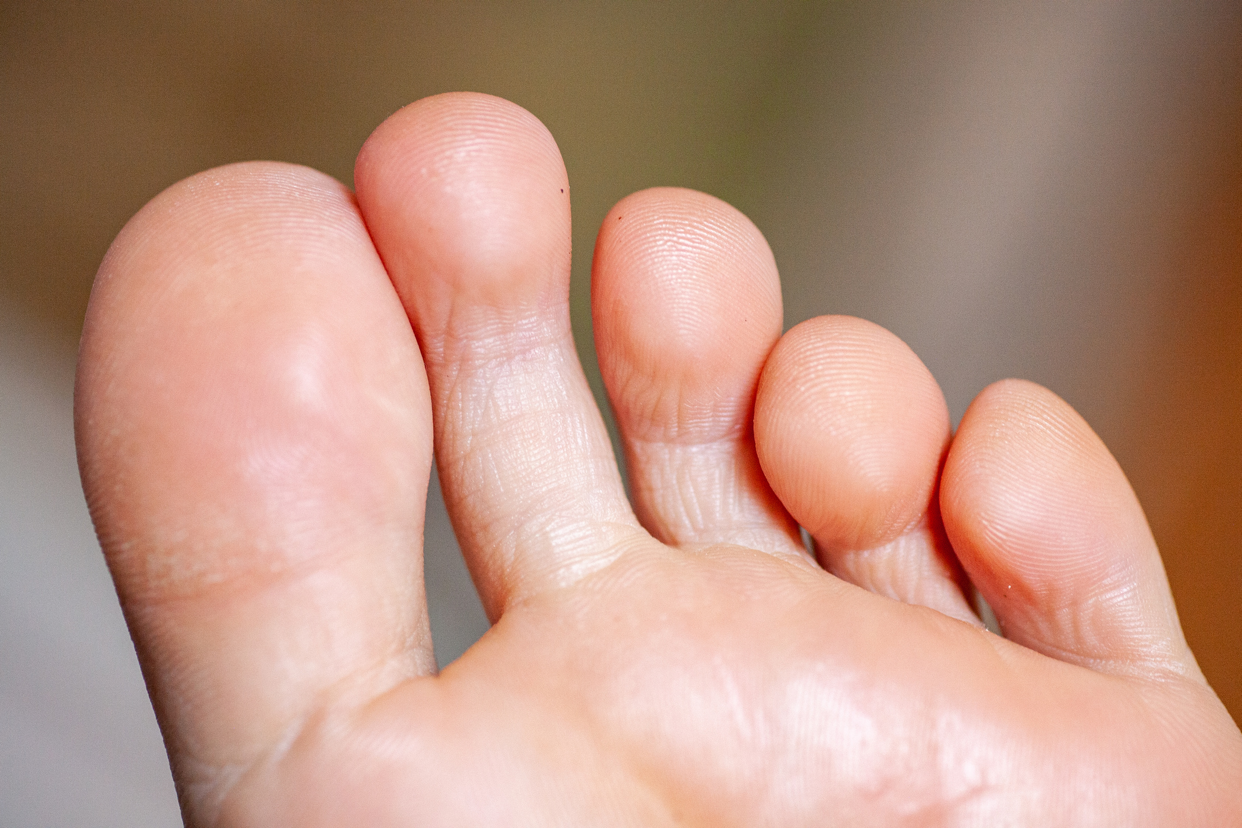
toes
One of the five separate parts at the end of your foot

Slide 26
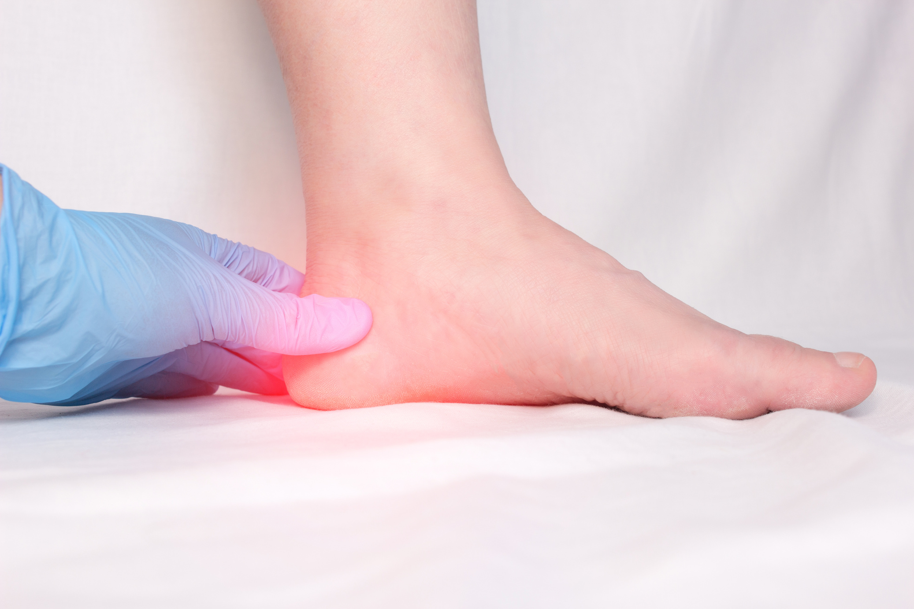
heel
The back part of your foot

Slide 27
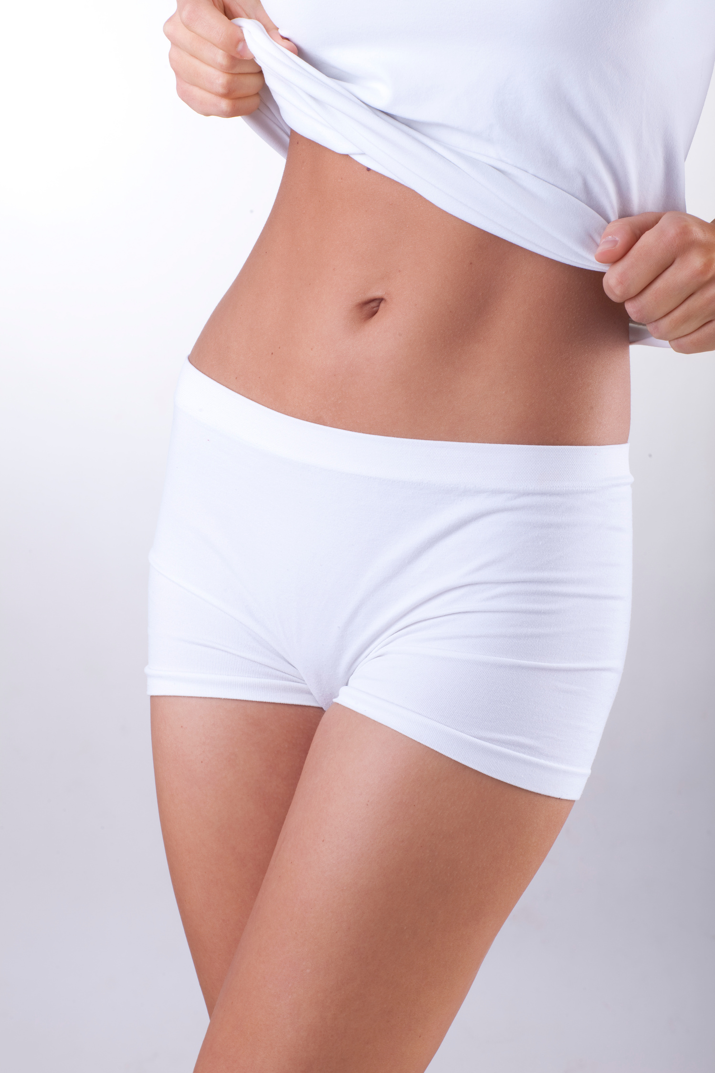
waist
The part around the middle of your body where you wear a belt

Slide 28
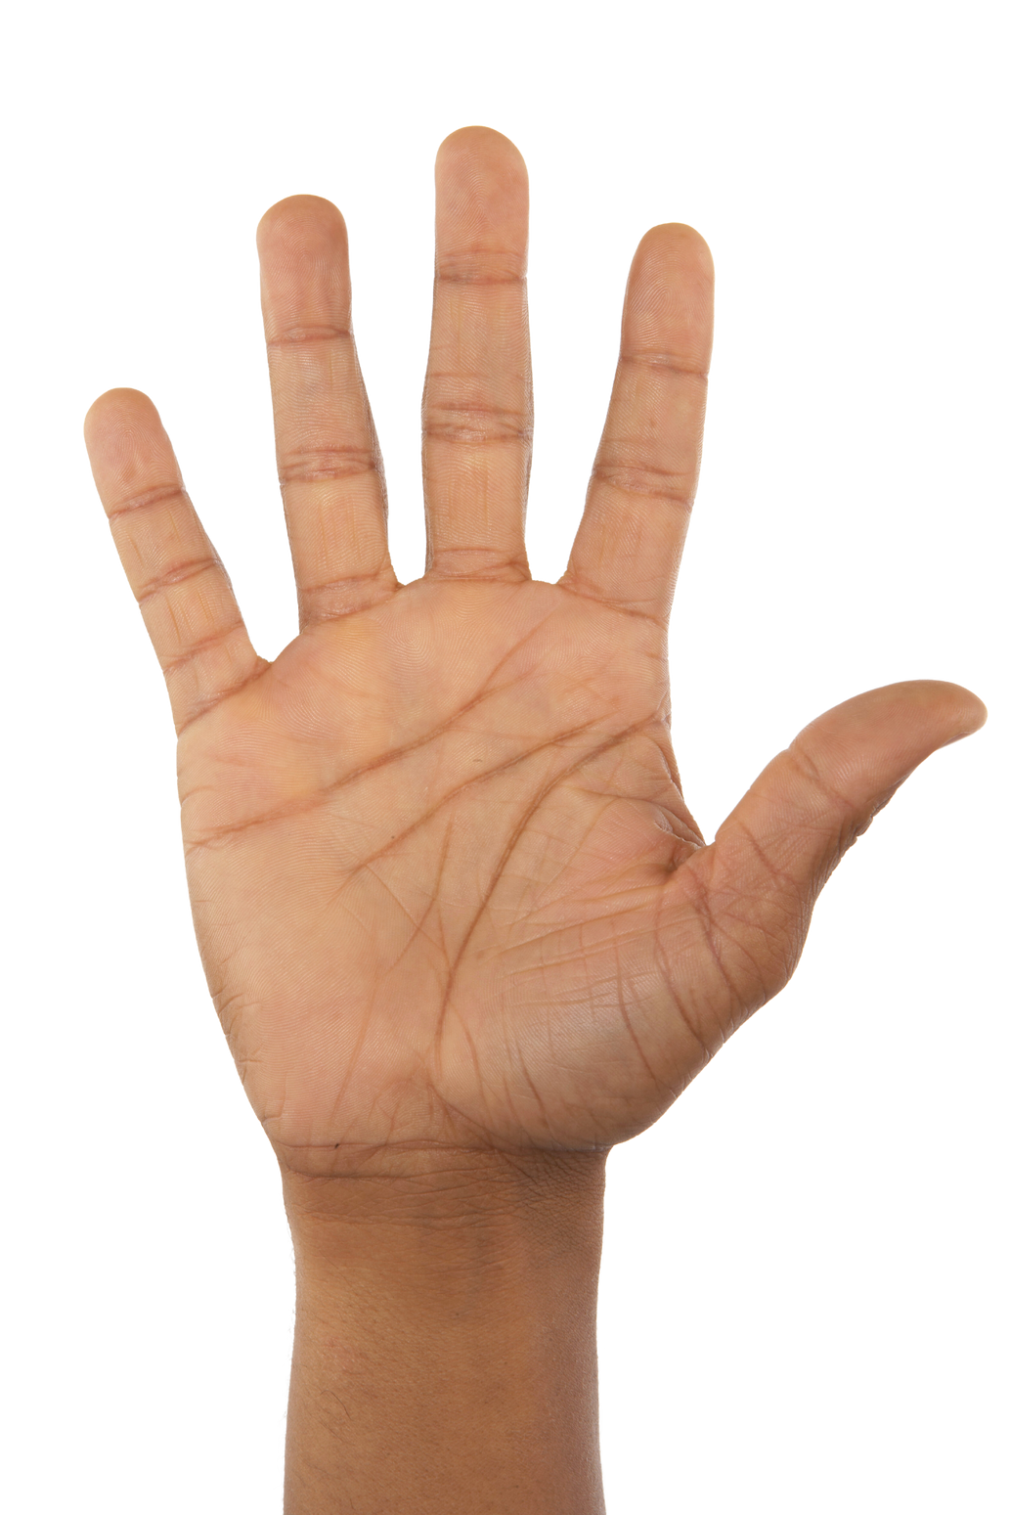
palm
The inside surface of your hand

Slide 29

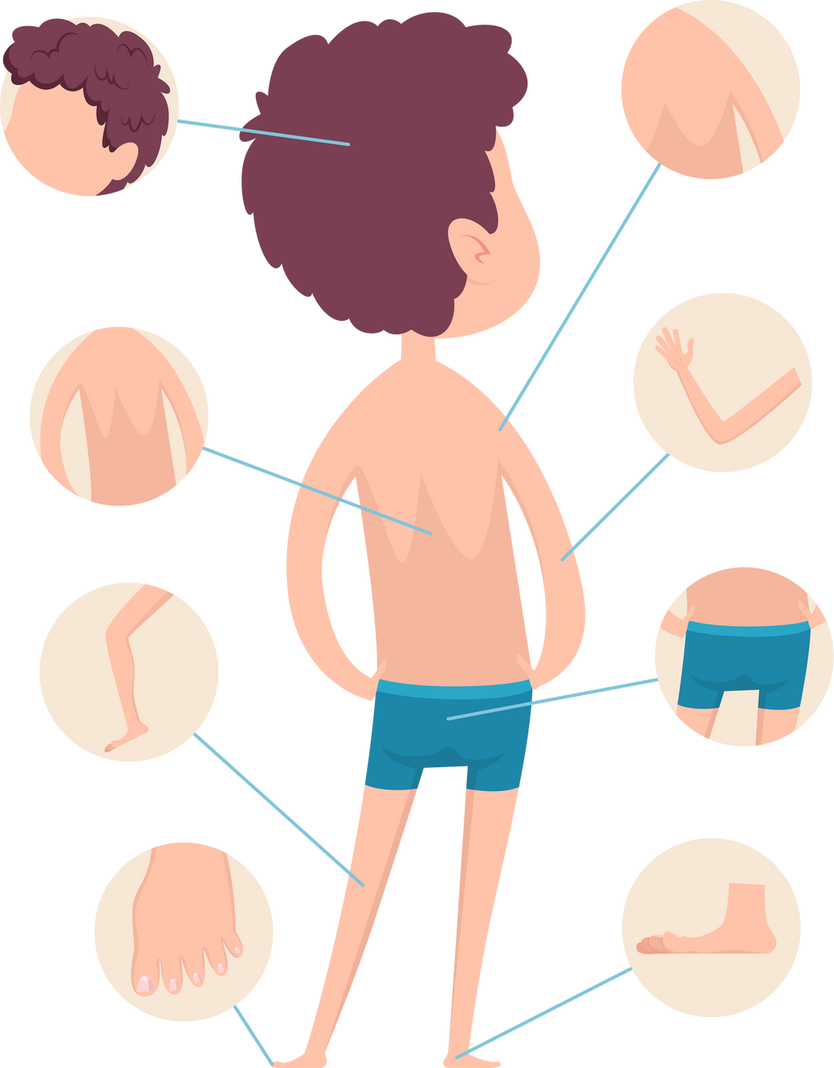
Activity 1 - Body Parts Guessing
Give descriptions using the target language, students must guess the body part you're describing.

Slide 30




Dialogue Practice 1
Pair up and distribute a set of body part Flashcards to each pair.
Practice the dialogue, "Is his head big?
Yes, it is. / No, it isn't." using the Flashcards.
Mars
Dialogue practice with different Flashcards.
Provide correction and guidance as necessary.

Slide 31





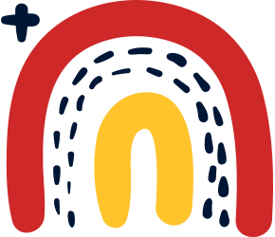
Taking care of your body
Q: Is his head big?
A: Yes, it is. / No, it isn't.

Slide 32
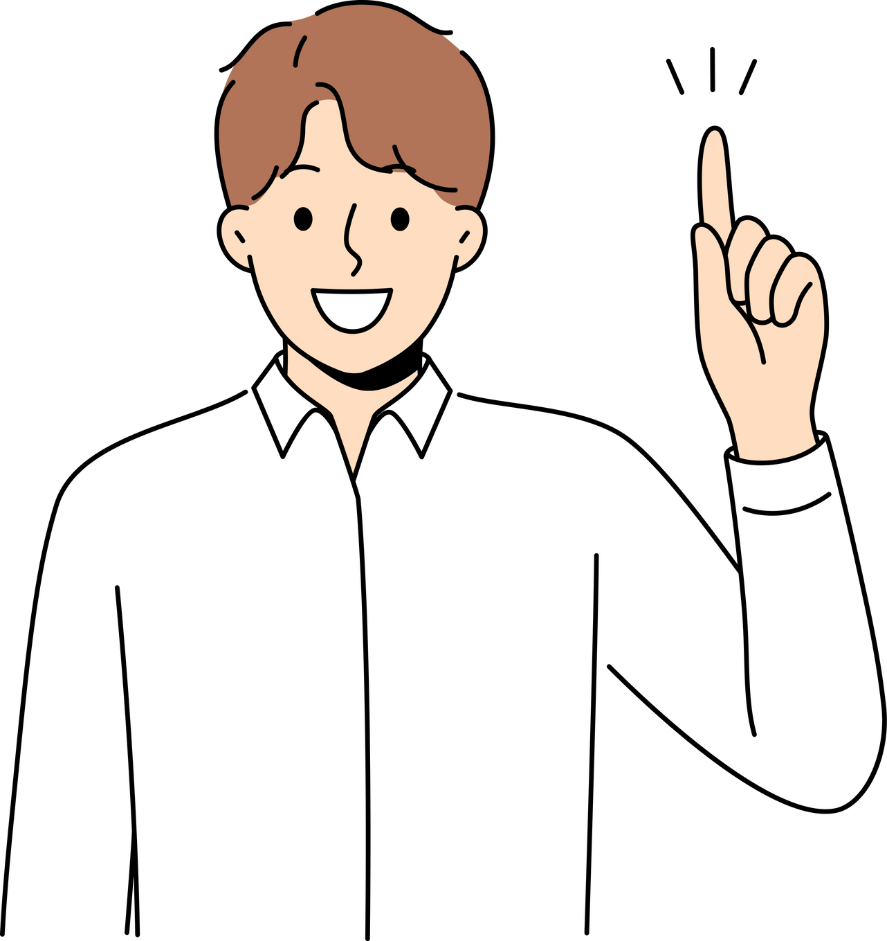
Activity 2 - Body Parts Simon Says
Instruct students to touch the body part you mention when you say "Simon says...". Utilise the extension vocabulary and adjectives in your commands.

Slide 33
Dialogue Practice 2
Pair the students again and distribute a new set of body part and adjective Flashcards to each pair.
Practice the dialogue, "Are they long? Yes, they are. / No, they aren't." using the Flashcards.
Mars
Dialogue practice with different Flashcards.
Provide correction and guidance as necessary.

Slide 34
Taking care of your body
Q: Are they long?
A: they are. / No, they aren't.

Slide 35



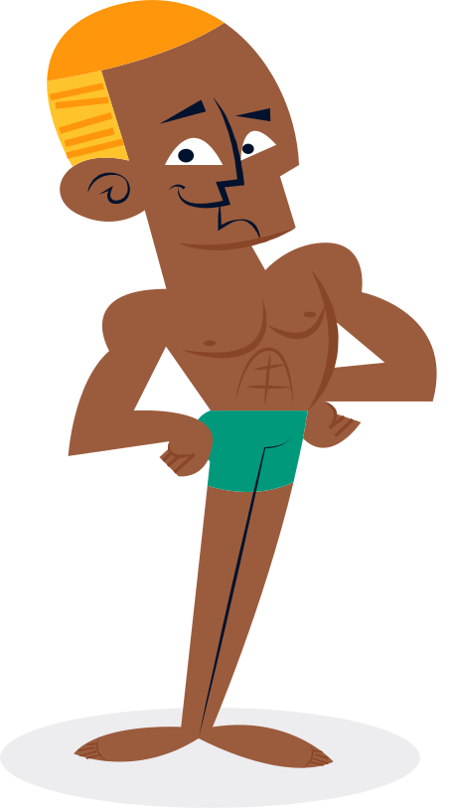

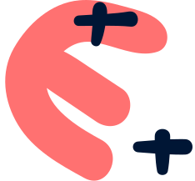

Draw and Introduce

Slide 36




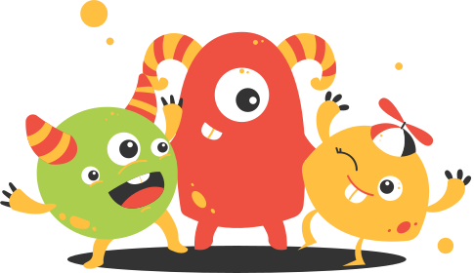

draw a monster with various body parts and label the body parts. Then, each student should stand up, show their drawing, and describe it using the target language "Is his head big? Yes, it is. / No, it isn't.".

Slide 37


Lets Review!
Is Sam tall? Yes, he is. / No, he isn’t.
Is his head big? Are they …?

Slide 38

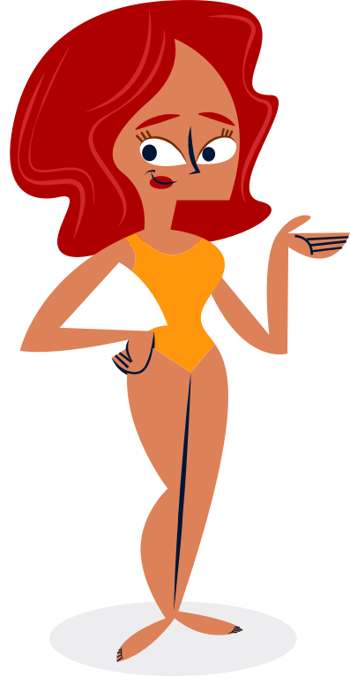

Great Effort!
See you next lesson!

