Slide 1






LESSON 1
GETTING TO KNOW EACH OTHER
Trinity GESE Grade 1 Prep
Prepared by Imperial Academy

Slide 2




TARGET LANGUAGE
  What's your name? My name is... / I am...
  Is your name ...? Yes, it is. / No, it isn't. It's ... .
  How old are you? I am eight years old. / I am eight.

Slide 3




TARGET
VOCABULARY
  name
  surname
  first name
  age

Slide 4




Material
NAME BALL
  softball
  student cards
  Introduce yourself
  Pass the softball to a friend

Slide 5




DIALOGUE PRACTICE 1
Get a student card
Practice with partner or in the group

Slide 6


Material
NUMBER LINE
  number line
  Point to the correct number on the number line.
  Tell the class your age.

Slide 7


DIALOGUE PRACTICE 2
Get a student card
Practice with partner or in the group

Slide 8



MY TALKING TIME
Draw a picture of yourself on the worksheet. Share your drawing with the class using the target language.

Slide 9

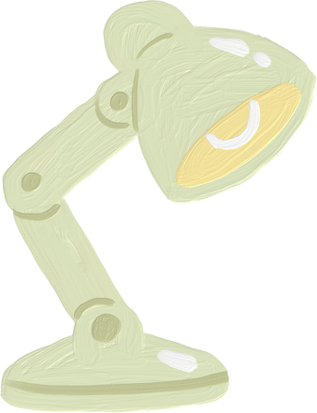


LETS REVIEW!
  What's your name? My name is... / I am...
  Is your name ...? Yes, it is. / No, it isn't. It's ... .
  How old are you? I am eight years old. / I am eight.

Slide 10





GREAT EFFORT!
See you next lesson!

